Slide 1
Evaluation of Culling Intensity and Criteria for Antler Traits in White -Tailed Deer
Masahiro (Masa) Ohnishi
Ph.D. Student
Caesar Kleberg Wildlife Research Institute
Texas A&M University – Kingsville
Committee Members
Randy DeYoung
Charles DeYoung
David Hewitt
Strickland Bronson
Steven Lukefahr
Donnie Draeger
Notes:
My name is Masa. I’m here to talk about my research how different intensities of culling have influence on the managed populations.

Slide 2
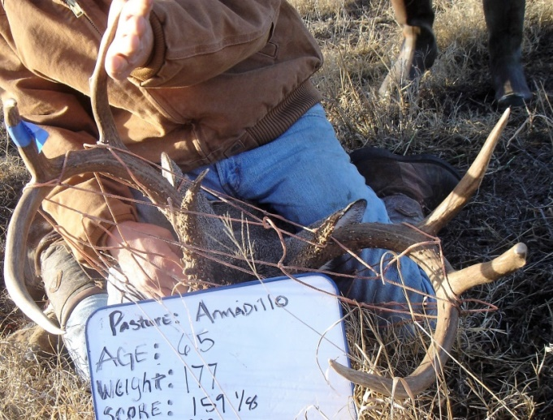
Which buck is a better sire for antler development?
GBC 159 = “Keep”
GBC 123 = “Cull”
6 years old
Notes:
Let’s take a look at those two bucks. One has 159 boone and crockett score, actually he became a 173 deer next year. And another buck has only 123. They are both 6 years old. Which buck is a better sire for future antler development? How do you know the breeding values at the field, or when you hunt? I hope you will start thinking about the breeding values. Thank you for your time and listening.

Slide 3
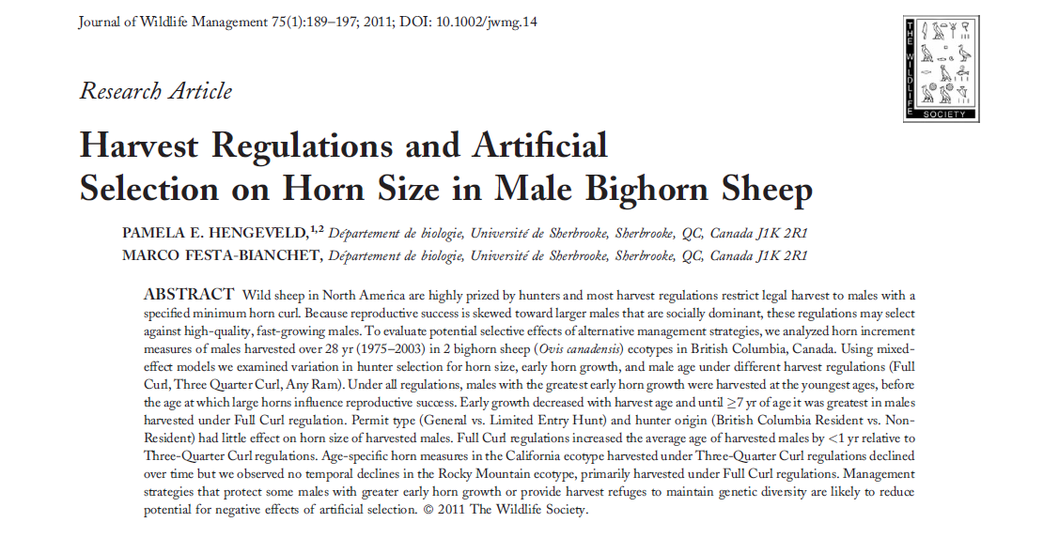
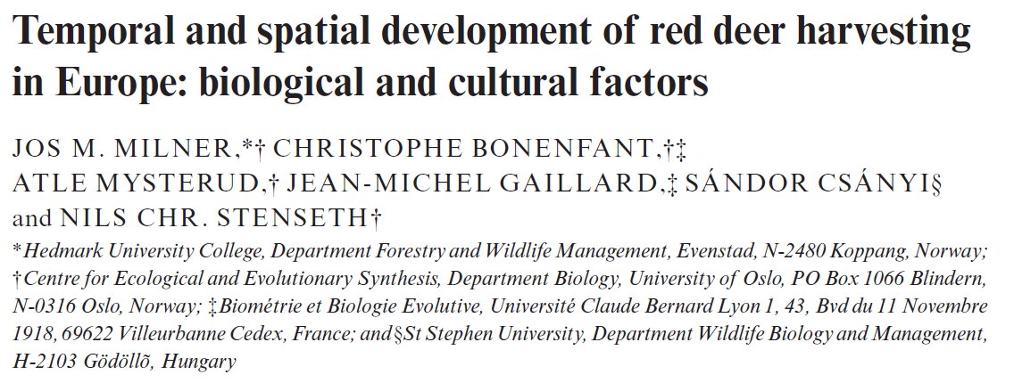
Harvest is Artificial Selection
Harvesting ungulates is widely common
Harvest is a form of artificial selection
Notes:
Harvesting ungulates are widely common. And, harvest can be considered as the artificial selection.

Slide 4
Improving Antler Traits Through Selection
Ideally, average breeding values and antler size increase over time
Directional Selection
Notes:
Ideally, we can improve the average breeding values and antler size over time through culling. This shift is called directional selection.

Slide 5
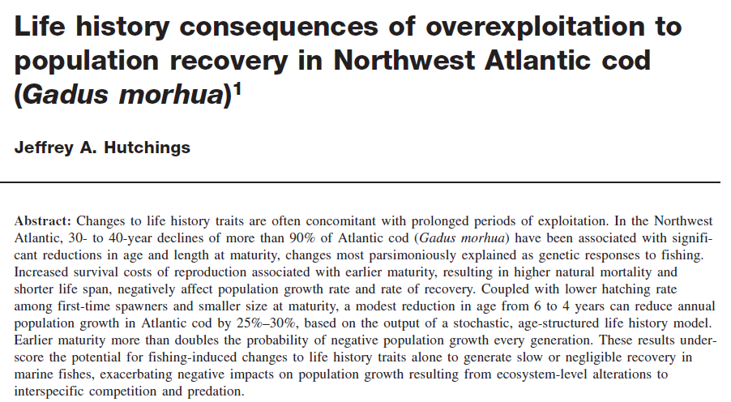
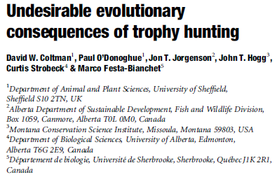
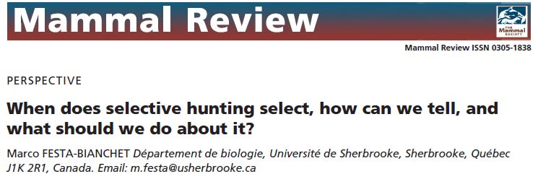
Undesirable Effects of Harvest
High Grading = Harvesting the best quality of animals
Potential for “negative” effects of trophy hunting
Notes:
Biologists are concerned about the negative effects of trophy hunting. High grading, harvesting the best quality of animals, may decline the population mean of phenotypes.

Slide 6
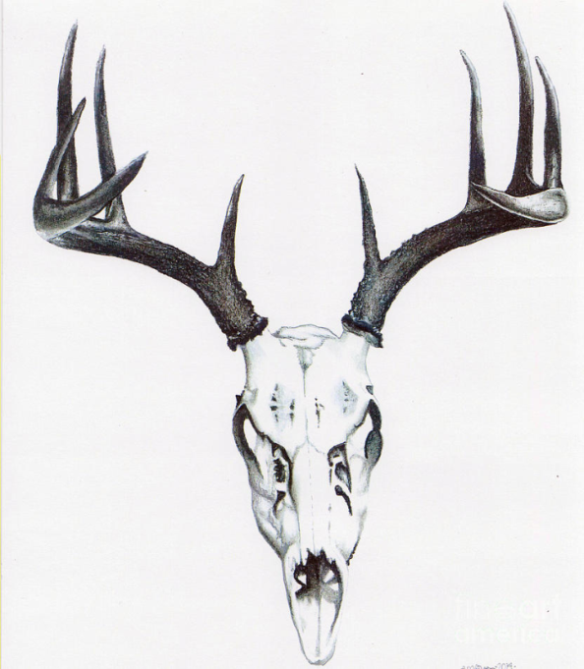
How much variation in antler size due to genetics?
Difficulty in determining how genes and environment affect antler size in wild populations
■ Heritability (genetics)
■ Permanent Environment
■ Year of Growth
??%
??%
??%
Notes:
Biologists have been also concerned about the effects of genetics and environmental factors on the antler growth.
It is difficult to quantify genetic and environmental effects separately, especially in wild populations because quantifications need the pedigree information and repeated measurements of antler size.

Slide 7
Objectives: Comanche Culling Study
Overall goal: Is it possible to improve population antler traits through culling in wild deer?
1: Do offspring “resemble” their father?
2: How “intense” was the culling?
3: How long before “response” is apparent?
Notes:
That is how the Comanche Culling Study was developed. Today, I would like to talk about 3 objectives. Do offspring resemble their father? How intense was the culling? And How long before response is apparent?

Slide 8
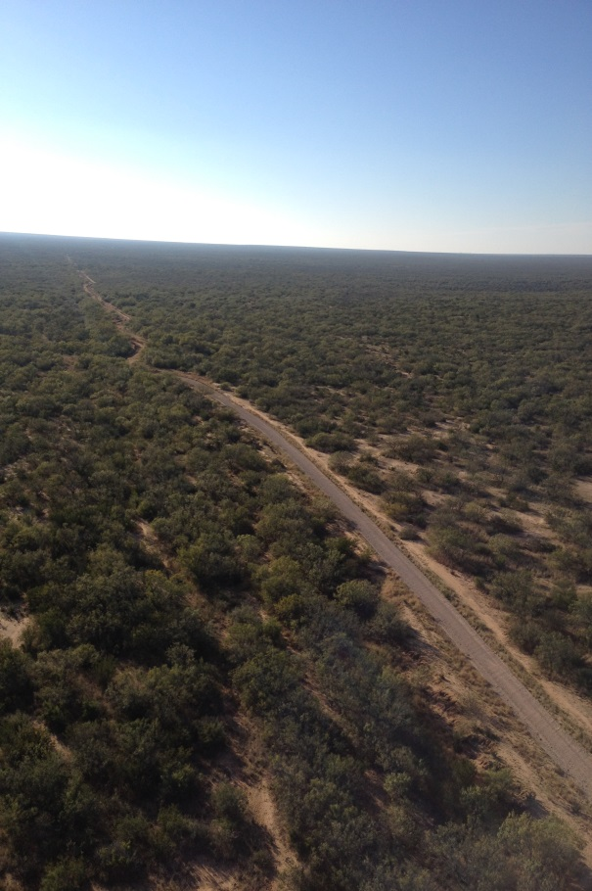
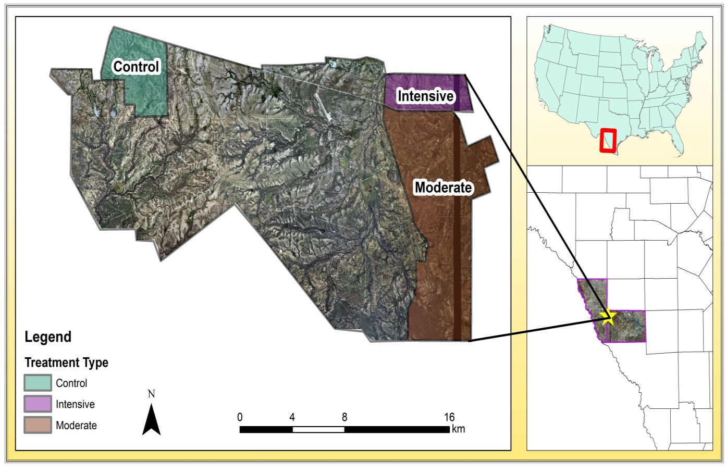
Methods: Study Area
Comanche Ranch, Maverick County, TX
Texas-Tamaulipan Thornscrub Ecoregion
120,000 ac
High fences at each treatment
Notes:
The Comanche Ranch is my study site, and it is located in Maverick County, Texas. The ranch is in the Texas-Tamaulipan Thornscrub ecoregion and has 120,000 acres. High fences were installed at each treatment to increase selection intensity.

Slide 9
Moderate Culling Treatment
18,000 ac
Culling: only ages 3.5+
 | Moderate
Age | Antler Points | B&C score
1.5 | Not culled
2.5 | Not culled
3.5 - 4.5 | < 9
≥ 5.5 |  | < 145
Notes:
Moderate culling treatment is 18,000 acres. Please take a look at the yellow part of the table. At this treatment, we did not cull young deer, because we wanted to evaluate their genetic potential of future antler growth, but we culled over three and a half years old bucks if the deer did not meet the harvest criteria.

Slide 10
Intensive Culling Treatment
3,500 ac
Culling: All age classes
 | Intensive |  | Moderate
Age | Antler Points | B&C Score | Antler Points | B&C Score
1.5 | < 6 |  | Not culled
2.5 | < 8 |  | Not culled
3.5 - 4.5 | < 9 pts
≥ 5.5 | < 145 B&C
Notes:
At intensive culling treatment, we culled any aged deer who did not meet the criteria. For example, yearlings with less than 6 points were harvested. Young deer who did not meet the criteria were considered as genetic inferior. And also, this treatment is designed to increase more selection intensity.

Slide 11
Control Area: No Culling
5,000 ac
Notes:
At control area, we captured bucks and released them.

Slide 12
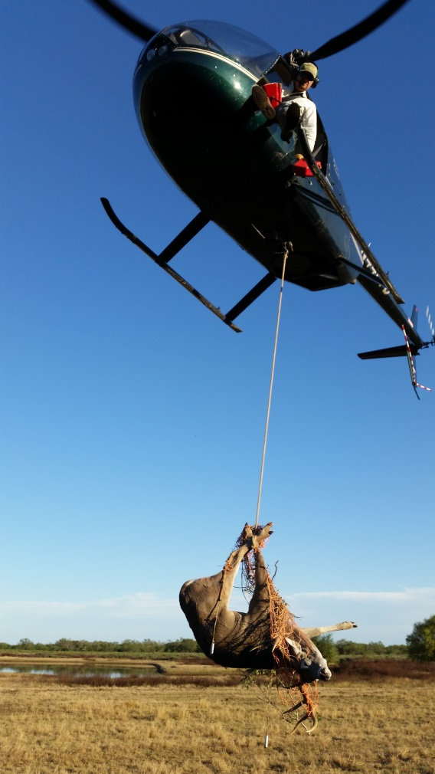
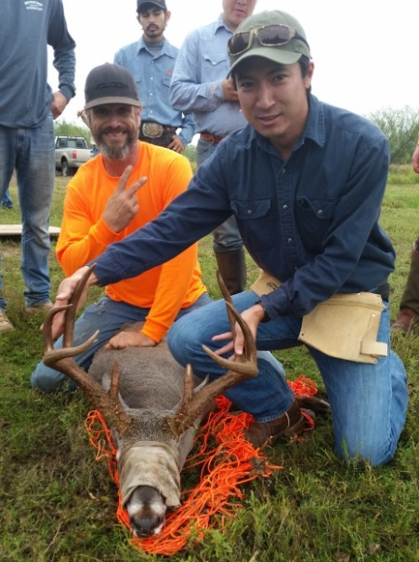
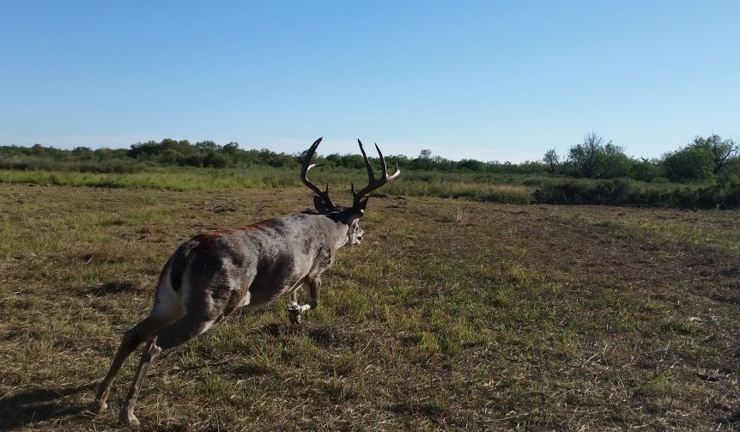
Data Collection: Falls of 2006 – 2016
MARK & helicopter survey
Helicopter net-gun method before the rut
Tissue biopsy for DNA
Age and antler size (Gross Boone & Crockett)
Sacrificed bucks that did not meet culling criteria
Pit-tag if bucks were released
Stopped culling after 2012 capture
Notes:
Program MARK and the annual helicopter survey were used to evaluate culling intensity.
We used the helicopter net-gun method to capture bucks before the breeding season.
Collected tissue biopsy for DNA. The same researcher estimated age for all capture deer. And we also used Gross Boone & Crockett score to evaluate antler size.
We sacrificed bucks that did not meet culling criteria and installed pit-tag if bucks were released. So, we know which deer was captured before.
We stopped culling after 2012 capture to investigate how young deer express their antler size as response to culling.

Slide 13
Resemblance: Heritability and Breeding Values
Do offspring resemble sire? If yes, then the antler trait is heritable
Heritability = how phenotypes are determined by genes transmitted from parents
Sire’s Breeding Value = The average antler size of offspring
Offspring
Sire
?
??
Large
Antlers!!
=
Average
Antler Size
??
Notes:
Heritable traits means offspring resemble their father.
We can use the breeding values to compare each sire how much offspring resemble their father. The sire’s breeding values can be measured by the average offspring antler size, compared to the total population mean.

Slide 14
Resemblance: Heritability and Breeding Values
Cervus 3.0
Distribution of mating success
Pedigree information
MTDFREML
Heritabilities antler points & GBC
Sire’s breeding values
3 age classes (1.5, 2.5, 3.5+)
??%
??%
??%
Notes:
Cervus was used to estimate the distribution of mating success and develop pedigree information. We grouped 3 age classes to run MTDFREML to estimate heritabilities and breeding values of antler points and score.

Slide 15
Resemblance: Multi-State (Category) Analysis
Next Year
2.5 years old
Yearlings
“Keep”
again
Categorized “Keep”
bucks
“Cull”
Categorized “Cull”
bucks
“Keep”
*Young deer were released at moderate
and control treatments
“Cull”
again
Notes:
Culling criteria creates two categories “keep” in yellow and “cull” in gray. I combined all populations across treatments to use Multi-state or multi-category analysis to estimate the proportion of bucks changing, originally from the category “Keep” to the category “Cull” next year. Vice versa, what was the proportion of bucks changing, originally from the category “Cull” to the category “Keep” next year. I tested for all age classes.

Slide 16
Culling Intensity: Selection Differential (S)
S = Selected Bucks Mean – Total Population Mean
Total Population Mean
Selected Bucks Mean
Culling Criteria
Frequency
S
Antler Size
Notes:
Selection differential was calculated by the difference in the mean antler size of the selected animals from the total population mean. Selection differential can evaluate how effective culling criteria is to the managed population.

Slide 17
Response: Generation Time
Generation Time = Average years between consecutive generations
? average
years
Sire
Offspring
Grandson
Great-
grandson
2006 2010 2014 2018 2022
Notes:
Generation time was calculated to estimate the average years between consecutive generations.

Slide 18
Response to Selection (R)
R = Predicted gain of antler size per generation
“Breeder’s equation”:
R = h² * S
Modified for selection on 1 sex:
R = ½ (h² * S)
Selection differential (S)
Heritability of antler traits (h²)
Notes:
Response to selection is used to predict the gain of the antler size per generation after selection. We modified the breeder’s equation because we only captured male for selection.

Slide 19
Results: Data Collection (2006-2016)
Captured 5,447 bucks (including recaptures)
Individuals: 2,937
Recaptured: 2,510
Culled: 1,333 (7 years)
Total offspring assigned to sire(s): 1,718
Notes:
Here is my results.
Intensive enough, we captured 5,400 bucks including recaptured bucks.
We culled 1,300 bucks for 7 consecutive years.
We assigned 1,700 sires.

Slide 20
Resemblance: Heritabilities of Antler Points
■ Heritability (h²)
■ Unknown effects (e²)
■ Permanent environmental effects (p²)
Yearlings
2.5 years old
3.5+ years old
h² (SD) = 0.17 (0.14)
* Not Significant
e² (SD) = 0.83 (0.14)
* Significant
h² (SD) = 0.15 (0.15)
* Not Significant
e² (SD) = 0.85 (0.15)
* Significant
h² (SD) = 0.25 (0.09)
* Significant
e² (SD) = 0.50 (0.02)
* Significant
p² (SD) = 0.25 (0.09)
* Significant
Notes:
Heritability for yearling's antler points is 17%. For two and a half years old, heritability is 15%. And for over three and a half years old, heritability is 25%. Permanent environmental effects were 25%. Permanent environmental effects are the year effects and birth year effects.

Slide 21
Resemblance: Heritabilities of GBC
■ Heritability (h²)
■ Unknown effects (e²)
■ Permanent environmental effects (p²)
Yearlings
2.5 years old
3.5+ years old
h² (SD) = 0.30 (0.28)
* Not Significant
e² (SD) = 0.70 (0.28)
* Significant
h² (SD) = 0.27 (0.14)
* Not Significant
e² (SD) = 0.73 (0.14)
* Significant
h² (SD) = 0.45 (0.09)
* Significant
e² (SD) = 0.13 (0.09)
* Significant
p² (SD) = 0.45 (0.02)
* Significant
Notes:
Heritability for yearling’s boone & crockett score is 30%. For 2.5 years old, heritability is 27%. And for over three and a half years old, heritability is 45%. And permanent environmental effects were 13%.

Slide 22
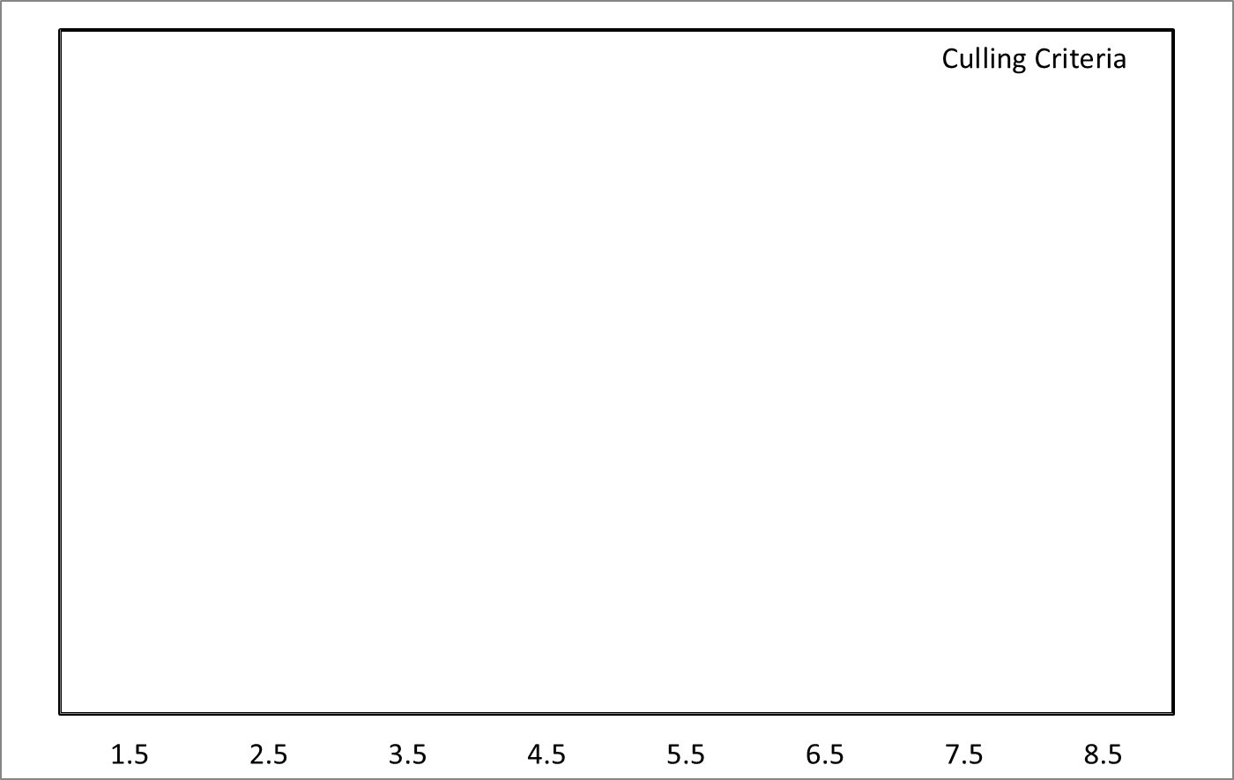
Resemblance: Multi-State Analysis “Cull” to “Keep”
Keep
Keep
Keep
Keep
Keep
Keep
Keep
Categorized “Keep”
Bucks
48%
36%
26%
18%
12%
8%
5%
3%
Categorized “Cull”
Bucks
Notes:
This is multi-state analysis results. The proportion of yearling bucks changing, originally from the category Cull to the category Keep next year is 48%. The proportion of 2.5 years old bucks changing, originally from the category Cull to Keep is 36%.

Slide 23
Resemblance: Multi-State Analysis “Keep” to “Cull”
33%
32%
32%
32%
31%
31%
30%
30%
Categorized “Keep” Bucks
Cull
Cull
Cull
Cull
Cull
Cull
Cull
Categorized “Cull”
Bucks
Notes:
Vice versa, we tested the proportion of bucks changing, originally from the category Keep to the category Cull next year. The proportion ranges 30 to 33% across all age classes.

Slide 24
Genetic (Breeding Values) Improvements??
Average breeding values and antler size increase over time
Notes:
Ideally, we can improve the average breeding values and antler size over time through culling. This shift is called directional selection.

Slide 25
Resemblance: Breeding Values: Moderate
Y = - 0.0031x + 0.0285
R² = 0.214
(+/- 1 SE)
Notes:
This is the results of breeding values at moderate treatment. X axis is birth year. Y axis is the mean breeding values.
At moderate treatment, we did not find any genetic change across years.

Slide 26
Resemblance: Breeding Values: Intensive
Y= 0.032x – 0.023
R² = 0.0272
(+/- 1 SE)
Mean Breeding Value
Notes:
At intensive treatment, we did not find any genetic change across years as well.

Slide 27
Resemblance: Breeding Values: Control
Notes:
At control, there is no sign of genetic change across years.

Slide 28
Culling Intensity: Moderate
Year
Culling Intensity:
CONSISTENT!!
Notes:
How intense was the culling?
X axis is year, and y axis is number of bucks. Blue is the estimated buck population, yellow is bucks captured, and red is bucks culled.
At moderate treatment, sex ratio ranges 1 buck per 0.6 to 1.6 does.
The culling intensity ranges from 25 to 45%. Culling intensity remained consistent from 2006 to 2012.

Slide 29
Culling Intensity: Intensive
Year
Notes:
At intensive culling treatment, sex ratio ranges 1 buck per 1 to 6 does.
The culling intensity ranges 48 to 75%. We removed many young bucks, however, the culling intensity still remained high.

Slide 30
Culling Intensity: Who is sire??
Adult Bucks Sired
Most Offspring!!!
Notes:
This is paternity tests at moderate and intensive treatments.
X axis is year, and Y axis is the proportion of actual sires.
Age distribution of actual sires became skewed toward mature bucks at both treatments. Unfortunately, we did not find sufficient paternity assignments in control area.

Slide 31
Culling Intensity: Average Male Offspring per Sire
■ Moderate
■ Intensive
■ Control
Mean (SD) = 1.1 (0.07)
Mean (SD) = 1.3 (0.24)
Mean (SD) = 0.9 (0.09)
Not Significantly Change!!
Notes:
Here is the mean male offspring per sire results. X axis is year. Y axis is the average number of male offspring. Blue is moderate, red is intensive, and black is control. The average male offspring per sire slightly increased at intensive treatment across years.

Slide 32
Culling Intensity: Selection Differential “Antler Points”
Culling Criteria is EFFECTIVE for Yearling!
Yearling = 3 Antler Points
2.5 = 1 AP
Frequency
3.5+ = 2 AP
AVERAGE 1 2 3
Antler Points
Notes:
Selection differential of antler points were 3 for yearlings, 1 for two and a half, and 2 for over three and a half years old.

Slide 33
Culling Intensity: Selection Differential “GBC”
Culling Criteria is EFFECTIVE for Adult Bucks!
Yearling = 18 GBC
Frequency
2.5 = 11 GBC
3.5+ = 33 GBC
Population Mean 10 20 30
Gross Boone & Crockett
Notes:
Selection differential of boone & crocket score were 18 for yearlings, 11 for two and a half, and 33 for over three and a half years old.

Slide 34
Response: Generation Time
■ Offspring ■ Grandson ■ Great-grandson ■ Great-great-grandson
SLOWER!!
 |  |  | ↓ | ↓ | ↓
2006 |  |  | 2010 |  |  | 2015
Average years between consecutive generations
Mod Ctrl Int
Notes:
How long before “response” to culling is apparent?
The range of generations at moderate treatment was the first to the forth generation.
However, most of consecutive generations stopped at the second generation because we culled young deer.
Average years between consecutive generations at moderate treatment was 7.5 years. 8.7 years at intensive treatment, and 7.9 years at control.

Slide 35
Predicted Response to Selection (gain per generation)
Antler Points
GBC
R = ½ (h² * S)
Yearling
2.5
3.5+
+0.26
+0.10
+0.23
+2.64
+1.42
+7.46
Sire
Offspring
Grandson
Notes:
We used the breeder’s equation to predict that yearling will increase only 0.26 antler points per generation. 0.23 antler points were expected to increase per generation over three and a half years old.

Slide 36
Objective 1: Do sons resemble their father?
Heritability of yearling antler points was ONLY 17%*
Maternal, environmental, and other factors contributed 83%
Breeding values did not change across years
48% of yearlings: “Cull” ➔ “Keep”
30% of all age classes: “Keep” ➔ “Cull”
Keep
Keep
Keep
Keep
Keep
Keep
Keep
48%
36%
26%
18%
12%
8%
5%
3%
Notes:
Here is my summary and discussion.
How sons resembled their father?
Heritability for yearling antler points is only 17%.
Contributions of environmental effects to young antler growth is large.
We did not see any sign of genetic change across years.
And also, 48% of yearlings changed, originally from the category Cull to the category Keep next year.
30% of all age classes changed from the category Keep to the category Cull next year.

Slide 37
Objective 2: How intense was the culling?
Selection differential large for young, mature bucks
Intense enough to:
Mature bucks sired most offspring
Reduced competitors for mating
No change:
Proportion of bucks culled in each treatment
Harvesting young deer was not sustainable
Notes:
How intense was the culling?
Selection differential was large for young and mature bucks, so culling criteria was effective.
Mature bucks sired most offspring in intensive and moderate treatment.
Intensive enough to reduce competitors, and benefitted mature bucks, but not young bucks.
However, culling intensity in intensive and moderate treatments remained high– ideally, the culling intensity would decrease over time
As a result, we recognized that intensive harvesting young deer was not sustainable, If kept on culling, we lost most of bucks in the intensive treatment.

Slide 38
Objective 3: How long before the response is apparent?
Long generation time (7 to 9 yrs)
Young bucks did not breed
Young bucks culled (Intensive TRT)
Heritability was low* for young buck traits
Environment overwhelmed genetic potential
Predicted response was low:
<0.5 antler point/generation (yearlings)
 |  |  |  |  | ↓
2006 |  |  | 2010 |  |  | 2015
Predicted Response to Selection
+0.26 AP
Notes:
How long before the response to culling is apparent?
After culling, young bucks did not breed much anymore during the study period because we harvested most young deer, they did not have chance to mate.
Those young bucks did not meet the criteria because the heritability of young antler points was low.
In this culling effect, we predicted that yearling may gain only 0.26 antler points per generation during the 9 years.

Slide 39
Conclusions
Most intensive manipulative study of culling ever done
More intense than recreational harvest!
Juvenile antler traits not a good indicator of genetic potential
Environment affected young deer antler growth (phenotype vs. genotype)
Intensive culling of young males (S) not based on genetic potential
Successful males sired <2 male offspring per year
Generation time became slower by removing young males
Notes:
Here is my conclusion. This study is more intense than ever could be achieved by recreational harvest, such as antler point restrictions, but we did not see any positive result.
Juvenile antler traits are not a good indicator of genetic potential, because environment affected young deer antler growth.
Now we know that culling young bucks was not based on genetic potential.
Successful males sired less than two male offspring per year.
And, generation time became slower because we culled the large proportion of young bucks.

Slide 40
Conclusions
Culling criteria was based on antler size but NOT breeding values
Thus, no sign of the GENETIC RESPONSE to culling in this study
Culling is Designed to GENETICALLY change antler size…BUT
Intensive
Mean Breeding Value
Notes:
Here is my last slide, culling criteria is not based on the breeding values but only antler size performance. Probably that is the reason, we did not find any positive microevolutionary response to culling in this study. Do you still need to worry about “high-grading”?

Slide 41
Acknowledgements
Major funding by:
Comanche Ranch
Additional funding by:
Caesar Kleberg Wildlife Research Institute
Texas Parks and Wildlife Department
Additional thanks to:
Houston Safari Club
Mr. Kenneth Leonard
Mr. Bill Rauch and Mr. Ronnie Howard
Mr. Rene Barrientos
Caesar Kleberg Foundation
All graduate students
Family and friends
Notes:
Comanche Ranch provided the major funding for this study, so I want to publicly thank Comanche Ranch.
And also, I’d like to thank CKWRI, TPWD, and other contributors for the additional funds and supports.

Slide 42
Which buck is a better sire? Importance of breeding values…
GBC 159 = “Keep”
GBC 123 = “Cull”
Lowest 10% of breeding values
Highest
breeding values
Notes:
Let’s take a look at those two bucks. One has 159 boone and crockett score, actually he became a 173 deer next year. And another buck has only 123. They are both 6 years old. Which buck is a better sire for future antler development? How do you know the breeding values at the field, or when you hunt? I hope you will start thinking about the breeding values. Thank you for your time and listening.

