Slide 1
Putting Culling, Genetic Management, in Perspective
Deer Associates 2017
Dr. Randy W. DeYoung

Slide 2
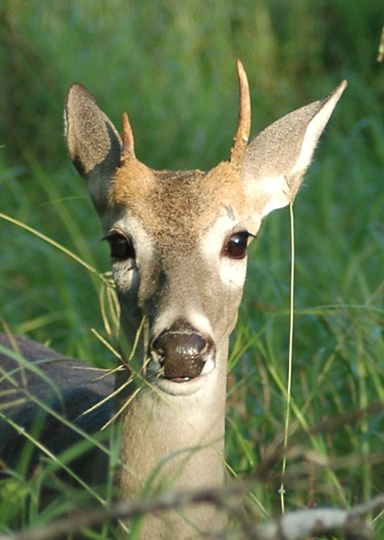
Why would anyone cull?
Two reasons to remove small-antlered bucks:
Leave larger bucks
Improve antlers in future
generations through
genetic changes
D. Hewitt

Slide 3
Critical questions
If a buck has small antlers as a youngster, will he remain small?
Does phenotype = genotype?
(how reliable are antlers?)
What other factors should influence my decision to cull?

Slide 4
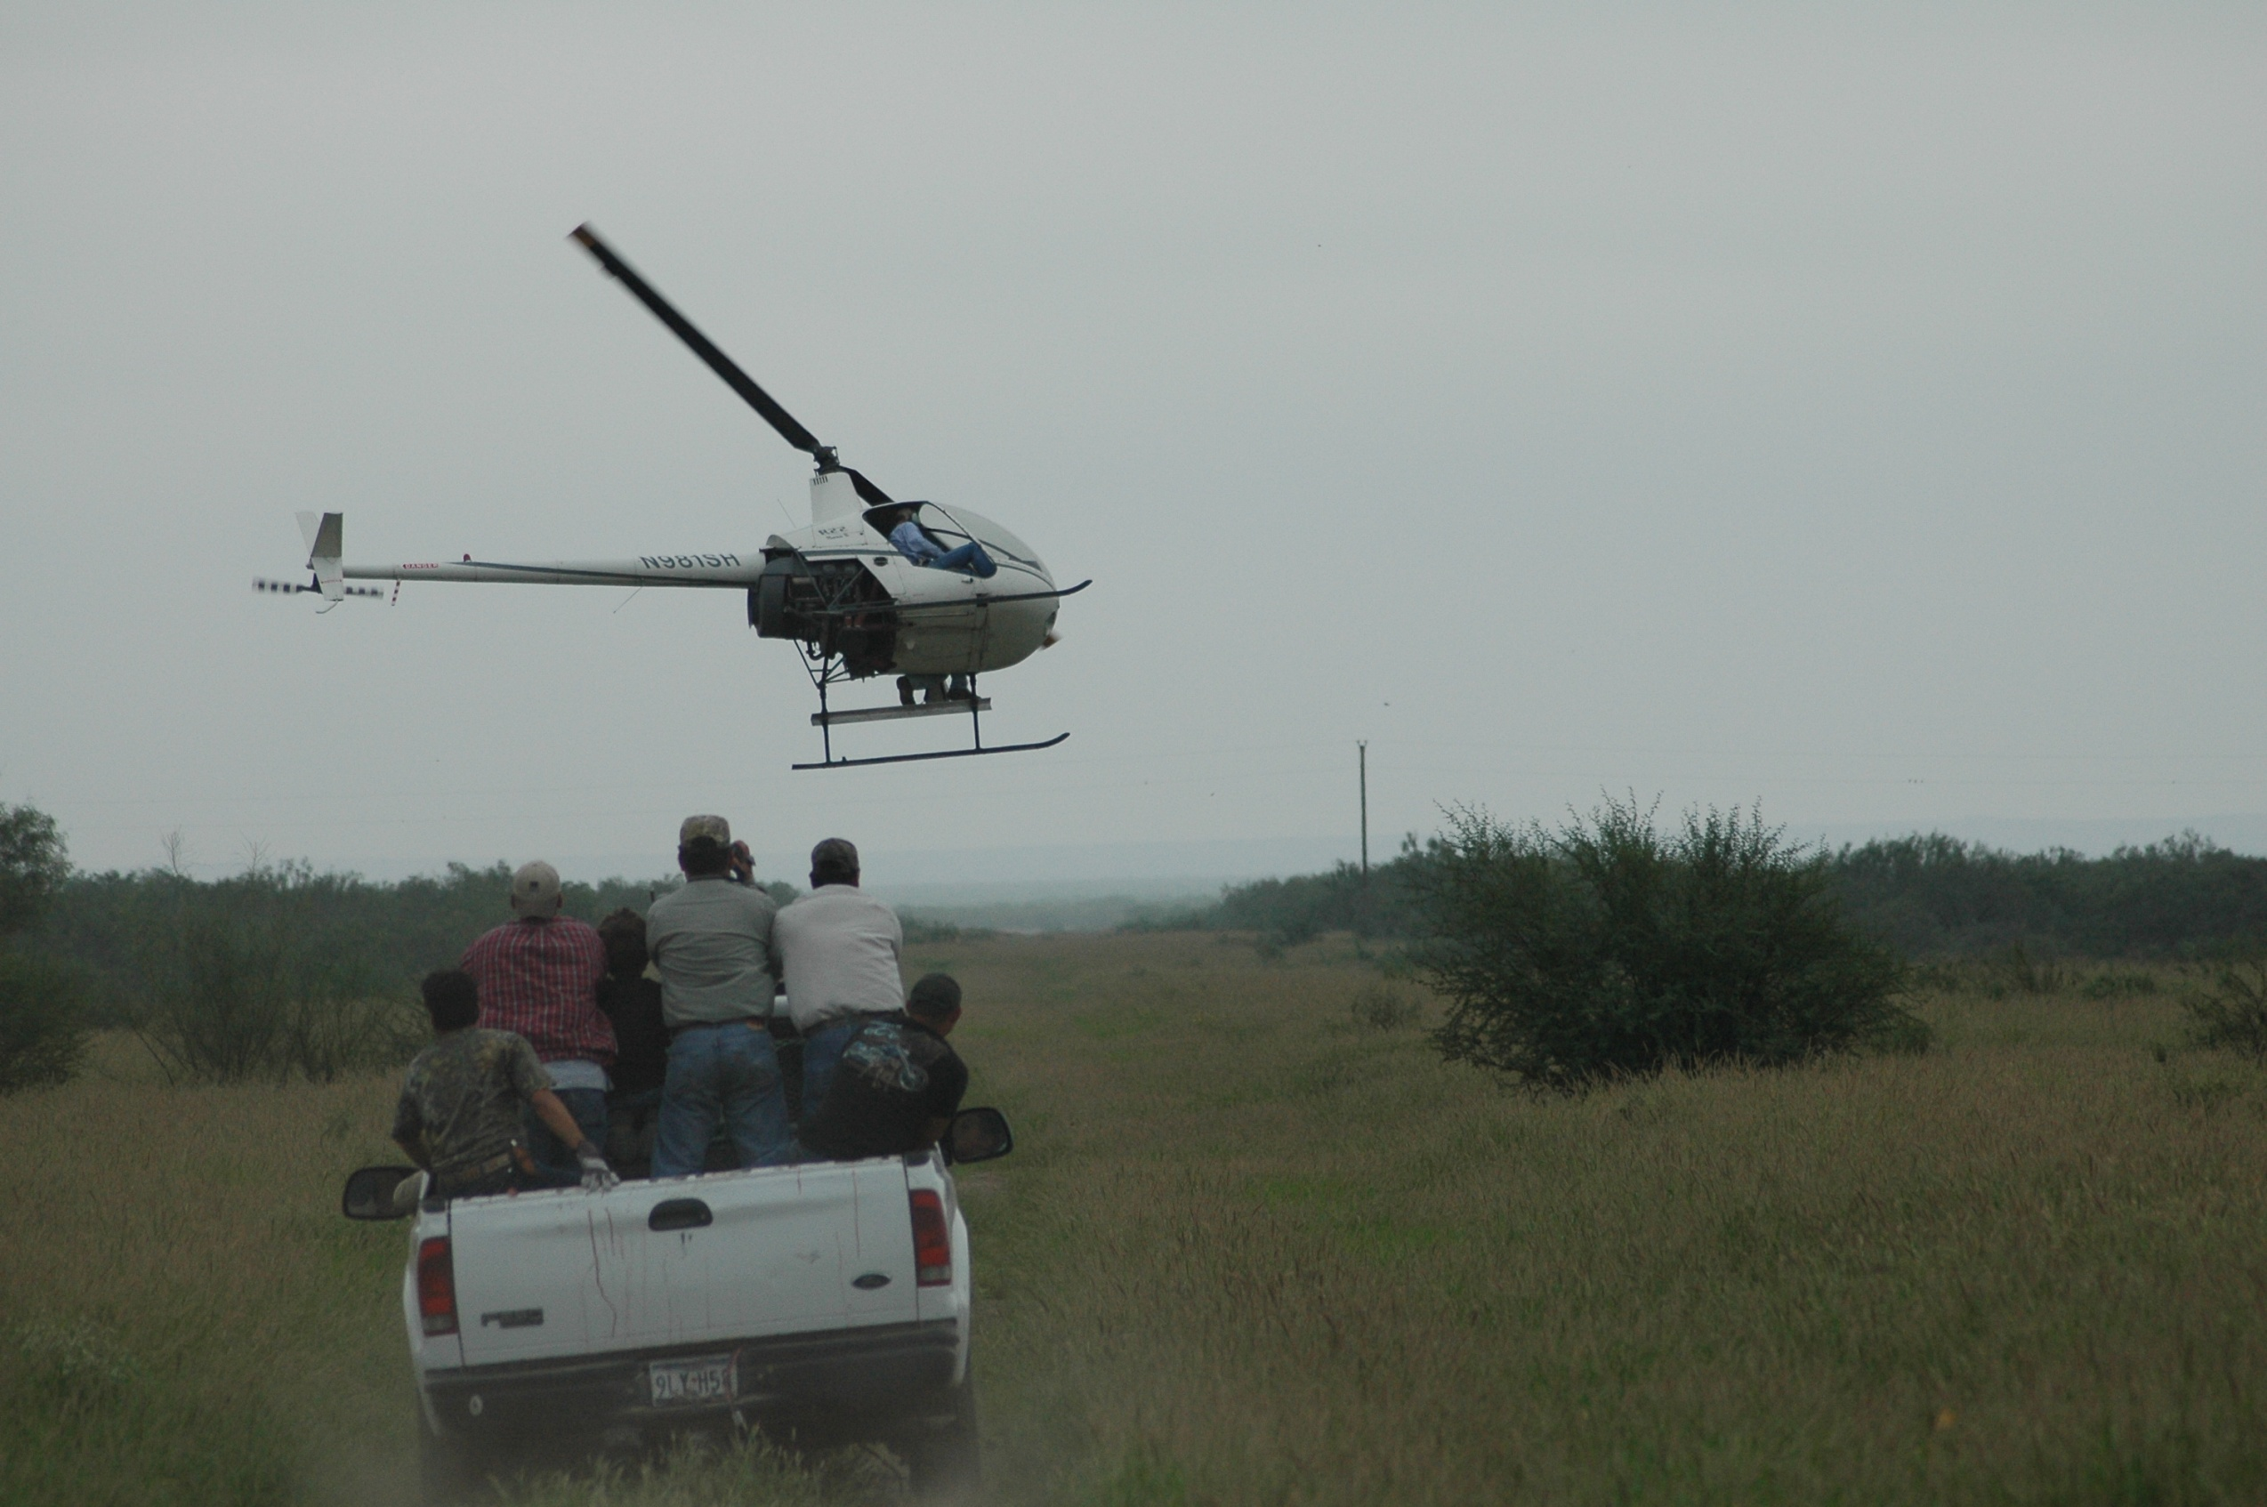
Methods
South Texas Buck Capture Project
Helicopter/net-gun capture
Bucks captured randomly
5 ranches
D. Hewitt

Slide 5
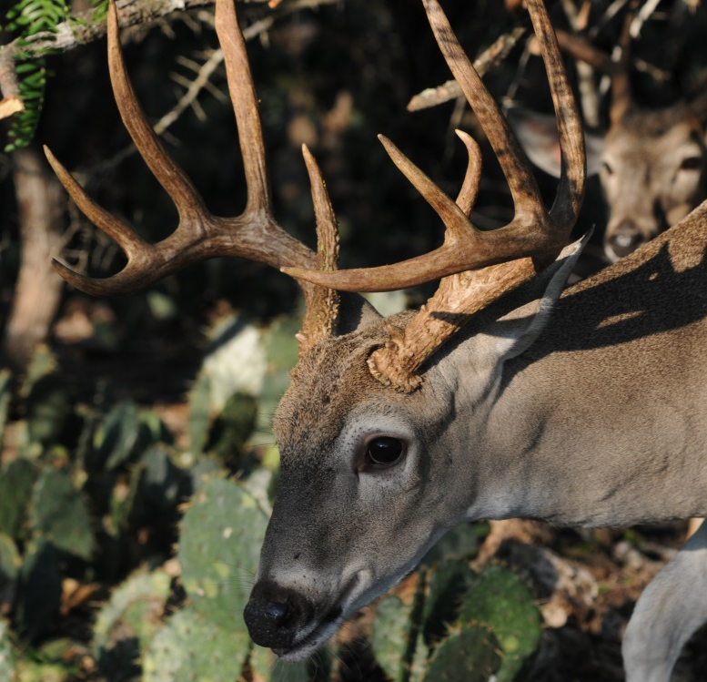
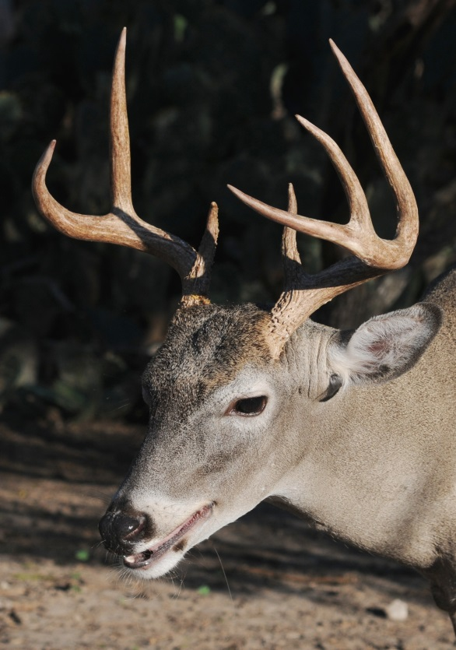
?
D. Hewitt
D. Hewitt
D. Hewitt

Slide 6
Spikes vs. Forks Over Time
10”
15”
≥
Hewitt et al. 2014; Journal of Wildlife Management 78:976–984

Slide 7
Yearling vs. Mature Antler Size
Hewitt et al. 2014; Journal of Wildlife Management 78:976–984

Slide 8
Yearling vs. Mature Antler Size
Hewitt et al. 2014; Journal of Wildlife Management 78:976–984

Slide 9
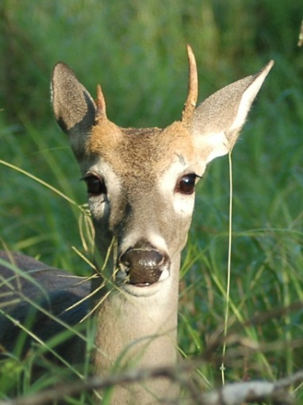
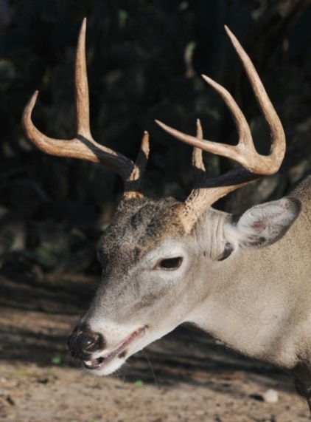
If a young buck has small antlers, will he remain proportionally smaller at maturity?
In general, yes…

Slide 10
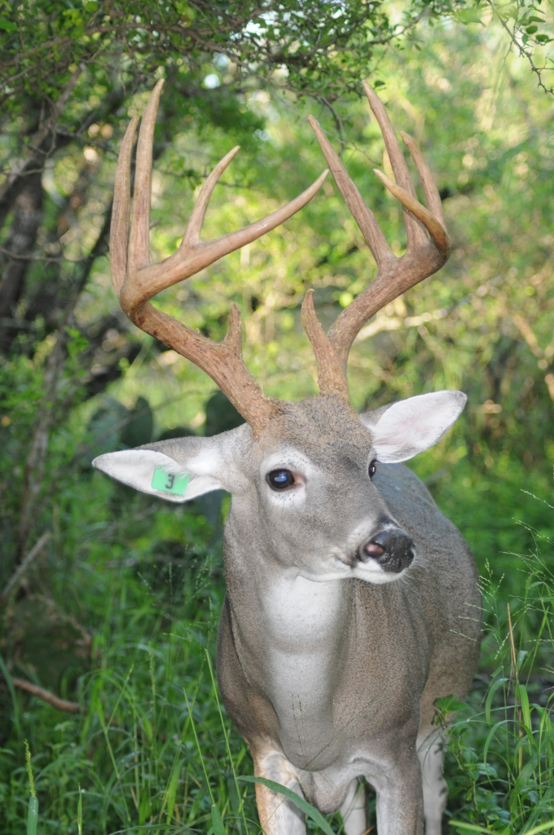
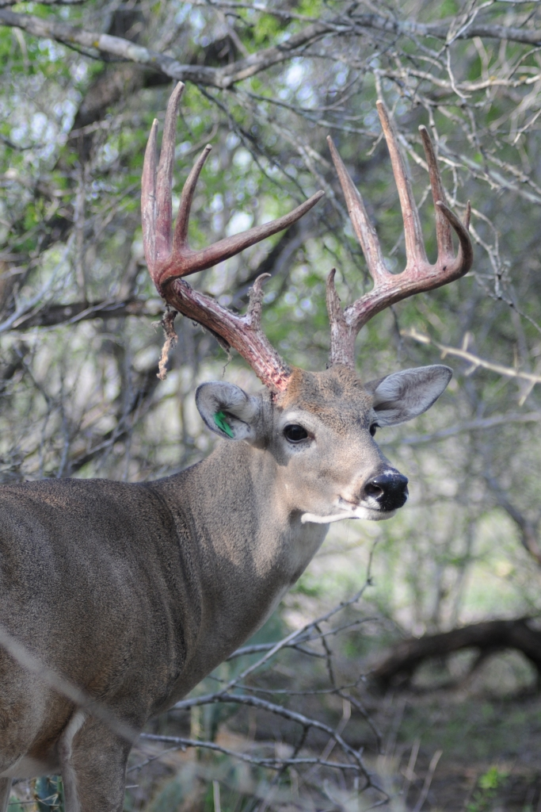
Are antlers a reliable indicator of genetic potential?
D. Hewitt
D. Hewitt
D. Hewitt

Slide 11
Heritabilities of Antler Points
■ Heritability (h²)
■ Unknown effects (e²)
■ Permanent environmental effects (p²)
Yearlings
2.5 years old
3.5+ years old
h² (SD) = 0.17 (0.14)
* Not Significant
e² (SD) = 0.83 (0.14)
* Significant
h² (SD) = 0.15 (0.15)
* Not Significant
e² (SD) = 0.85 (0.15)
* Significant
h² (SD) = 0.25 (0.09)
* Significant
e² (SD) = 0.50 (0.02)
* Significant
p² (SD) = 0.25 (0.09)
* Significant
Notes:
Heritability for yearling's antler points is 17%. For two and a half years old, heritability is 15%. And for over three and a half years old, heritability is 25%. Permanent environmental effects were 25%. Permanent environmental effects are considered as the year effects and birth year effects.

Slide 12
Heritabilities of GBC
■ Heritability (h²)
■ Unknown effects (e²)
■ Permanent environmental effects (p²)
Yearlings
2.5 years old
3.5+ years old
h² (SD) = 0.30 (0.28)
* Not Significant
e² (SD) = 0.70 (0.28)
* Significant
h² (SD) = 0.27 (0.14)
* Not Significant
e² (SD) = 0.73 (0.14)
* Significant
h² (SD) = 0.45 (0.09)
* Significant
e² (SD) = 0.13 (0.09)
* Significant
p² (SD) = 0.45 (0.02)
* Significant
Notes:
Heritability for yearling’s boone & crockett score is 30%. For 2.5 years old, heritability is 27%. And for over three and a half years old, heritability is 45%. And permanent environmental effects were 13%.

Slide 13
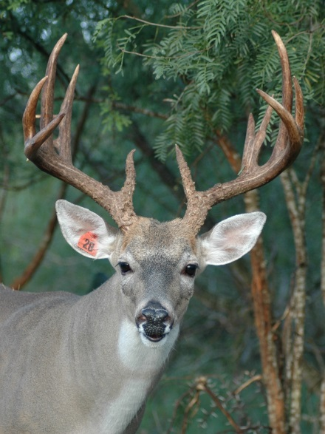
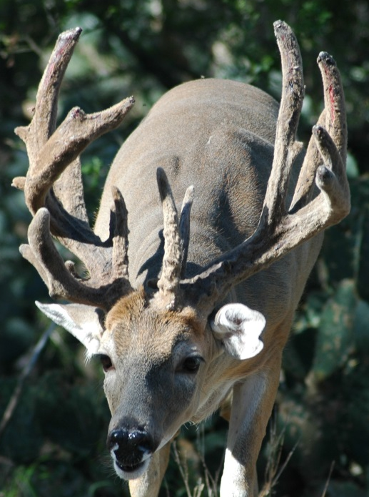
Repeatability: “Consistency”
Repeatability ≈ 0
Antlers change yr to yr
D. Hewitt
D. Hewitt
Repeatability ≈ 1
Antlers same yr to yr
D. Hewitt
D. Hewitt

Slide 14
Repeatability of antler size at maturity?
7 sites across S. Texas
Total “Score” = 0.59 – 0.82
# Points = 0.42 – 0.64
Spread = 0.58 – 0.80
Base = 0.54 – 0.70
D. Hewitt
D. Hewitt
Foley et al. 2012; J. Mammalogy 93:1149–1157
D. Hewitt
D. Hewitt

Slide 15
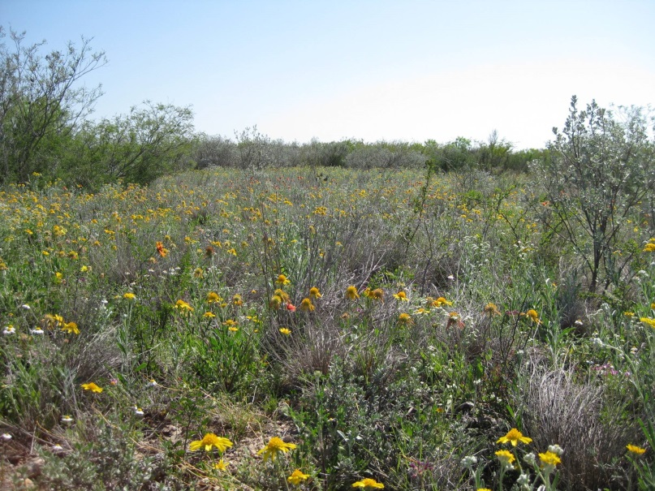
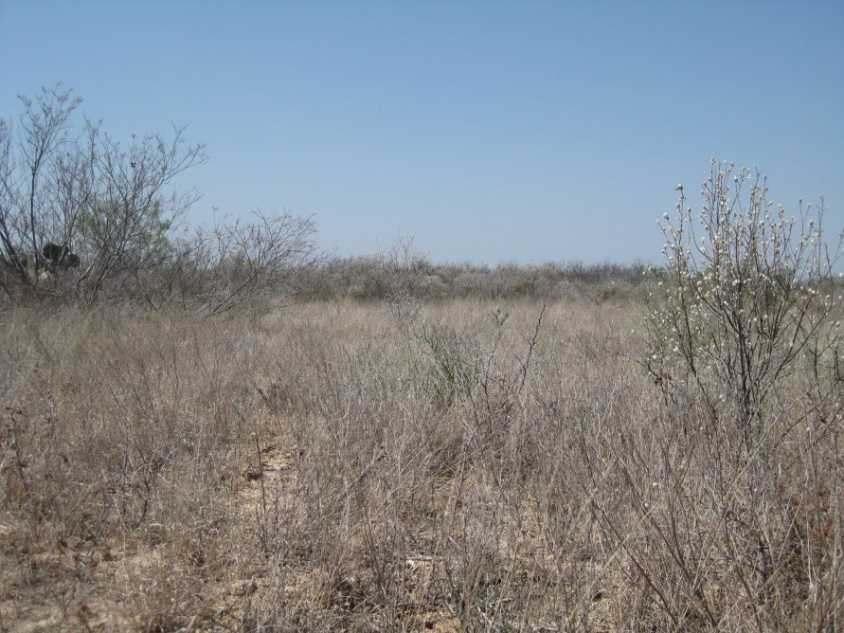
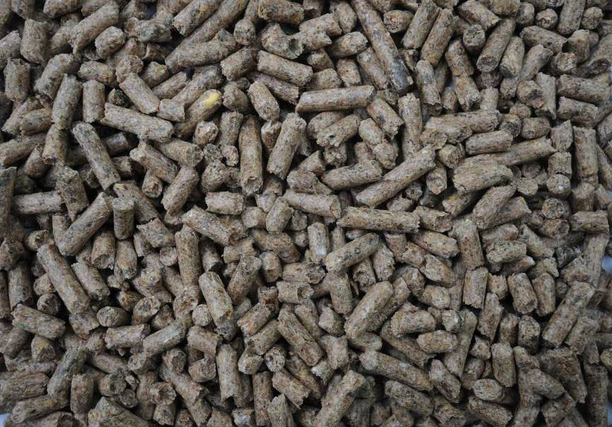
Repeatability of antler size
Less consistent in areas with variable rainfall
More consistent with pelleted supplement
D. Hewitt
D. Hewitt
D. Hewitt
Foley et al. 2012; J. Mammalogy 93:1149–1157

Slide 16
Critical questions
Does phenotype = genotype?
(how reliable are antlers?)
Not very reliable for young bucks
Increases with age
“transition” frequency high
Imperfect indicator of breeding value

Slide 17
Selection
Antler traits are heritable
Trait can be altered through selection
Kerr WMA study:
Selection increased yearling antlers
3.2 antler points
36 inches B&C score
Lockwood et al. 2007

Slide 18
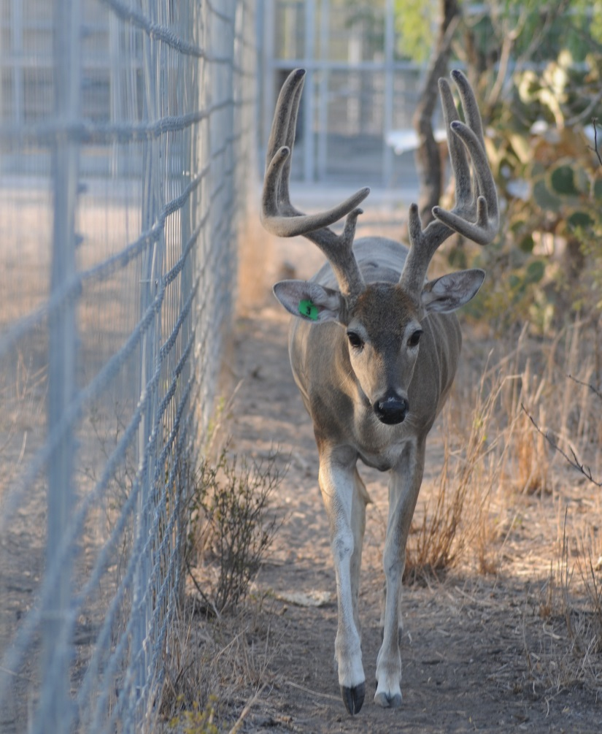
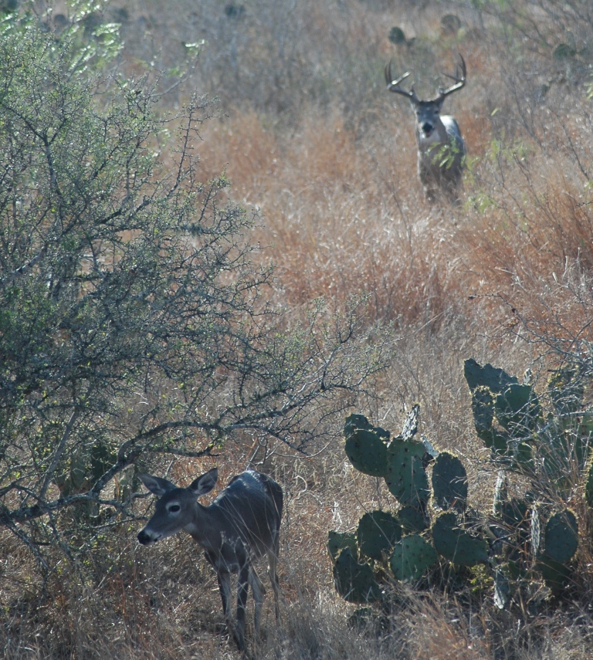
Works in pen, but not wild…
Why difference in Pen vs. Pasture?
D. Hewitt
D. Hewitt

Slide 19
Scale of management: the “Corral Continuum”
Corral, penned, or captive:
Ensure paternity and maternity
Selection for buck antler traits
Selection for maternal characters
Breeding records improve selection
Free-ranging :
Can not ensure paternity or maternity
Selection for bucks inefficient
Selection for maternal characters impossible
Dispersal and lack of breeding records
Game-proof or “high-fenced”
Low-fenced, free-ranging
Unable to select for maternal characters
Genetic manipulation difficult or impossible due to dispersal, inefficiency of selection
Corral
County
250 ac.
High-fenced
1,000 ac.
High-fenced
10,000 ac.
High-fenced
50,000 ac.
Low-fenced
Adapted from Stedman, unpublished
Jacobson et al 2011, Biology and Management of White-tailed Deer: 464
Notes:
19

Slide 20
What makes selection more efficient in a pen?
Kerr WMA:
“Best-case”
85% bucks culled
Breeders chosen carefully
No competition
Each buck bred >10 does
Fastest possible generation
“Monte Carlo” situation
Selection of does?
D. Hewitt

Slide 21
What makes selection more efficient in a pen?
Wild deer:
55% bucks culled
No selection on does
More bucks mating
1-3 does/buck
Slow generation time
Few offspring bred
D. Hewitt

Slide 22
Response to Selection (R)
R = Predicted gain of antler size per generation
“Breeder’s equation”:
R = h² * S
Modified for selection on 1 sex:
R = ½ (h² * S)
Selection differential (S)
Heritability of antler traits (h²)
Notes:
Response to selection is used to predict the gain of the antler size per generation after selection. We modified the breeder’s equation because we only captured male for selection.

Slide 23
Response to Selection (R)
Low heritability for younger bucks
Long generation time
No information on breeding values
No ability to select does
Fewer offspring per sire
Not sustainable?
Possible with rifle?
R = Predicted gain of antler size per generation
“Breeder’s equation”:
R = h² * S
Modified for selection on 1 sex:
R = ½ (h² * S)
Selection differential (S)
Heritability of antler traits (h²)
Notes:
Response to selection is used to predict the gain of the antler size per generation after selection. We modified the breeder’s equation because we only captured male for selection.

Slide 24
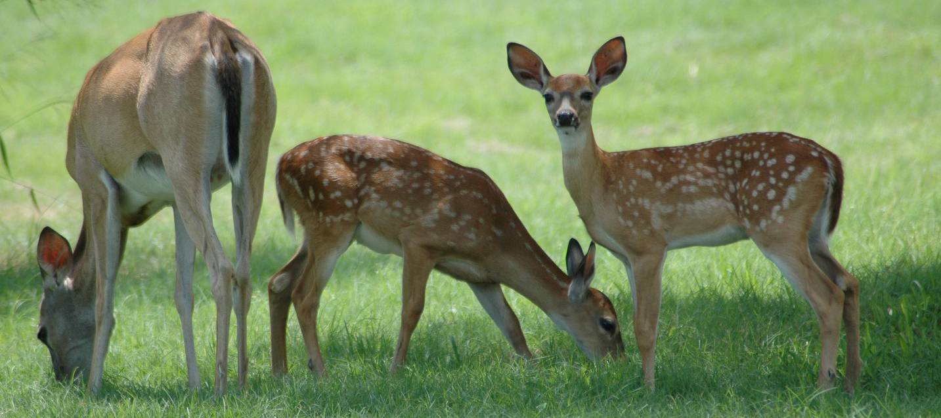
Other Considerations
Productivity
Fawn recruitment: must be high and consistent
Nutrition influence on “potential” antler size
“Turn the does over…”
Adult does produce most of the fawns!
Not selective
D. Hewitt

Slide 25
Other Considerations
Ageing decisions
On the hoof vs. captured deer
Comanche study: about 20% of young bucks
D. Hewitt

Slide 26
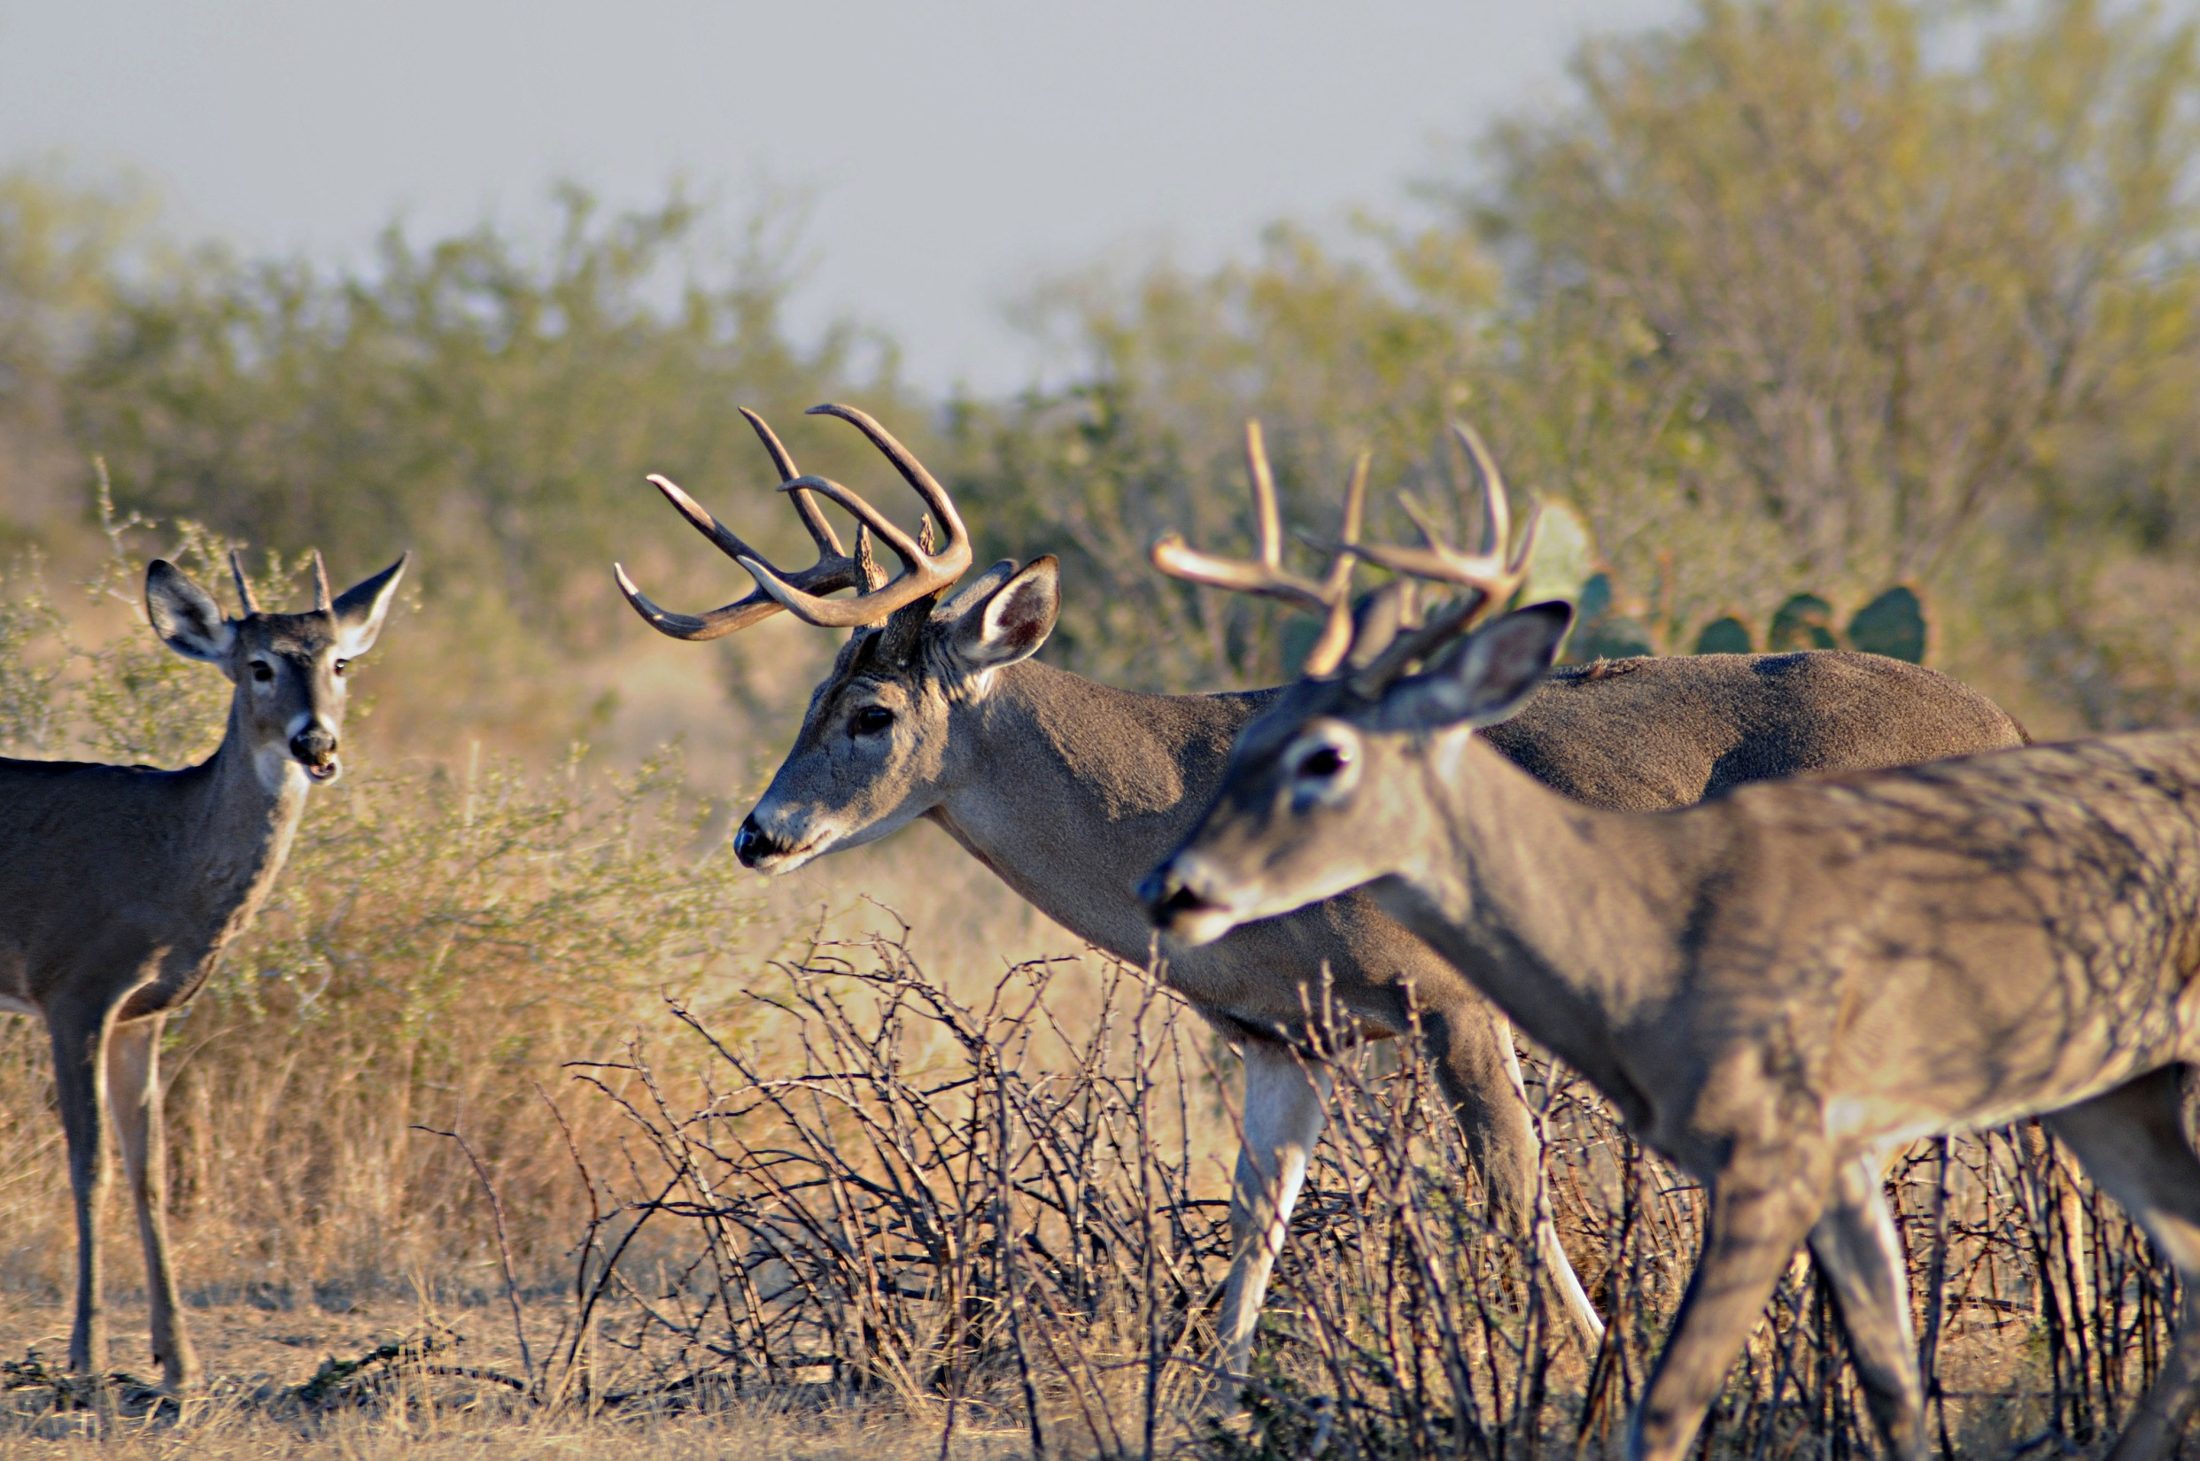
Cost of Culling
Shooting young deer → Fewer old deer
D. Hewitt

Slide 27
Antler Development by Age Class
Largest increase in size
Some young bucks have large antlers early in life
Others will get bigger
Best potential at 5.5 yrs +
140” at 3.5 yrs may be 170+ at 6.5
N
Age Est.
1 745
2 834
3 657
4 739
5 446
6 230
7 176
8 144
South Texas Buck Capture Study

Slide 28
Antler size of yearling and mature bucks
An inexact science….
Poor yearlings are less likely to become giants
Some poor yearlings turn out ok
Some good yearlings never measure up
South Texas Buck Capture Study
R. DeYoung

Slide 29
Options…..
“Monte Carlo”?
Increase the odds
DMP?
Hope for good breeding values
Other…..?
Goals and philosophy
At some point, no longer “wild deer”
R. DeYoung

Slide 30
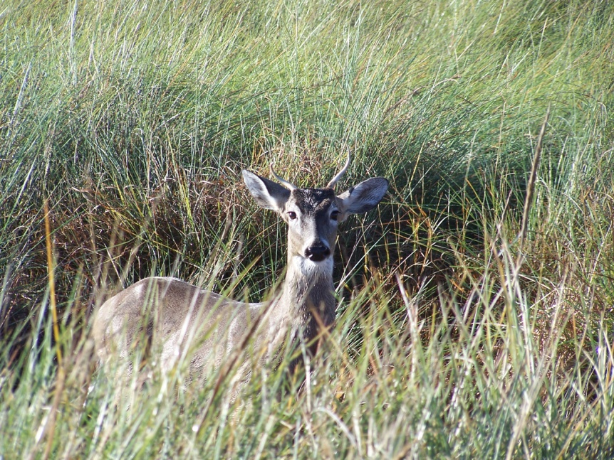
Should I cull, shoot spikes, etc.????
It depends….
Culling is viable practice
Your goals
What you like/need to harvest
Your management intensity
Your population status
Nutrition, age structure
Recruitment, “closure”
No “1 size fits all” recommendation
Both culling and not culling have been successful
R. DeYoung

