Slide 1
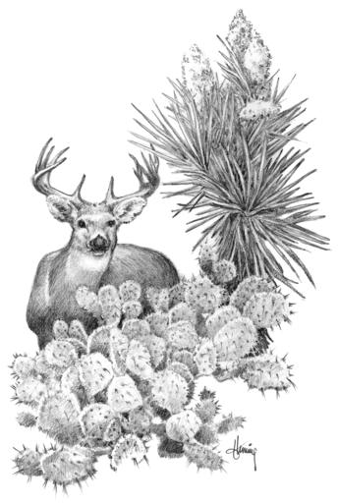
Dietary Energy Influence
Body and Antler Size
Ryan L. Reitz
Don B. Frels, Jr., Justin A. Foster, David G. Hewitt, Randy W. DeYoung, David Wester

Slide 2
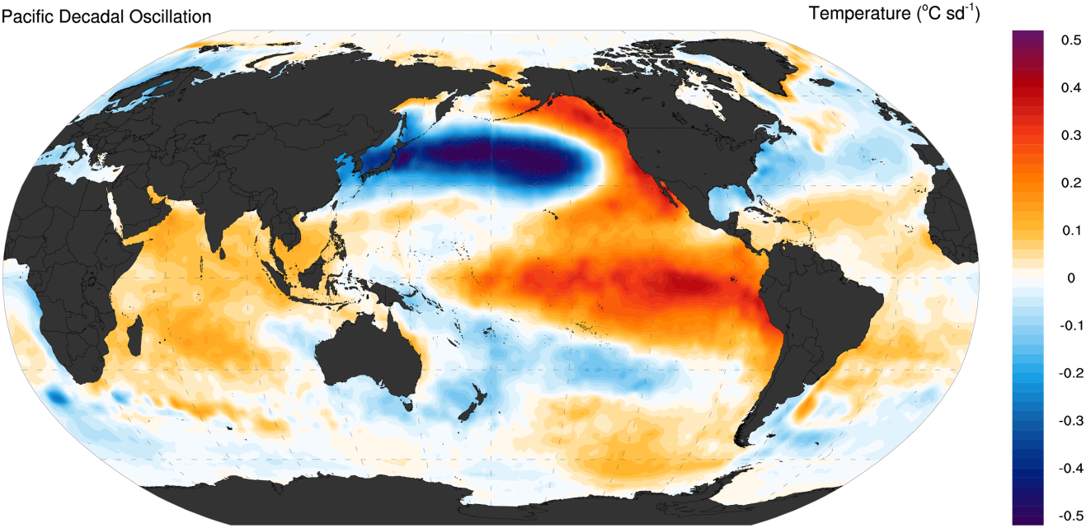
Environmental Interaction
Supply
Limited
Demand
Varies
Strickland, et al. 2014
“ The environment supplies food but also exerts demand on the animal” P. Barboza, Integrative Wildlife Nutrition

Slide 3
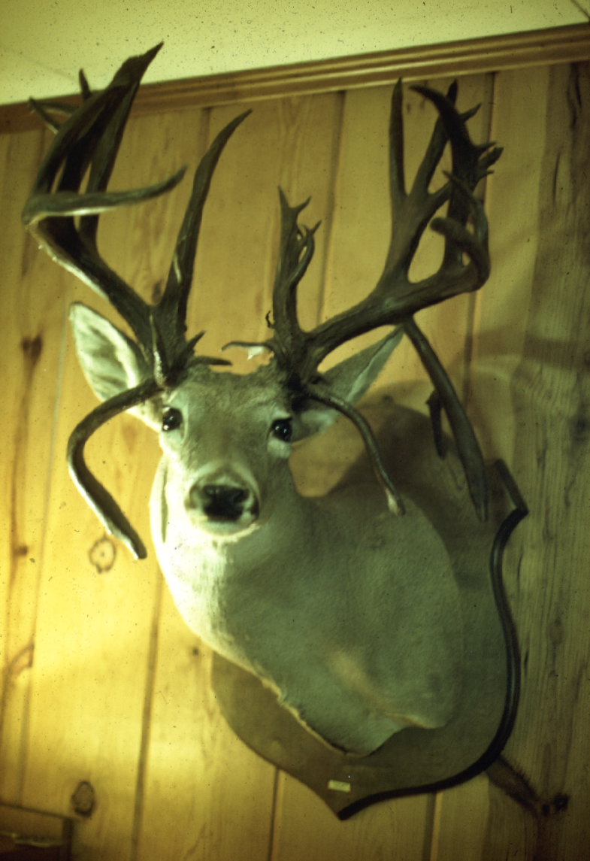
Notes:
Localized level. The head grows with the pasture. Deer are a product of their environment. Mostly in Texas that is a product of a management system, set of tools = habitat. In some cases deer are primary, others livestock primary. Be willing to bet (deer associates), deer are primary here. At any rate in management, livestock and wildlife often used together symbiotic relationship (plant benefits) for habitat portfolio and economic portfolio. As a concentrate selector, deer glean, daily decision based on demand.

Slide 4
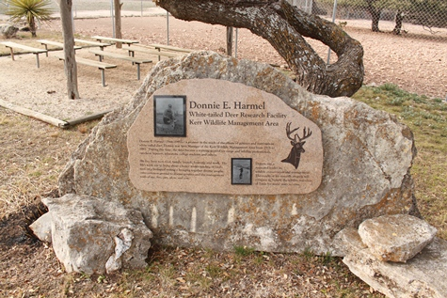
Kerr WMA
Research and Demonstration Site
Established 1950
Donnie E. Harmel White-tailed Deer Research Facility (1974)
TPWD
Notes:
Forge mgmt tools

Slide 5
Dietary Energy
Ability to do work
Stand
Walk
Grow
Lactate
Basal metabolic rate (Kj, Kcal/g)
+ activity = cost
Maintenance at 2.17 Kcal/g (Ammann et al. 1973)
Notes:
What is energy and how do we quantify/measure it.
Energy is fuel, Ability to work = stand, grow, lactate are all directly related to energy balance. Energy itself is quantified metabolically in Kj , calories or Kcal which we will use today. Costs of any activity are in addition to the BMR and maintenance is described at 2.1 kcal/g dry matter

Slide 6
Nutrient Currency
Dietary Energy
Growth (2.7 – 3.0 Kcal/g)
Supply (1.7 – 2.7 Kcal/g)
Dietary Protein
Growth ( 12% – 16%)
Supply (10% – 19%)
Digestible energy levels often fall below maintenance during peak periods of lactation and antler production
Notes:
Hewitt; meyer et al. 1984.

Slide 7
Nutrient Currency
Dietary Energy
Growth (2.7 – 3.0 Kcal/g)
Supply (1.7 – 2.7 Kcal/g)
Dietary Protein
Growth ( 12% – 16%)
Supply (10% – 19%)
 | Ep | ep | EP | eP
Trial 1 | 1 | 4 | 2 | 3
Trial 2 | 1 | 3 | 2 | 4
Trial 3 | 1 | 3 | 2 | 4
Trial 4 | 2 | 3 | 1 | 4
Berteaux, 1998
Digestible energy levels often fall below maintenance during peak periods of lactation and antler production
Notes:
Hewitt; meyer et al. 1984.

Slide 8
Donnie E. Harmel White-tailed Deer Research Facility
Rearing Pen
Individual Pens &
Working Facility
Rearing Pen
6 - 2/3 ac breeding pens

Slide 9
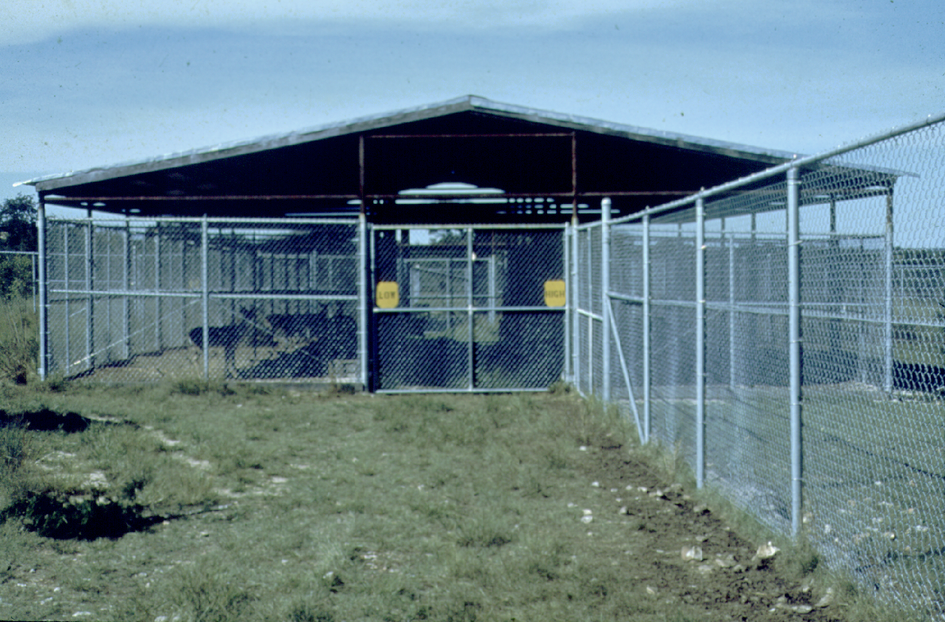
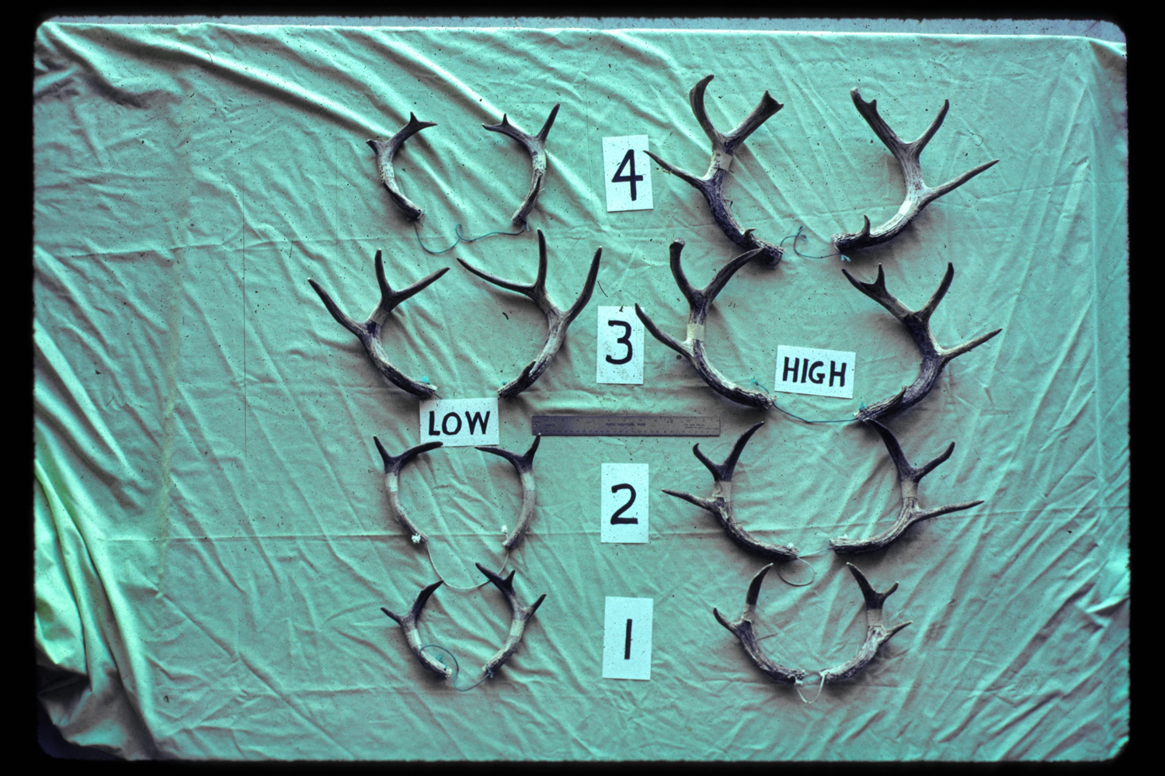
Notes:
@ 2.5 14.9% (antler msmts) 19% BW

Slide 10
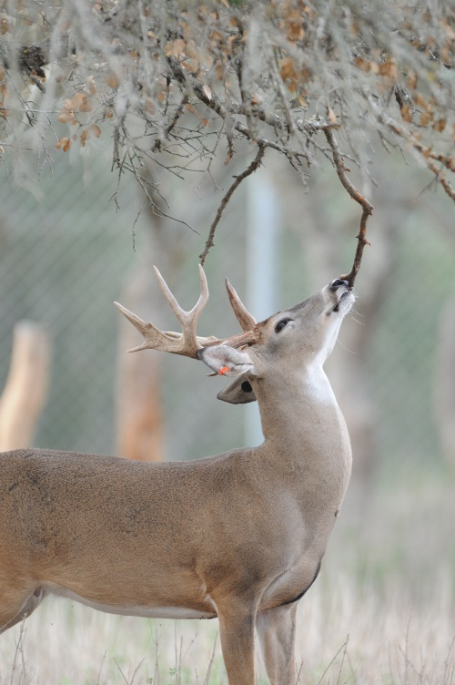
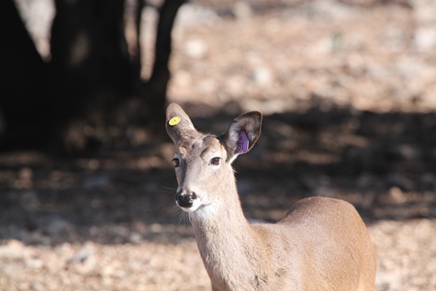
Phenotypic Limitations
Cost
Body Size (Verme and Ozoga, 1980)
Antler Size (French et al. 1956)
Reproductivity (Alber et al. 1976)
Maternal (Freeman, et al. 2013)
Generational (Monteith et al. 2009, Michel et al.)
Grady Allen
TPWD
Notes:
What are the costs and how do they compare? Great deal of evidence exists demonstrating the costs of growth due to a limits in dietary energy. Furthermore, Maternal effects or the “inherited environmental effects” although not solely affecting the individual but the phenotype of her offspring independent of it’s genotype. i.e. growth performance indicative of past rather than current conditions.

Slide 11
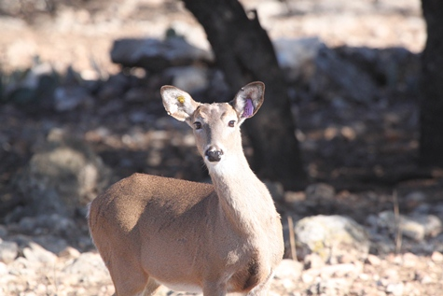
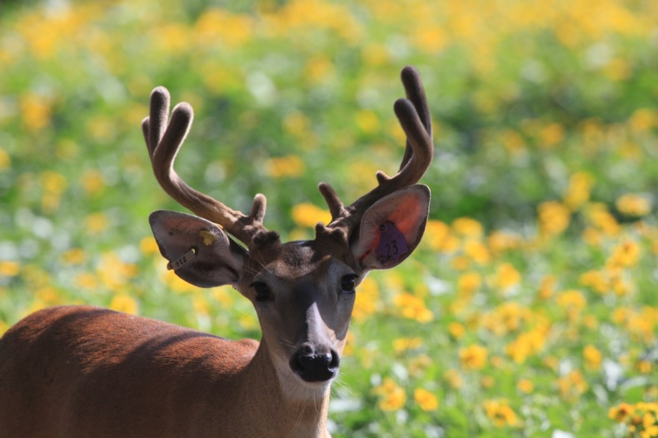
Kerr WMA Study
Design
2 Phases
1) Population Effect
By Sex and Age
2) Generational Effect
Null = Feed has no effect
TPWD
Notes:
Testing divergence
Marix of age, nut, gen, amplified by maternal/gen effects

