Slide 1
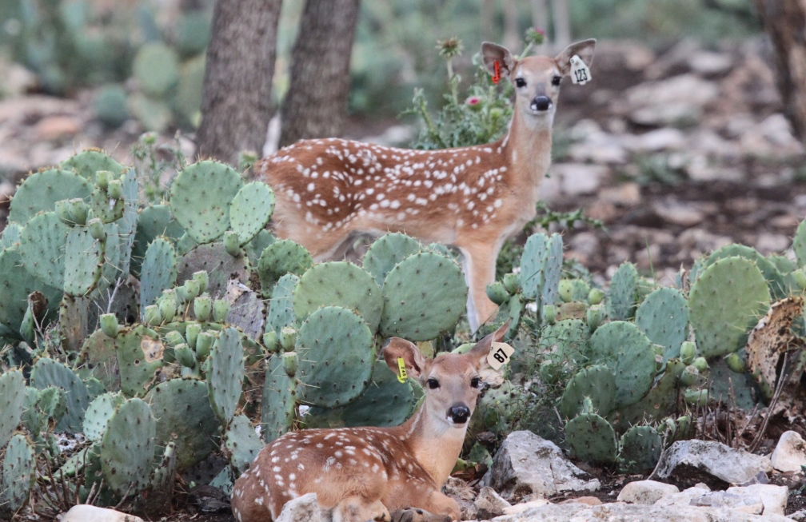
Phase 1 Design
Produce fawns under standard energy environment
Ad libitum
Breeding females
1.5-5.5 years of Age
Sires
3.5 years of age

Slide 2
Treatment and Year
2012
2013
2014
M
F
M
F
M
F
SEM
LEM
SEF
LEF
SEM
LEM
SEF
LEF
SEM
LEM
SEF
LEF
Standard Energy Males (SEM)
Low Energy Males (LEM)
Standard Energy Females (SEF)
Low Energy Females (LEF)

Slide 3
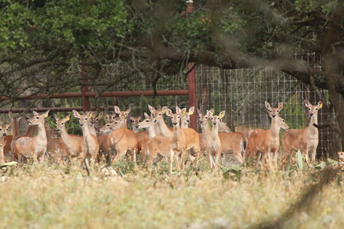
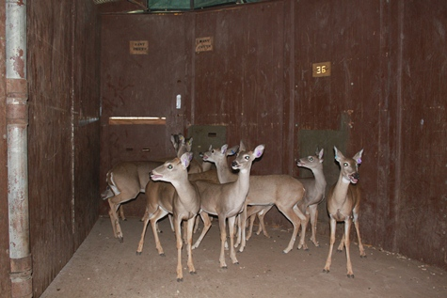
Population at Weaning
n = 43
n = 67
n = 65
TPWD
n = 41
n = 51
n = 42
TPWD

Slide 4
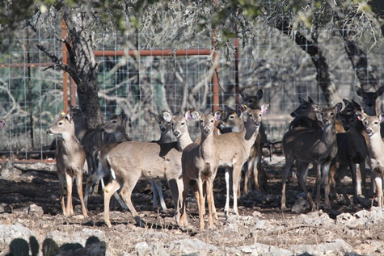
Cohort Data
Remain on diet through 4 yrs of age
Data collected annually in October
Weight
Total Body Length
Hind Foot Length
Body Condition Score
Rump Fat
Antler Size
TPWD

Slide 5
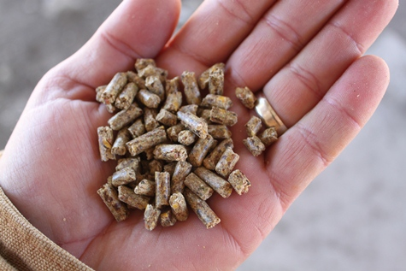
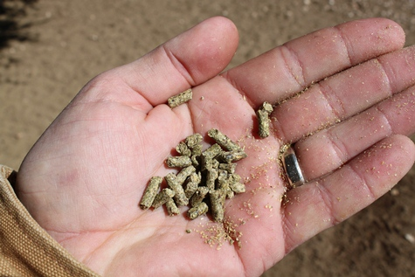
Diet
Pelleted 16% Protein
Vitamin and Minerals
Standard Energy > 2.8 Kcal/g
Low Energy < 2.2 Kcal/g
DDM; SE = 61.5%, LE = 41.4%
TPWD
TPWD
TPWD
Notes:
Average and 95% CI
Low energy 41.4 +/- 38.9-43.9
Standard energy 61.5 +/- 59.4-63.7

Slide 6
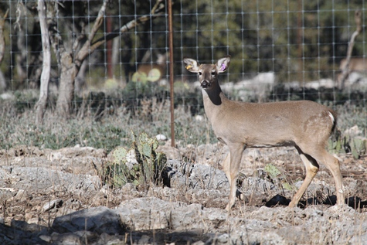
Observational
Male Consumption
Consumption at 1.5 years (lbs)
SEM | LEM
3.22 | 4.81
Monthly Mean
Lbs per Deer
TPWD
Notes:
15% difference in mean consumption.
October 25% difference

Slide 7
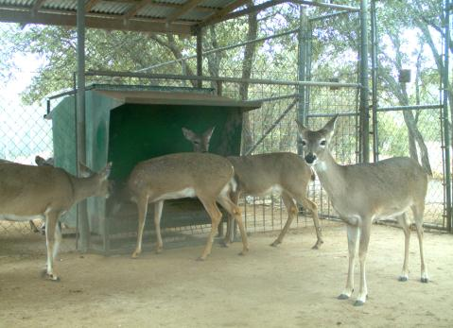
Observational
Female Consumption
Consumption at 1.5 years (lbs)
SEF | LEF
2.62 | 3.82
Monthly Mean
Lbs per Deer
TPWD
Notes:
1.2 lbs difference at October
18 % difference

Slide 8
Body Condition is predictive of
treatment

Slide 9
Weight is treatment sensitive
Magnitude varies by sex
Variation across ages and birth year

Slide 10
Skeletal size overall independent of treatment

Slide 11
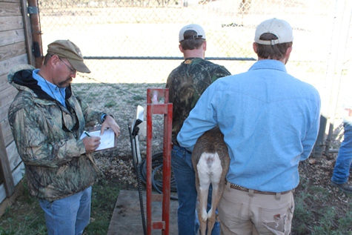
Weight - Birth Year 2012
Mixed Procedure
Test of Effect
AGE | SEM | LEM | SEF | LEF
1.5 | 120.8 | -18.5 | 91.7 | -18.8
2.5 | 141.3 | -8.6 | 104.2 | -17.3
3.5 | 170.1 | -26.8 | 110.8 | -16.9
4.5 | 180.0 | -29.6 | 107.3 | -14.8
P =0.0004, P <.0001
P = 0.2749, P = 0.0003
P <.0001, P =0.0002
P < .0001 P <.0001
Weight Gain in lbs
TPWD

Slide 12
Weight - Birth Year 2013
Mixed Procedure
Test of Effect
AGE | SEM | LEM | SEF | LEF
1.5 | 118.1 | -21.6 | 86.8 | -.8
2.5 | 157.2 | -35.7 | 98.4 | -5.3
3.5 | 177.7 | -40.2 | 100.8 | -7.8
P = 0.0001, P = 0.5212
P < .0001, P = .01871
P <.0001, P =0.0002
Weight Gain in lbs
TPWD

Slide 13
Weight - Birth Year 2014
AGE | SEM | LEM | SEF | LEF
1.5 | 118.7 | -25.2 | 88.7 | -10.0
2.5 | 148.1 | -35.6 | 93.5 | -5.03
Mixed Procedure
Test of Effect
P <.0001, P =0.0018
P <.0001, P =0.1490
Weight Gain in lbs
TPWD

Slide 15
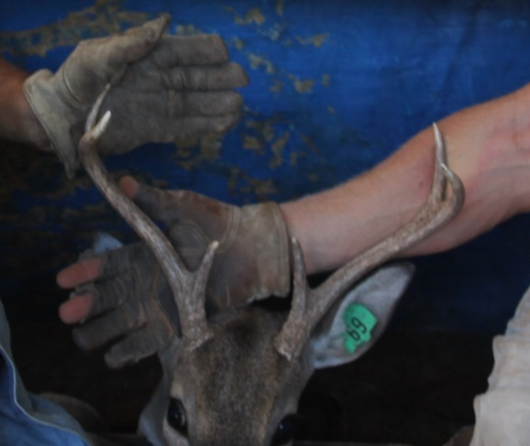
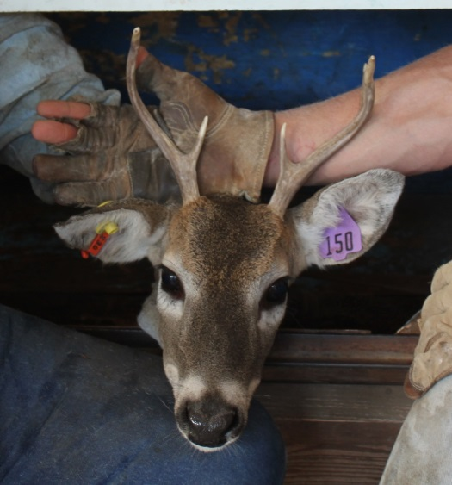
1.5 yrs - Antler Development
Mean Antler BCS
Birth Year | SEM | LEM
2012 | 74.3 | 46.9
2013 | 69.4 | 49.2
2014 | 66.2 | 47.4
GLM Procedure
Least Square Means
P <.0001
Antler Weight
Grams
1.5 Median
N = 156
Notes:
2 plus fold diff in antler wt

Slide 16
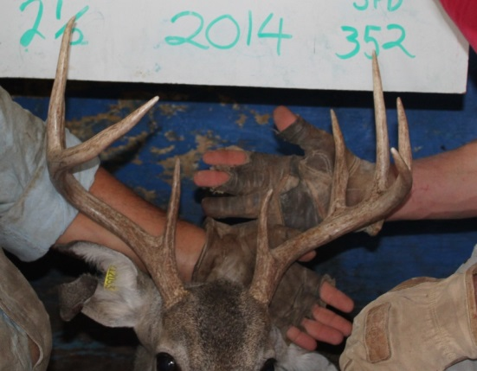
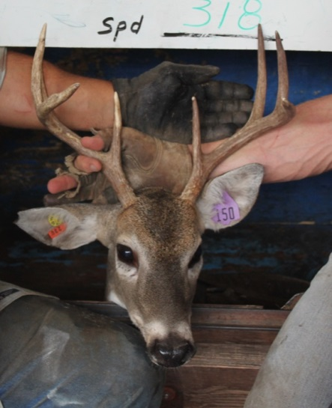
2.5 yrs - Antler Development
Mean Antler BCS
Birth Year | SEM | LEM
2012 | 117.5 | 90.9
2013 | 117.4 | 95.2
2014 | 105.9 | 73.2
GLM Procedure
Least Square Means
Antler Weight
Grams
P <.0001
2.5 Median
N= 132
Notes:
300 gram

Slide 17
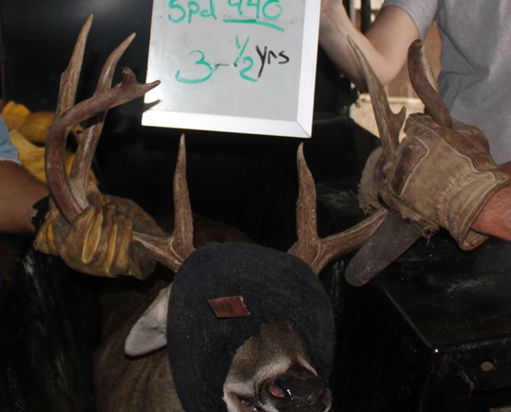
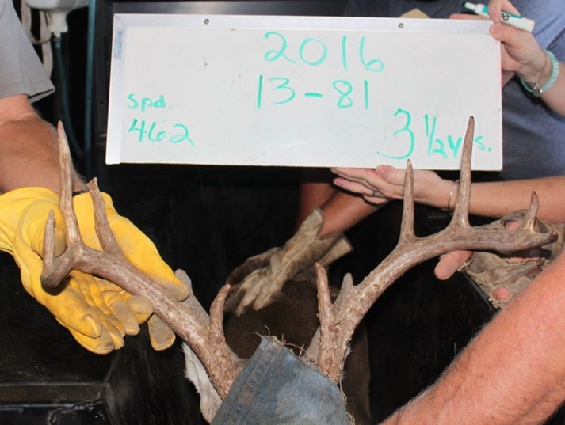
3.5 yrs - Antler Development
Mean Antler BCS
Birth Year | SEM | LEM
2012 | 127.0 | 118.6
2013 | 144.6 | 109.1
GLM Procedure
Least Square Means
Antler Weight
grams
P =0.3015
P <.0001
3.5 Median
N = 69
Notes:
3-400 grams

Slide 18
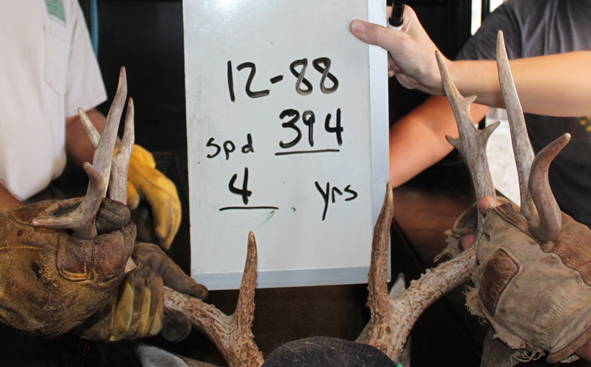
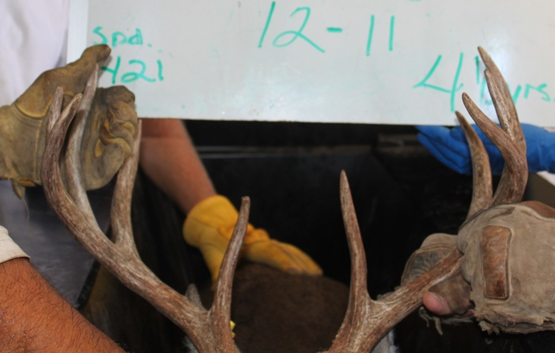
4.5 yrs - Antler Development
Mean Antler BCS
Birth Year | SEM | LEM
2012 | 141.1 | 121.5
GLM Procedure
Least Square Means
Antler Weight
grams
P =0.0344
4.5 Median
N = 20
Notes:
400 grams

Slide 19
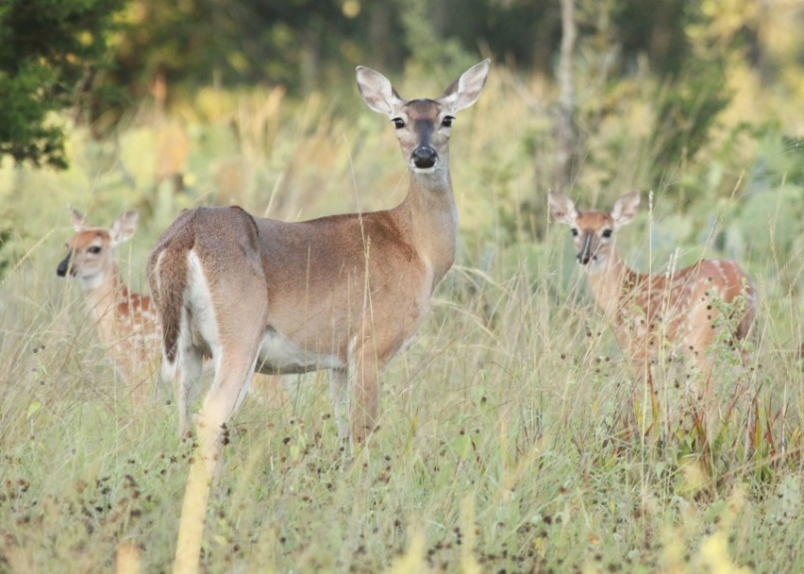
Discussion
Body weight and antler size are sensitive to dietary energy
At 1.5 and 2.5 years, male body weights and antler size differ by > 20 percent and > 26 percent
Female body weights differ by > 9 percent
Body Length and Hind Foot Length demonstrate canalization
Magnitude of effect for males and females varies by birth year across ages

Slide 20
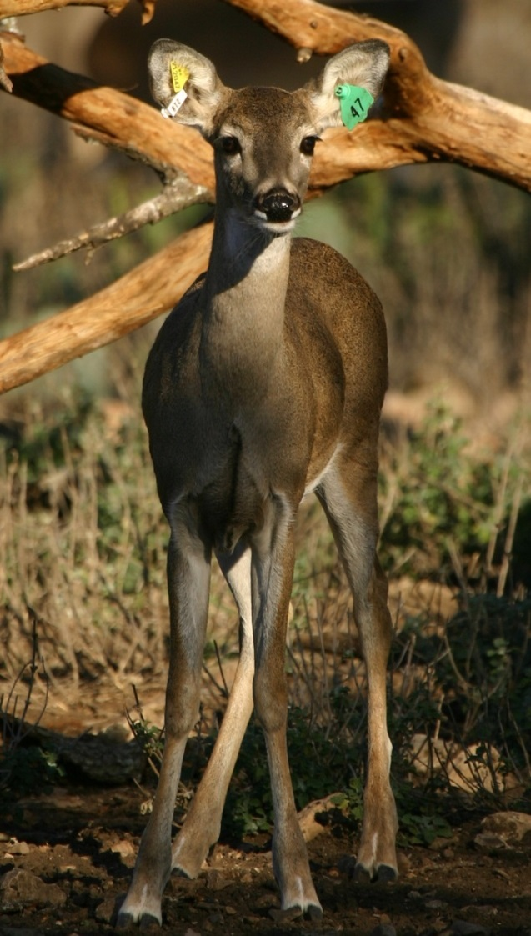
Discussion
LE consumption greater (>18%) at 1.5 years of age and remains similar with age
Increase in feed intake not adequate despite more protein
Yields opportunity to explore generational changes within a closed population

Slide 21
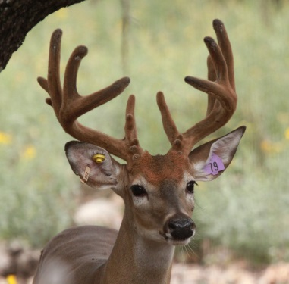
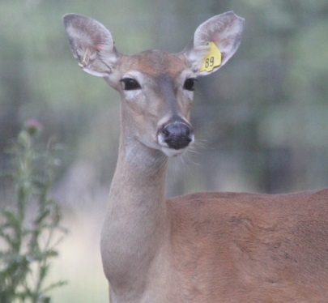
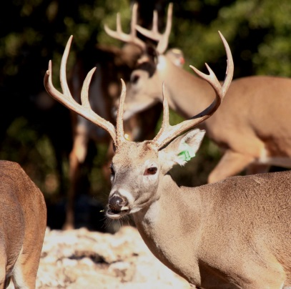
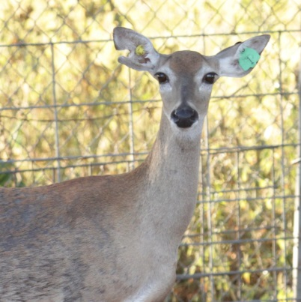
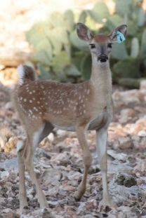
Phase I Phase II
Fawns per doe
1.66
Twinning Rate
.51
?
SE
Birth Weight
Male 5.5
Female 5.3
Fawns per doe
1.66
Twinning Rate
.63
?
LE
Birth Weight
Male 6.0
Female 5.3
Notes:
SE 12 male, 26 female; LE 11 male, 10 Female
Need survival

Slide 22
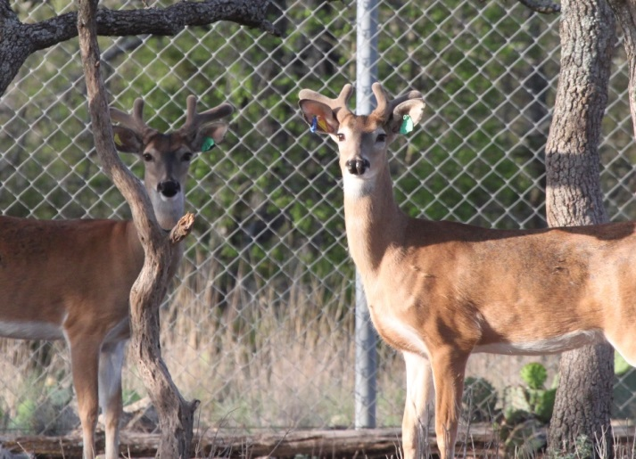
Generational Effect
n = 43
n =
n =
n = 43
n =
n =
Notes:
2017 and 2018 , F1 forthcoming
10 lbs males, 10 lbs females

Slide 23
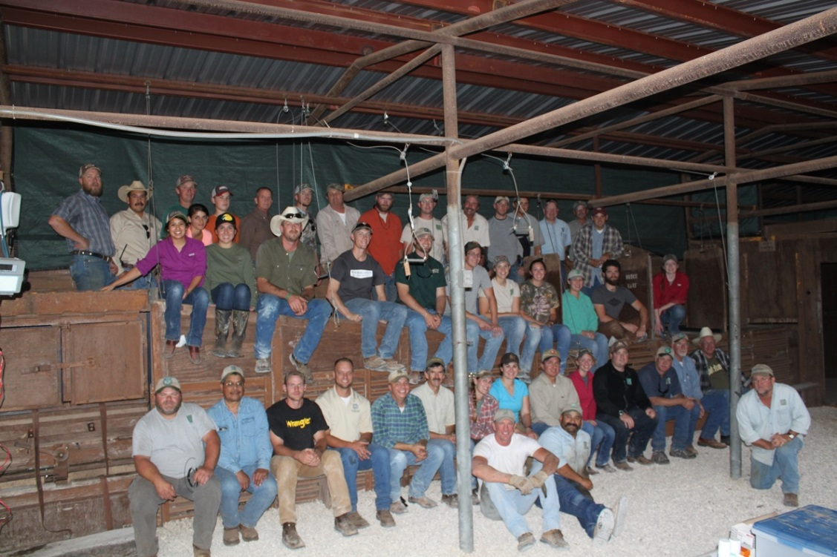
Acknowledgements
Kerr WMA
Fernando Gutierrez, Bjorn Palm, Evan McCoy, Lisa Wolle, John Kinsey
Mason Mountain and Muse WMA
Mark Mitchell, Jeff Forman, Kelsey Behrens, Jim Gallagher, Devin Erxleben
Regional TPWD Staff
Numerous Volunteers

Slide 24
