Slide 1
Patterns in Deer Body and Antler Size in South Texas: Genetics vs. Nutrition
Kory Gann
Texas Parks & Wildlife Department

Slide 2
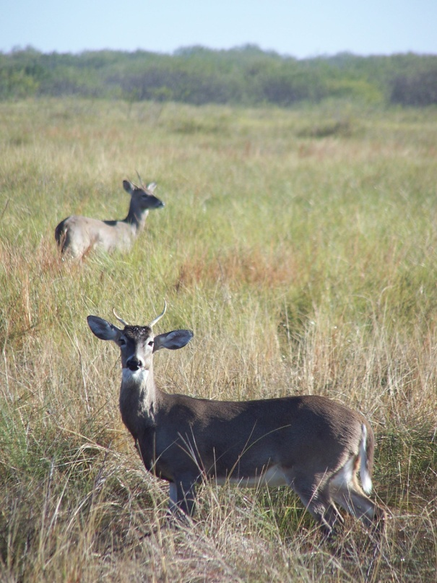
Factors that Affect Body and Antler Size:
Age
Nutrition
Genetics

Slide 3
Factors that Affect Body and Antler Size: Popular Thinking
Age
Nutrition
Genetics

Slide 4
Factors that Affect Body and Antler Size: Reality
Age
Nutrition
Genetics
Notes:
The main problem with addressing this concern is that expression of an animal’s genetic potential can be limited if nutrition is inadequate. In many cases, the underlying nutritional deficiencies that prevent expression of genetic potential are overlooked by managers.

Slide 5
The Importance of Age
Juveniles
Adults
Age N
1 745
2 834
3 657
4 739
5 446
6 230
7 176
8 144
South Texas Buck Capture Study

Slide 6
Subspecies of Deer: Variation on a Grand Scale
More than 30 total
Differences in Body and Antler Size
Why?
Baker (1984)

Slide 7
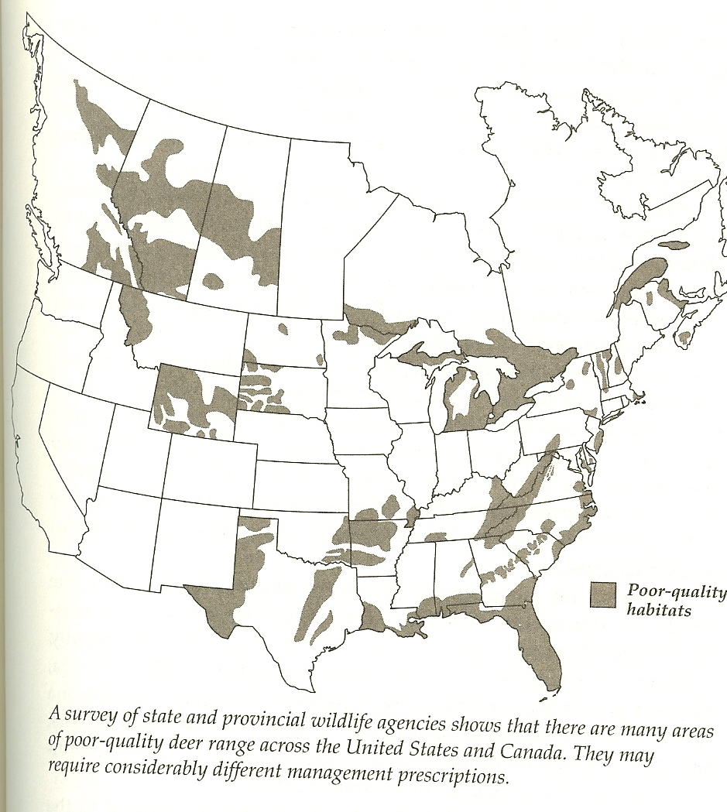
The Influence of Habitats…
Baker (1984)
Low quality habitats

Slide 8
The Influence of Habitats…
Baker (1984)
Low quality habitats

Slide 9
The Influence of Habitats…
Baker (1984)
Low quality habitats

Slide 10
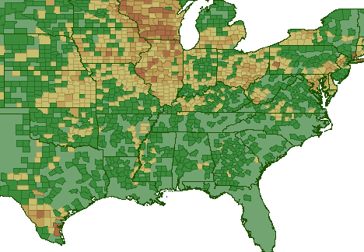
Where are the Trophies? On Good Soils!
Total Bucks that Qualify for Boone & Crockett, Pope & Young
1 - 4
5 - 20
21 - 50
> 50
Quality Deer Management
Association

Slide 11
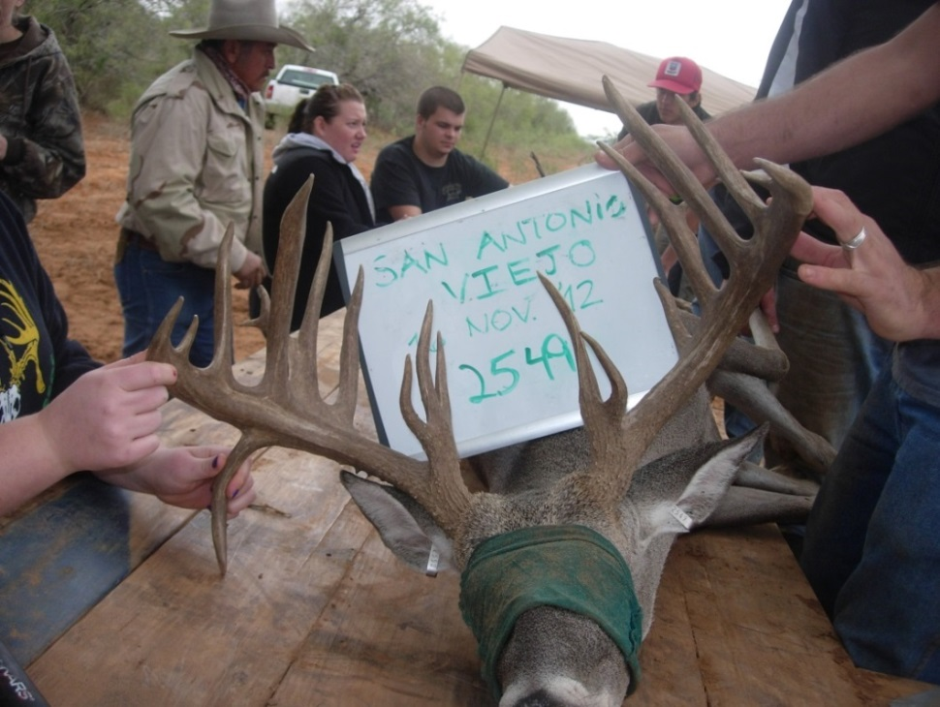
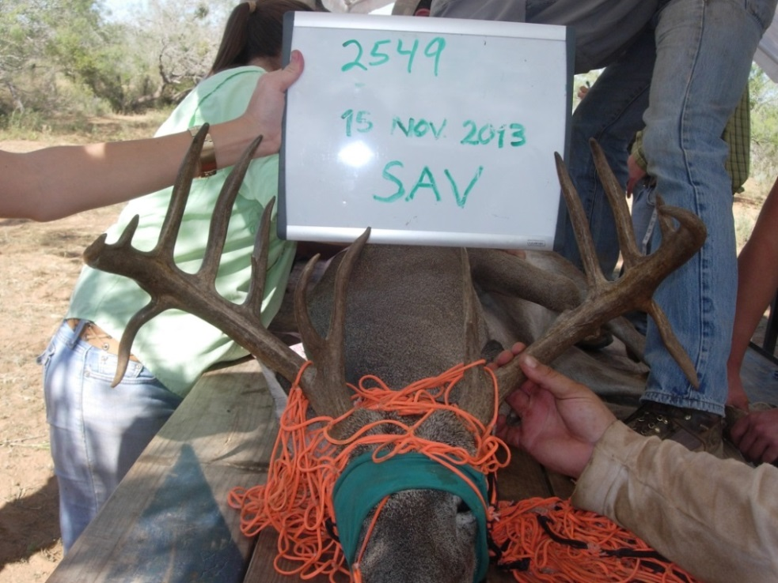
Questions
What is the effect of variability of soils on:
Body size
Antler size
Is there variation at the ranch scale?
Notes:
Use results to determine implications for harvest

Slide 12
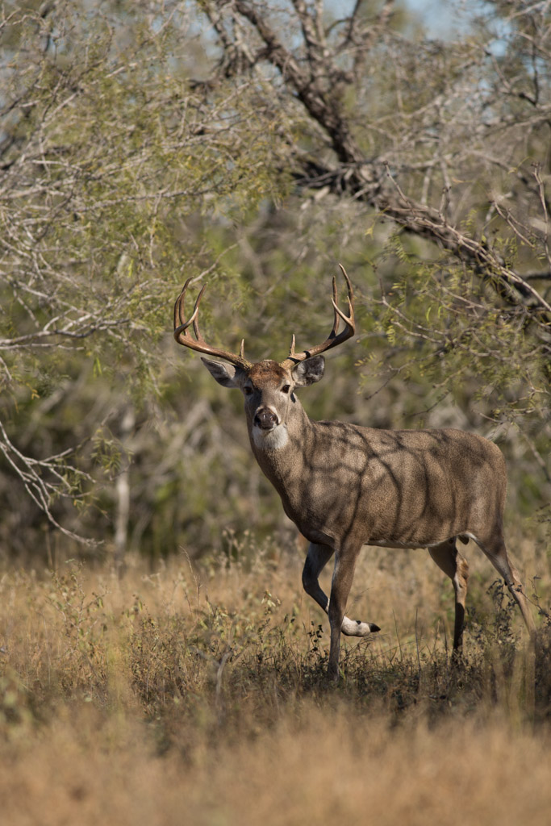
The East Foundation
Private Operating Foundation established from the estate of Robert C. East.
Mission to support wildlife conservation and other public benefits of ranching and private land stewardship.
Working cattle ranches owned by the East family since 1912, about 5,000 mother cows; no hunting or management of wildlife.
Notes:
Study conducted as part of the East Foundations research program

Slide 13
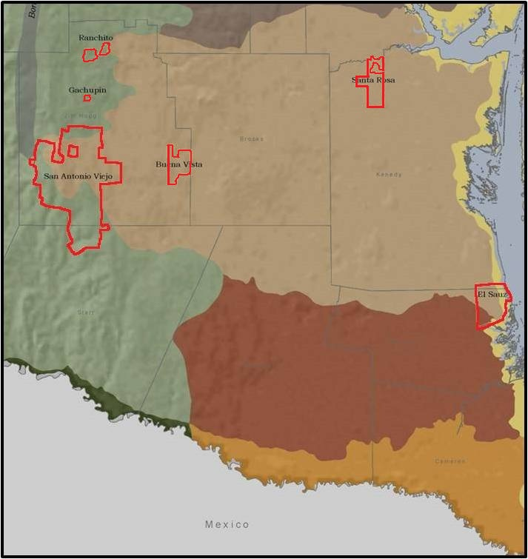
Landholdings
215,000 acres of South Texas Native Rangelands
Santa Rosa
Buena Vista
San Antonio Viejo
El Sauz
Notes:
ES – 11,082 ha
SR – 7,472 ha
BV – 6,109 ha
SAV – 60,179 ha
Deer unmanaged, cattle grazing
Consistant management across ranches

Slide 14
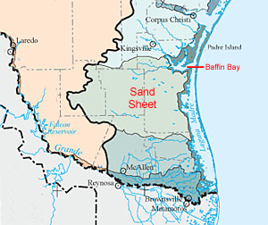
Productivity on Rangelands
Productivity varies spatially…..
Gradients of
Precipitation
Soil fertility
Precipitation
Lower
Higher
Sandy areas:
lower fertility
Notes:
Both precipitation and soil fertility can influence the nutritional quality of forages consumed by white-tailed deer
South Texas Sand Sheet - an area of deep, coarse textured, sandy soils and active sand dunes, nutrient poor soils
- Low moisture retention, leached of nutrients like N, P, and Ca
Quality of habitat can vary within a region, resulting in productivity differences
75 cm on east coast
50 cm inland

Slide 15
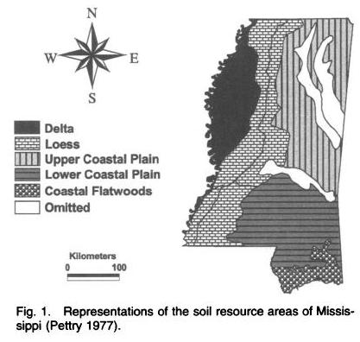
Strickland and Demarais 2000
Notes:
Strickland and Demarais
Harvest data from 247,000 deer harvested in Mississippi
Soil fertility affected growth rates of deer in Mississippi
Deer stop growing at an earlier age in the coastal flatwoods
Mature deer had 25% greater body weights and antler size in the delta than areas with poorer soil fertility

Slide 16
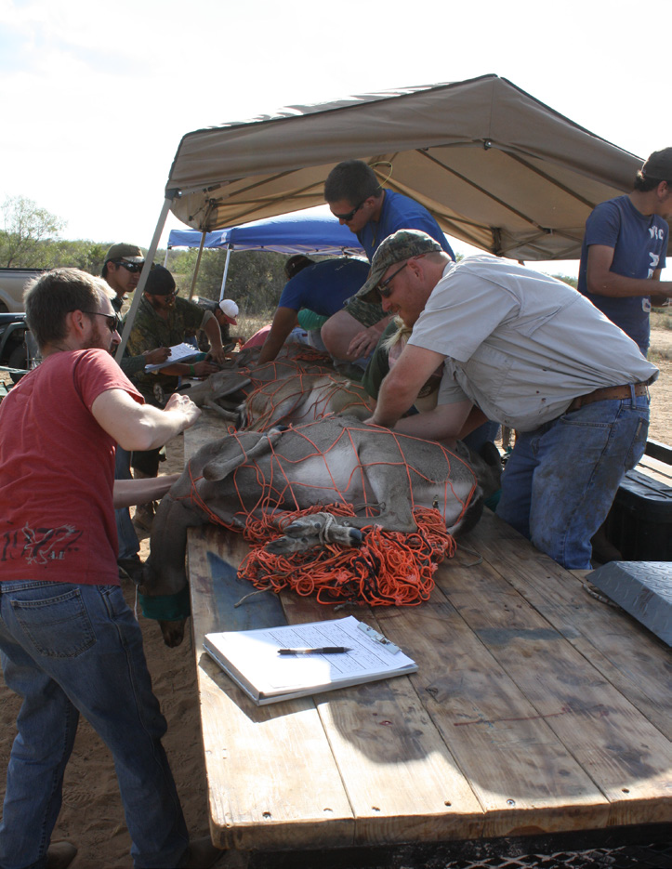
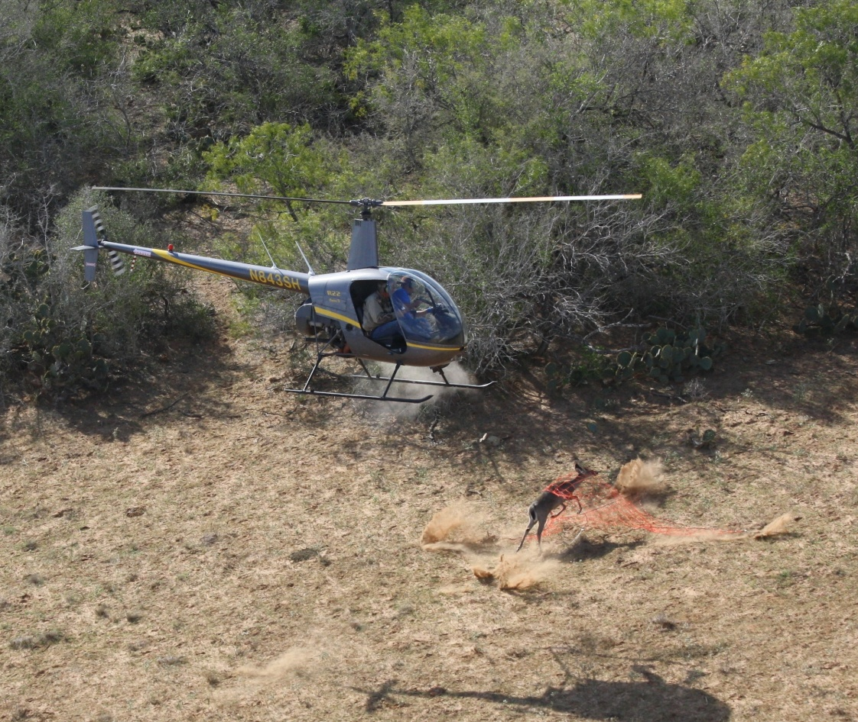
Methods
Captured deer Oct. – Nov. 2011 – 2014
All deer are taken to a central location
Metal ID tags
Age estimated
Body weight
Antler measurements
Photo by Poncho Ortega
Photo by Poncho Ortega
Notes:
Standing crop vs. harvest distribution
Cross section of natural population, not depending on harvest data

Slide 17
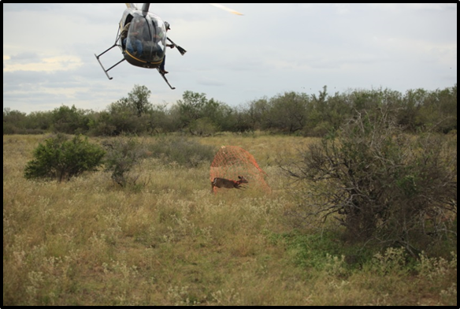
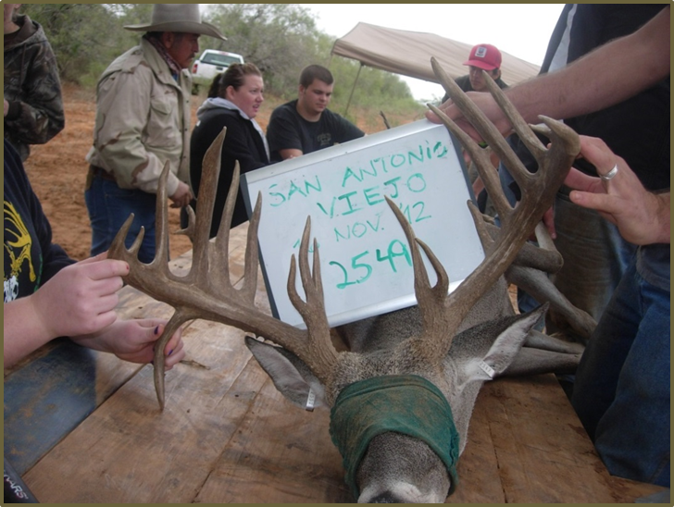
Results
El Sauz – 711 Deer
Santa Rosa – 413 Deer
Buena Vista – 623 Deer
San Antonio Viejo – 1,029 Deer
Notes:
2,776 deer total

Slide 18
P < 0.01
12 lbs
Notes:
Average body mass of females varied among ranches by age class (P < 0.01).
Middle aged and mature females 12% greater on SAV
SAV 11-12 lbs greater than ES
SAV 6-9 lbs greater than BV

Slide 19
Notes:
Average body mass of males varied among ranches by age class (P < 0.01).
Middle aged and mature males 17-22% greater on SAV
SAV 30 lbs greater than ES
SAV 12-16 lbs greater than BV

Slide 20
Notes:
Antler size of males showed a similar trend to body mass and varied among ranches by age class (P = 0.09), with middle aged and mature males on the western-most property having a 9−17% greater Gross Boone and Crockett score than males on the coastal property.
SAV 11-18 in greater than ES
SAV 10-12 in greater than BV

Slide 21
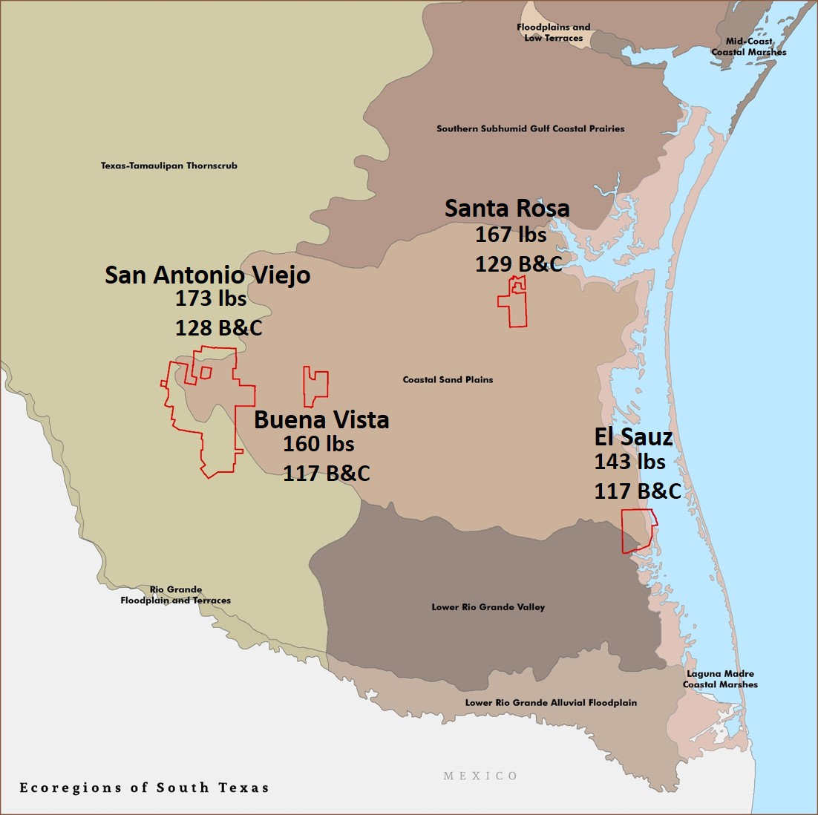
Body Mass and Antler Size
Middle aged and mature deer – Moderate east-west gradation.
Fawns and yearlings – Similar across sites
What about the middle sites?
Is this a problem of scale?
Jones et al. 2010
Population phenotype not fixed within soil region
Site-specific soil and forage variables can influence body and antler size
Notes:
But not younger deer……early growth rates are similar, but growth decreases at an earlier age along the coast.
Particularly mineral availability

Slide 22
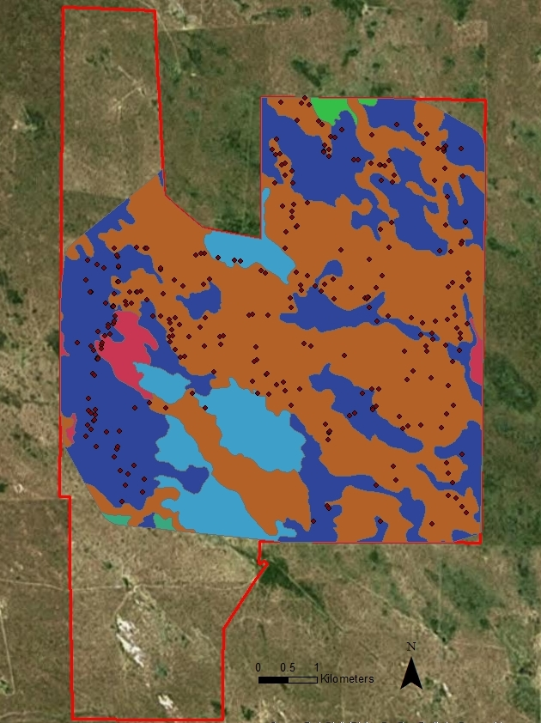
Local Soil Parameters
NRCS Web Soil Survey
Soil associations
Surface texture
Percent sand
Totaled by capture area
3 Models
Model 1 – % of site with sandy loam or clay loam
Model 2 – % of site with > 70% sand
Model 3 – % of site with > 80% sand
Notes:
Assess the relation between soil physical properties and deer morphology
MCP around capture points
400 m buffer to account for deer movement by helicopter
Clip at property boundaries
Overlayed with NRCS soill associations

Slide 23
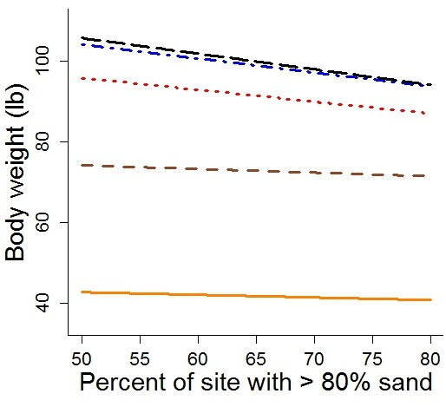
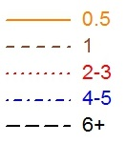
Female Body Weight
P < 0.01
R² = 0.74
Slope
- 0.39 lbs
- 0.35 lbs
- 0.29 lbs
Age Class

Slide 24
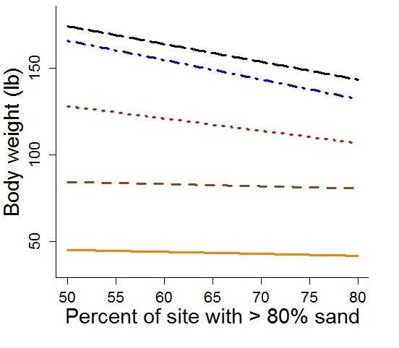
Male Body Weight
P < 0.01
R² = 0.85
Slope
- 1.03 lbs
- 1.13 lbs
- 0.71 lbs
Age Class

Slide 25
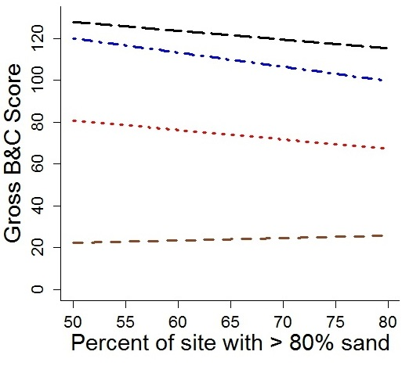
Gross Boone & Crockett Score
P < 0.01
R² = 0.78
Slope
- 0.42 pts
- 0.68 pts
- 0.45 pts
Age Class

Slide 26
Discussion
Significant variation in deer body and antler size across southern Texas.
Deer morphology is not fixed within an ecoregion and may be influenced by site-specific soil variables.
Nutrition vs. Genetics

Slide 27
Buena Vista
San Antonio Viejo

Slide 28
Management Implications
Differences in soil fertility could impact the efficiency of management programs
Length of time to achieve results
Absolute results
Understanding potential site specific limitations may limit unrealistic expectations
Notes:
Another example of how soils play a role in growing big bucks can be seen in the famed “Golden Triangle” region of the Western Rio Grande Plains. This area, which
runs west from Eagle Pass to Cotulla, and south to Laredo, grows some of the biggest bucks in the country. Bucks in this region are not genetically predisposed to being big; they are big because of the high quality, red, sandy loam soils that are found in much of this region. But even within this region, I am sure there are local areas where soil quality is lacking, and thus a limiting factor for growing big bucks.

Slide 29
Financial Contributors
The East Foundation
Caesar Kleberg Wildlife Research Institute
Houston Safari Club
South Texas Chapter of the Quail Coalition
Rene Barrientos Educational Assistance Fund

Slide 30
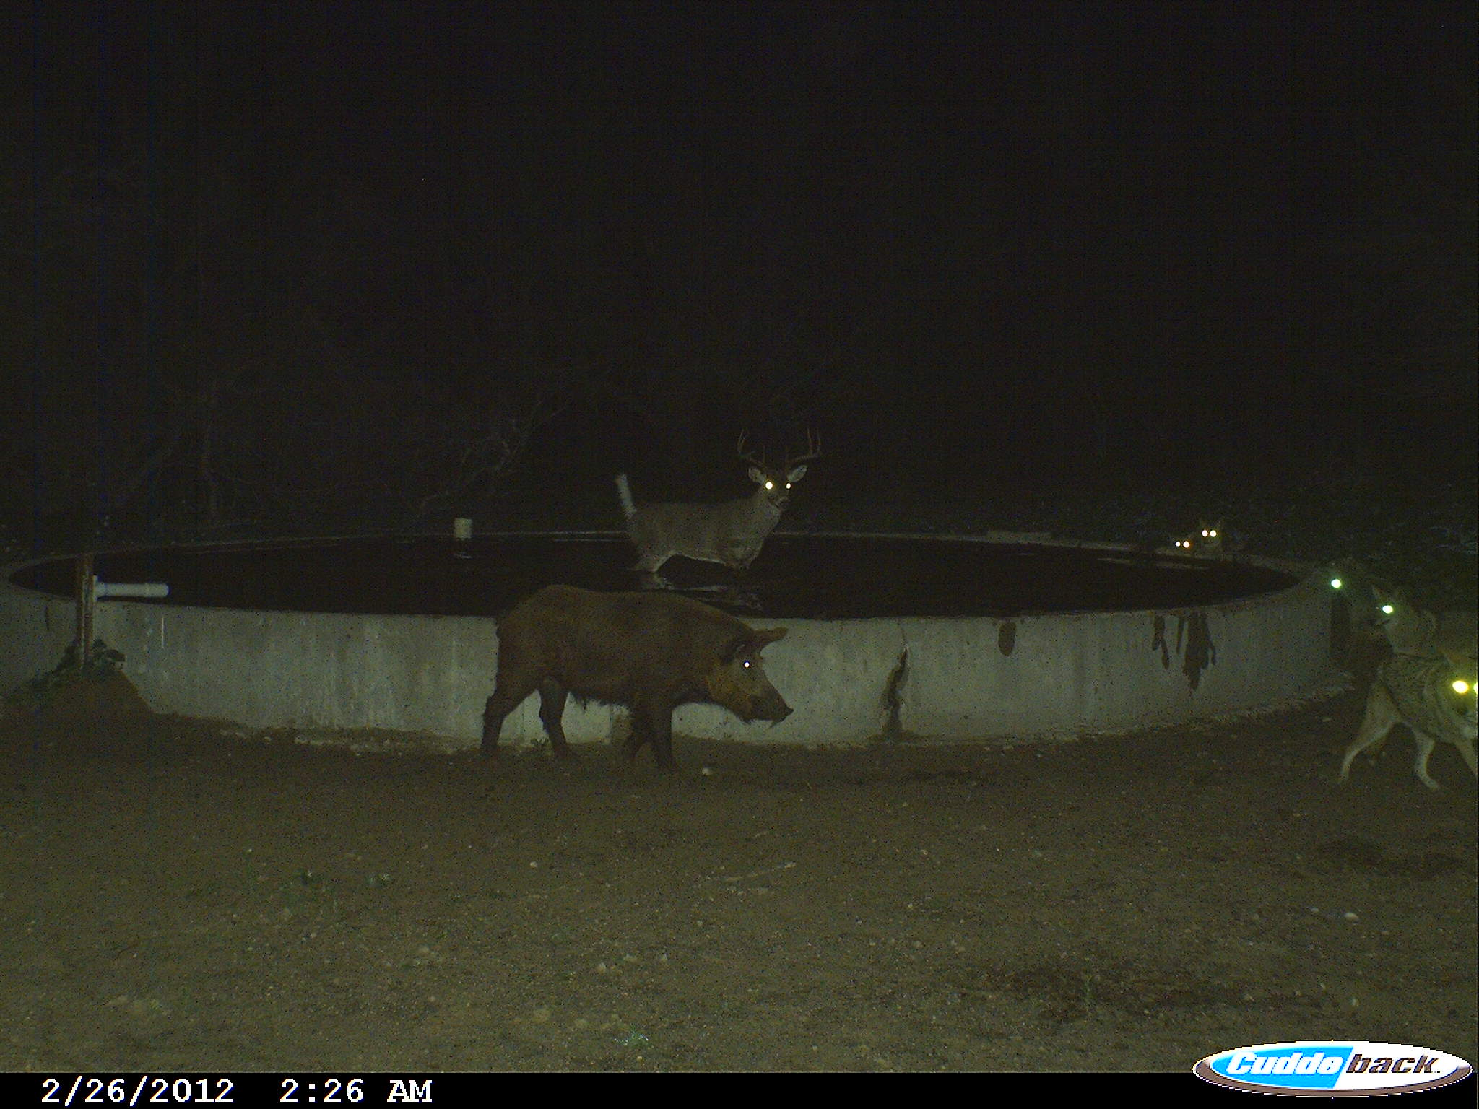
Literature Cited
Jones, P. D., B. K. Strickland, S. Demarais, B. J. Rude, S. L. Edwards, and J. P. Muir. 2010. Soils and forage quality as predictors of white-tailed deer Odocoileus virginianus morphometrics. Wildlife Biology, 16: 430-439.
Strickland, B.K. and S. Demarais. 2000. Age and regional differences in antlers and mass of white-tailed deer. Journal of Wildlife Management 64: 903-911.

