Slide 1


Chasing the Cause of Extreme Variation in Body and Antler Size in Mississippi:
Genetics vs Nutrition
Steve Demarais
Notes:
Lots of regional variation in important physical characteristics. We had biological hypotheses that could explain it, represented by the dots. But we didn’t have any smoking guns.

Slide 2
Regional Antler Size Variation @ 5+ Years
(Harvested Bucks)
20“
Delta
Loess
LCP
Coast
(Strickland and Demarais 2000)

Slide 3
Regional Body Size Variation @ 4 Years
(Harvested Bucks)
44 lb
Delta
Loess
LCP
(Strickland and Demarais 2000)

Slide 4
Cause of Regional Differences??
Plant
Quality
Deer
Morphology
Land Use
Soil Quality
Nutrition
Notes:
4

Slide 5
Nutrition & Antler Development
B&C Antler Score
120
16% Protein Diet
100
80
Antler Score
8% Protein Diet
60
40
20
0
1.5
2.5
3.5
4.5
Age (Years)
Adapted from Harmel et al. 1979
Notes:
20 inch difference in antler size related to diet quality.

Slide 6
Plant
Quality
Deer
Morphology
Land Use
Soil Quality?
Notes:
For example, when we look at differences in body weight, we know we have about a 41 pound difference between a three-year-old Delta and LCP buck. We see a similar pattern when looking at antler score with there being about a 25 inch difference between a three-year-old Delta and LCP buck. So hunters from the LCP region are frustrated with these huge differences in body and antler size.
6

Slide 7
Regional Variation in Soil Phosphorus
A
B
B

Slide 8
Regional Variation in Soil Calcium
A
B

Slide 9
Plant
Quality?
Deer
Morphology
Land Use
Soil Quality
Notes:
For example, when we look at differences in body weight, we know we have about a 41 pound difference between a three-year-old Delta and LCP buck. We see a similar pattern when looking at antler score with there being about a 25 inch difference between a three-year-old Delta and LCP buck. So hunters from the LCP region are frustrated with these huge differences in body and antler size.
9

Slide 10
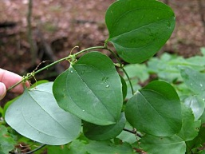
Regional Variation in Plant Quality
Spring Crude Protein - Greenbrier
Notes:
As biologists, we understand the basic relationship between forage quality and abundance and subsequent antler and body growth. We generally associate regional differences in body weight and antler size to differences in forage quality. For example, we know that the crude protein content of important deer browse species such as greenbrier vary across the state with the differences in crude protein content following the same pattern that we saw with body weight and antler size. Generally, the Delta soil region produces greenbrier with the highest percent crude protein, the LCP soil region produces greenbrier with the lowest percent crude protein and the Thin Loess soil region produces medium quality greenbrier. So to biologists, it was obvious that differences in body weight and antler size were related to differences in forage quality.

Slide 11
Regional Variation in Crude Protein
6 Deer Forages Combined
A
Percent
C
(Jones et al. 2008)

Slide 12
Plant
Quality
Deer
Morphology
Land Use?
Soil Quality
Notes:
For example, when we look at differences in body weight, we know we have about a 41 pound difference between a three-year-old Delta and LCP buck. We see a similar pattern when looking at antler score with there being about a 25 inch difference between a three-year-old Delta and LCP buck. So hunters from the LCP region are frustrated with these huge differences in body and antler size.
12

Slide 13
Antler Size
(203 Populations)
Vegetation &
Land Use
(Strickland et al. 2007)

Slide 14
Antler & Land Use Models
(n=65)
Agriculture (+)
Pines (-)
Hardwoods (-)
R² = 0.42
(Strickland et al. 2007)

Slide 15
Antler & Land Use Models
(n=45)
Agriculture (+)
Pines (-)
R² = 0.47
(Strickland et al. 2007)

Slide 16
Antler & Land Use Models
(n=17)
Pine (-)
R² = 69
(Strickland et al. 2007)

Slide 17
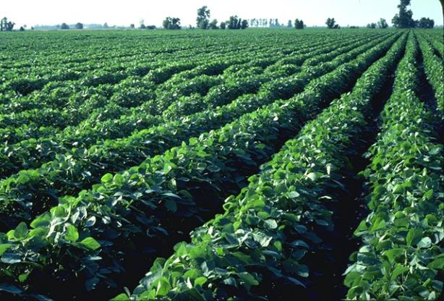
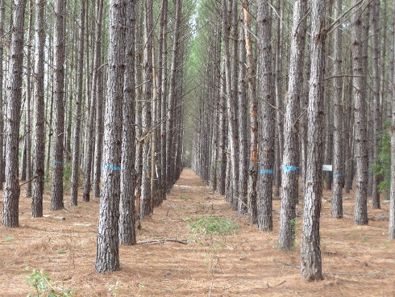
Regional Antler Variation Associated with Land Use
(Strickland et al. 2007)
Notes:
17

Slide 18
Plant
Quality
Deer
Morphology
Land Use
Soil Quality
Our Conclusion
Regional Differences
Likely Caused by
Nutritional Variation
Affecting
Expression of Genetic Potential
Notes:
For example, when we look at differences in body weight, we know we have about a 41 pound difference between a three-year-old Delta and LCP buck. We see a similar pattern when looking at antler score with there being about a 25 inch difference between a three-year-old Delta and LCP buck. So hunters from the LCP region are frustrated with these huge differences in body and antler size.
18

Slide 19
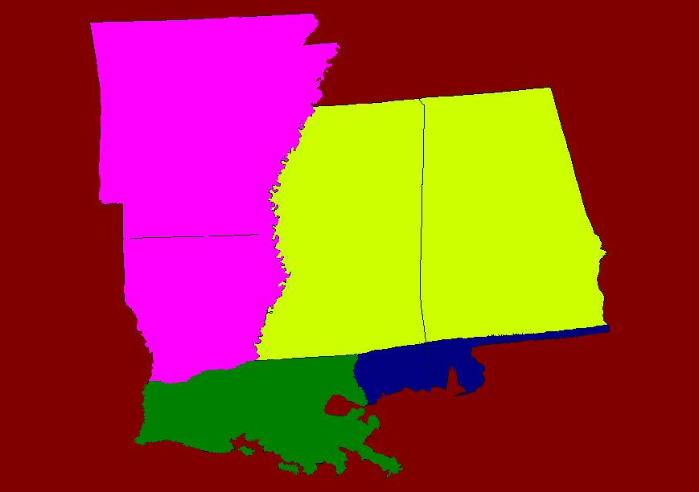
But, taxonomic classification suggests differences are real
O. v. mcilhennyi
O. v. macrourus
O. v. virginianus
O. v. osceola
Notes:
19

Slide 20
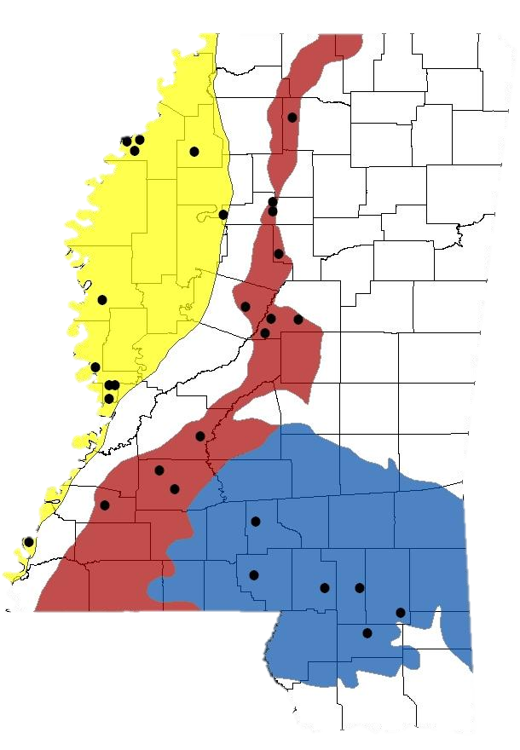
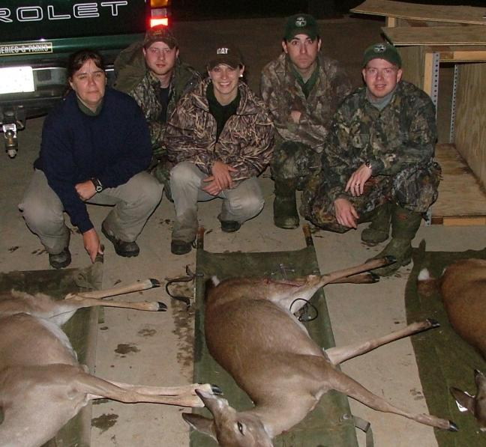
Source Populations
Bred Does and Fawns

Slide 21
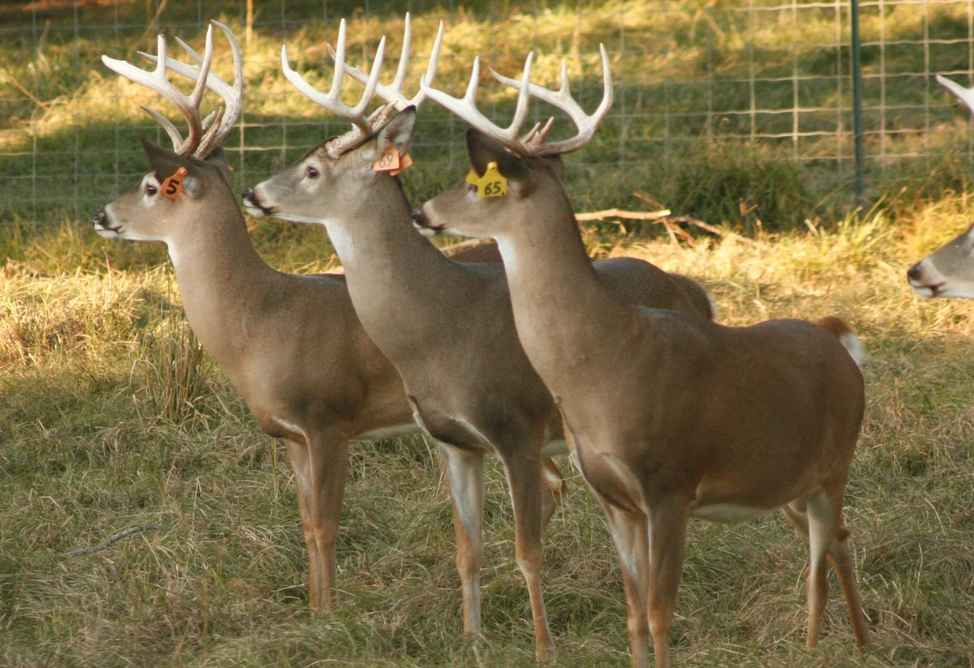
If genetic potential is the same then significant long-term nutritional improvement will allow morphological compensation

Slide 22
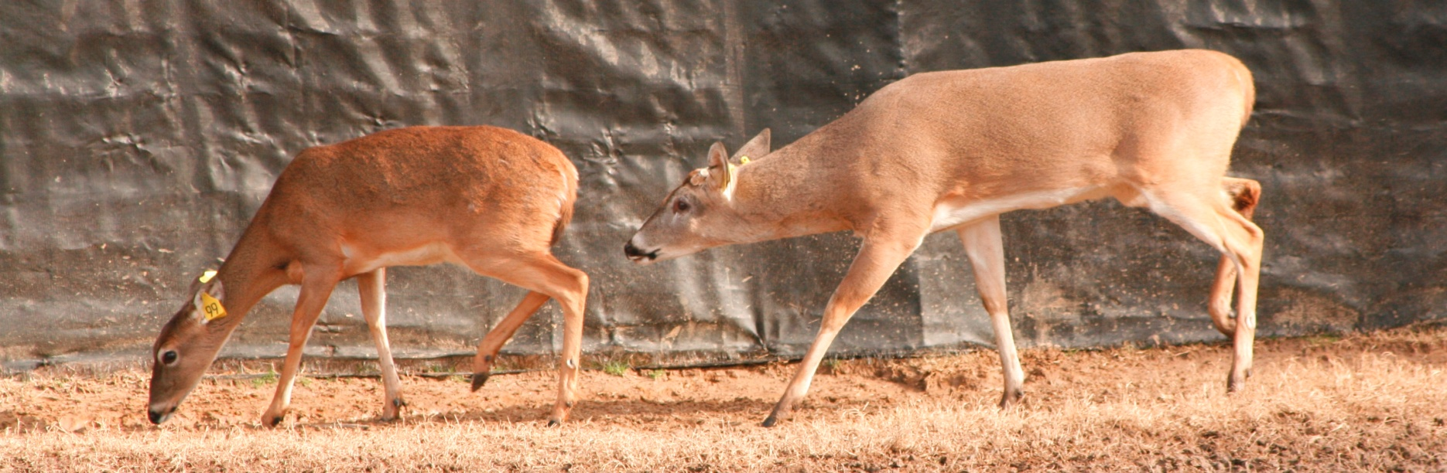
First generation (F1) – offspring of wild-raised adult deer and raised on optimum nutrition
Second Generation (F2) – offspring of F1s and raised on optimum nutrition
Notes:
22

Slide 23
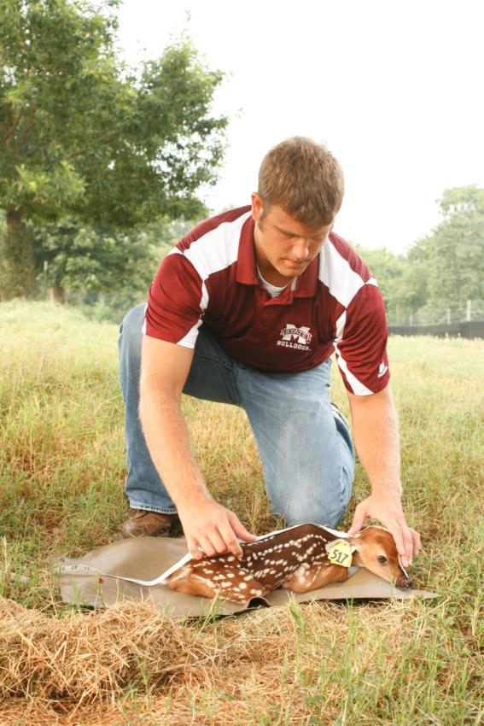
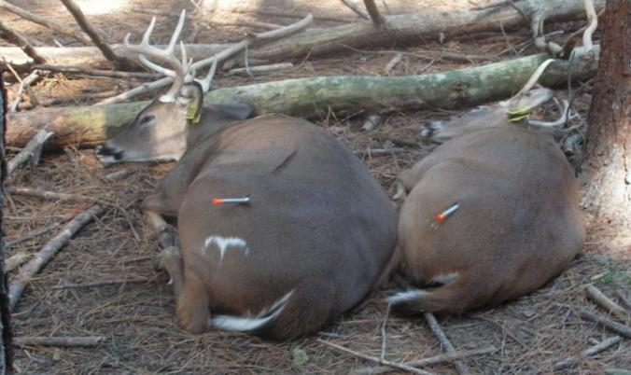
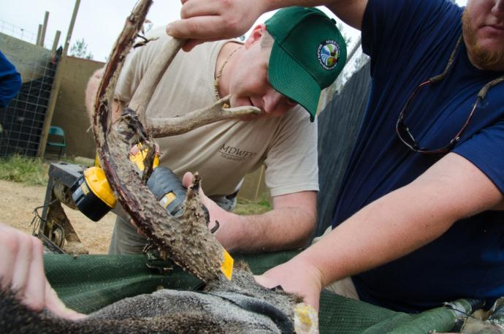
Body and Antler Data
Emily Flinn
Emily Flinn
Justin Thayer
Notes:
Each summer, MSU graduate students searched for fawns daily, and tagged and measured each fawn. Every fall, MDWFP biologists and MSU researchers sedated the bucks and took weight and antler measurements.

Slide 24
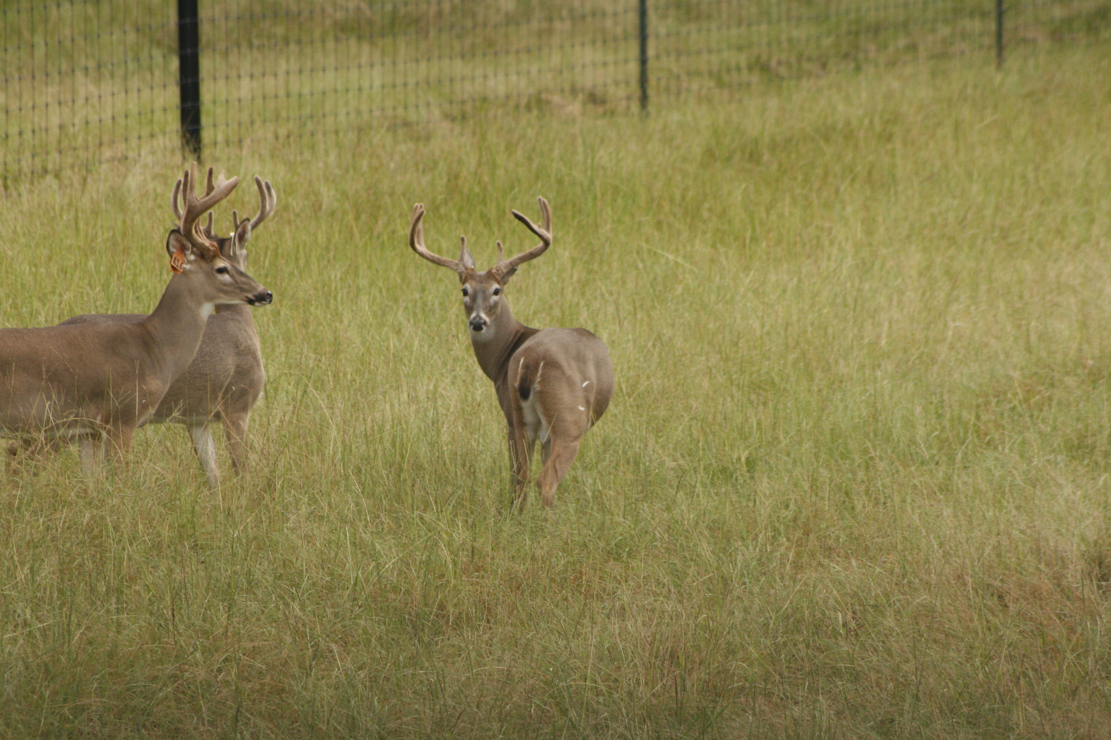
What’s the cause:
Nutrition or Genetics?
Emily Flinn
Notes:
So did we find that regional variation in body weight and antler size is due to nutritional limitations or differences in genetics?
24

Slide 25
Body Weight
At 3 years
Notes:
First, let’s look at body weight. This graph shows regional variation in body weight from DMAP data, which we’ll use as a baseline for our results.

Slide 26
Body Weight – Partial Compensation
At 3 years
+9
+9
+1
Notes:
After one generation of improved nutrition we saw substantial increases for Delta and Thin Loess bucks with both regions increasing an average of 9 pounds compared to their wild counterparts. However, we only saw about a 1 pound improvement for LCP bucks. We were expecting a larger improvement from the LCP bucks, but remember this first generation of offspring were produced from wild born adults.

Slide 27
Body Weight – Full Compensation
At 3 years
+24
+11
+35
(Michel et al. 2016)
Notes:
Now lets look at what body weight did after two generations of improved nutrition. We saw huge increases in body weight for all three regions after two generations of improved nutrition including a 35 pound increase from first to second generation for the LCP bucks. We were expecting these types of improvements from Thin Loess and LCP bucks but we weren’t expecting the 24 pound improvement from first to second generation for the Delta bucks. Remember, we were considering our Delta bucks as our gold standard to which we would compare the Thin Loess and LCP bucks to. Delta bucks already have the highest quality nutrition in the wild, so we didn’t expect much of an improvement from them; however, our results show that even Delta bucks experience some type of nutritional limitation in the wild. Our results also show that after two generations of improved nutrition, Thin Loess and LCP bucks fully compensated and are now as large as the wild harvested Delta bucks as indicated by the dashed green line.
So after one generation of improved nutrition we saw substantial improvements for Delta and Thin Loess bucks, but minimal improvements for LCP bucks. However, after two generations of improved nutrition, we saw huge increases in body weight for all three regions.
(Listed increases are improvements from first to second generation)

Slide 28
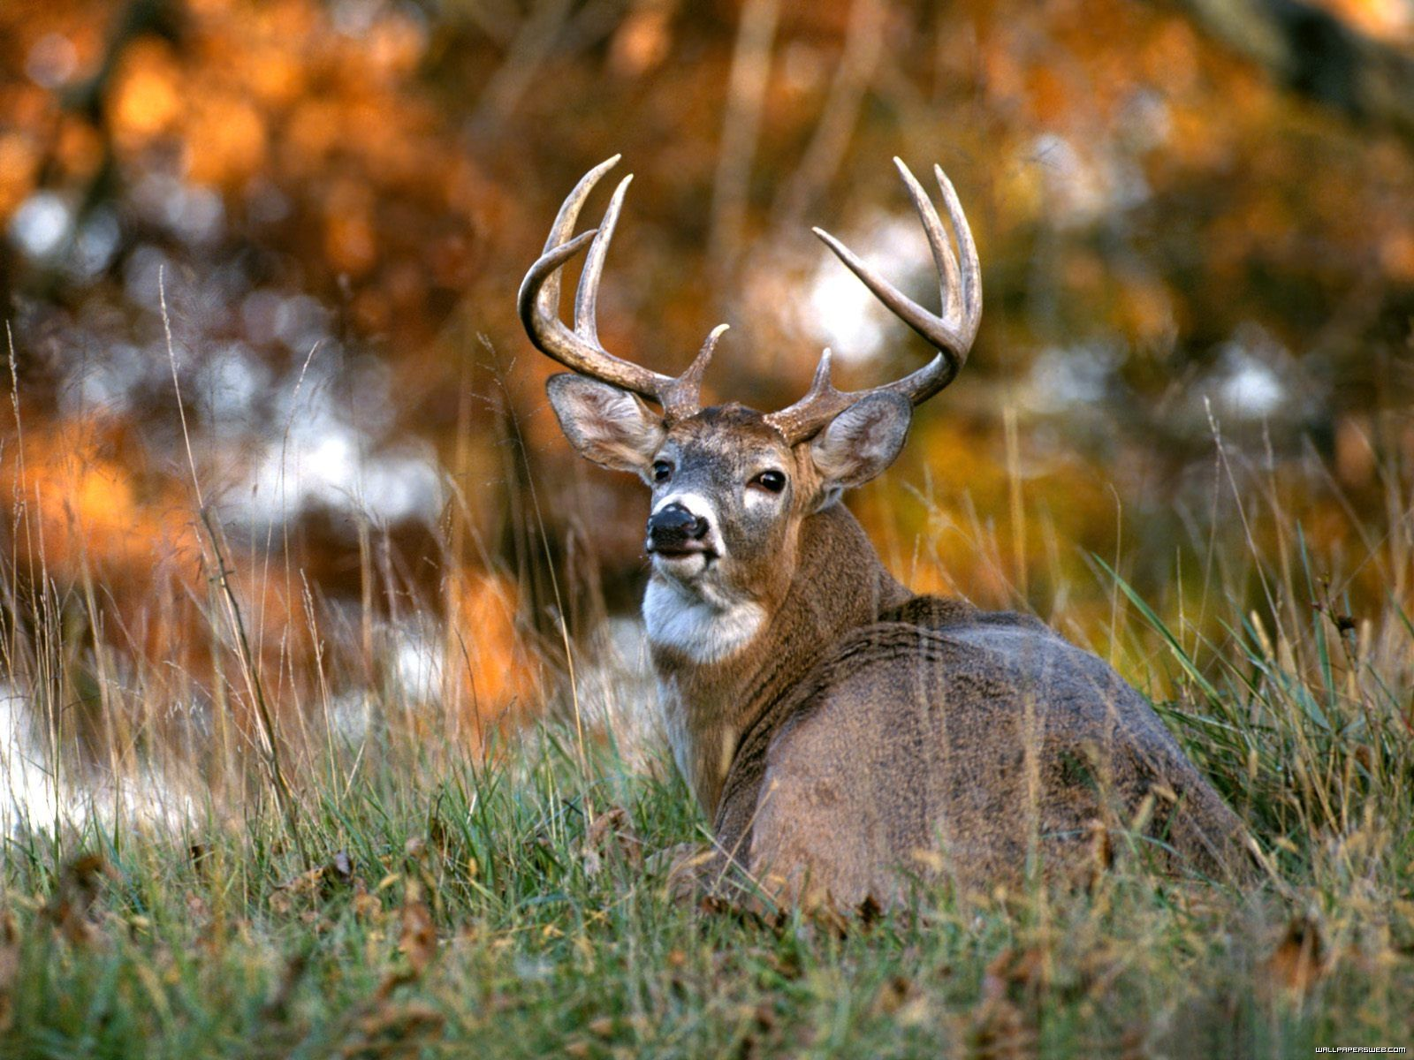
Notes:
Now lets look at what happened with antlers

Slide 29
Antler Score Comparison
At 3 years
Notes:
Again, in this graph we are looking at the same DMAP data that we showed at the beginning of the presentation and are using it for a base line for comparison to our two generations.

Slide 30
Antler Score – Partial Compensation
At 3 years
+7
+12
Notes:
After one generation of improved nutrition we saw large increases in antler size for Thin Loess (7 inches) and LCP bucks (12 inches). The 7 inch increase in the Thin Loess region was enough for us to consider that the Thin Loess bucks had fully compensated their antler size after one generation of improved nutrition as they are now as large as the Delta bucks. The LCP bucks also showed large improvements in antler size after one generation (12 inches); however, they still needed greater increases in antler size before they catch up to the Delta and Thin Loess bucks.
(If somebody asks about the slight decline in antler size in the delta region, you can explain how this could be related to hunters being more selective in the delta region and do not necessarily harvest the first legal buck they see. Whereas our results contain all bucks that meet the minimum antler restrictions (12 inch spread or 15 inch beam).

Slide 31
Antler Score – Full Compensation
At 3 years
+10
+4
+21
(Michel et al. 2016)
Notes:
After two generations of improved nutrition we saw improvements in antler size for all three regions including an additional 21 inch improvement from first to second generation for the LCP bucks. Additionally, there is no longer a difference in antler size among the three regions after two generations of improved nutrition as indicated by the dashed green line. Antler size is seemingly sensitive to changes in nutrition as we saw large increases after only one generation of improved nutrition. However, it still took two generations of improved nutrition for the LCP bucks to produce antlers as large as the Delta and Thin Loess bucks.
(Listed improvements are from first to second generation)

Slide 32
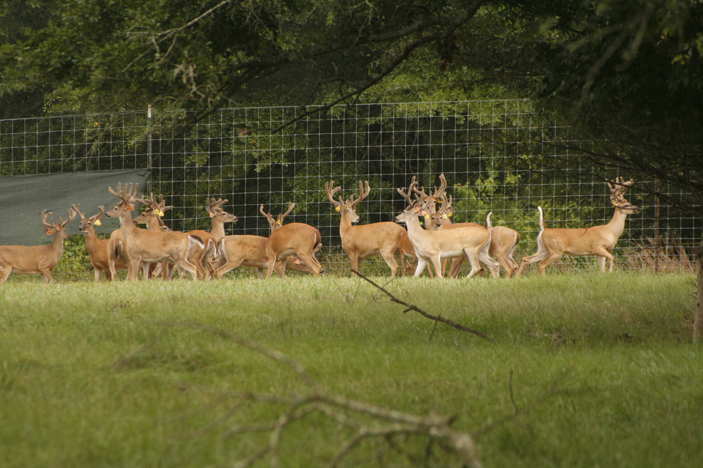
Antler Size and Body Weight Summary
Full compensation when nutrition was not limiting!
Differences in wild due to nutrition NOT genetics!
What is the upper limit of MS deer?
Emily Flinn
Notes:
Let’s summarize what we found. We saw full compensation of antler and body size from Thin Loess and LCP bucks after we provided them with high-quality nutrition for two generations. So we know that the differences that we see in the wild are due to differences in nutrition and NOT differences in genetics. We also saw continued increase in antler and body size across two generations, so we don’t know what our upper limit is for antler and body size here in Mississippi.

Slide 33
Implications for Ungulate Conservation?
Regional morphological variation
should not guide taxonomic designations
unless it is proven to be caused by
meaningful genetic variation

