Slide 1
Modeled impacts of CWD on white-tailed deer populations in South Texas
Aaron M. Foley, David G. Hewitt, Charles A. DeYoung,
Randy W. DeYoung, and Matthew J. Schnupp

Slide 2
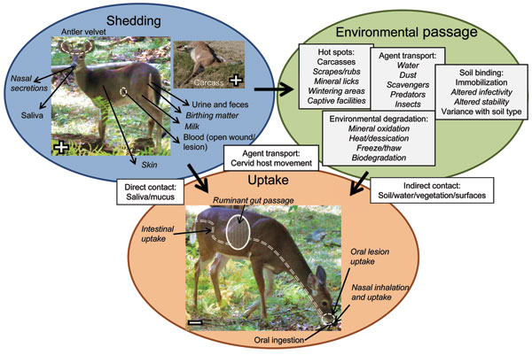
What is CWD?
Transmissible disease that affects Cervid family
Direct transmission
Deer to deer
Indirect transmission
Infected deer to environment via prions
cdc.gov

Slide 3
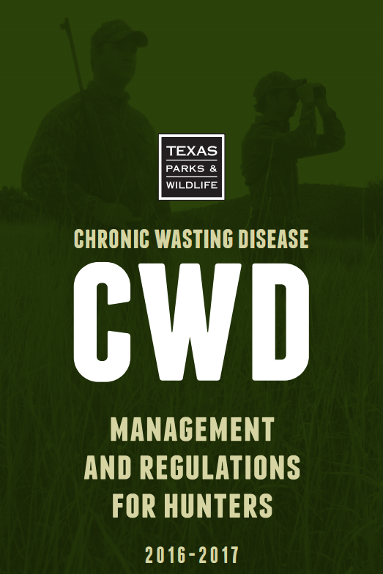
CWD in Texas
June 2015 – first case in captive WTD
Jan 25, 2017 – first case in free-ranging WTD
Concern about impacts on deer populations

Slide 4
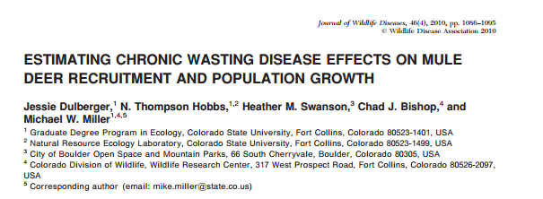
Previous CWD Population Models
WI, WY, CO
Most models predict population declines
Varying magnitude and severity

Slide 5
Why do we need another model?
WI, WY, CO
Consistent warm-cold seasons
Occasional severe winters
Productive habitat
South Texas
Variable rainfall
Frequent droughts
Marginally productive habitat

Slide 6
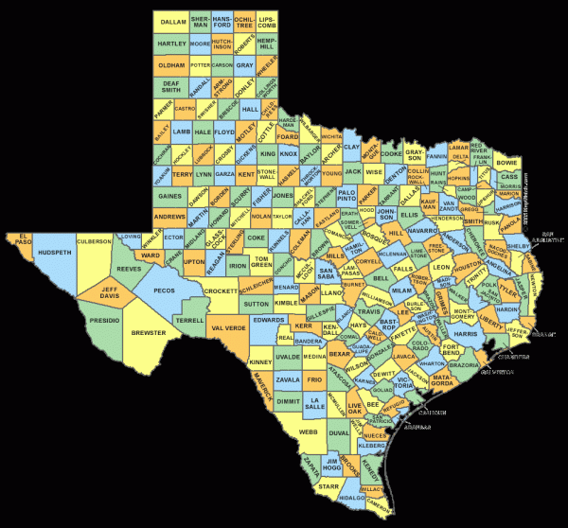
Baseline Model
55,000 ha of rangelands surveyed annually for 20 years
Portions of King Ranch in Brooks, Kleberg, and Kenedy counties
No supplemental feeding
Conservative harvest (~2% per year)

Slide 7
Model Parameters
Age- and sex-specific survival rates (S. Texas)
McCoy et al. 2005, Webb et al. 2007, DeYoung et al. 2008, Cook 2014
Harvest rates (empirical)
Fawn:doe ratios (empirical)

Slide 9
CWD parameters
Age- and sex-specific prevalence rates
Wisconsin; Grear et al 2006
Initial prevalence rate (1%)
CWD prevalence growth (0.26%/year)
Lowest reported rate; West Virginia; Evans et al. 2014
Mortality 1-3 years after infection
Williams et al. 2002

Slide 10
Scenarios
25-years, 1,000 sims
No harvest, no CWD
Harvest, no CWD
No harvest, CWD
Harvest, CWD

Slide 11
Results
No harvest, no CWD: 1.5% population growth/year

Slide 12
Results
No harvest, no CWD: 1.5% population growth/year
Harvest, no CWD: 2% harvest/year

Slide 13
Results
No harvest, no CWD: 1.5% population growth/year
Harvest, no CWD: 2% harvest/year
No harvest, CWD: growth rate = 0

Slide 14
Results
No harvest, no CWD: 1.5% population growth/year
Harvest, no CWD: 2% harvest/year
No harvest, CWD: growth rate = 0
Harvest, CWD: decline at 1% harvest

Slide 15
Results
No harvest, no CWD: 1.5% population growth/year
Harvest, no CWD: 2% harvest/year
No harvest, CWD: growth rate = 0
Harvest, CWD: decline at 1% harvest
Harvest limited to males = no decline but…

Slide 16
Fewer mature males in population even with light harvest
CWD prevalence increases with age in males

Slide 17
Comparison
Why S. Texas decline with only 1% harvest?
Other CWD states have higher harvest rates
Added fawn:doe ratios from 3 CWD areas into model

Slide 18
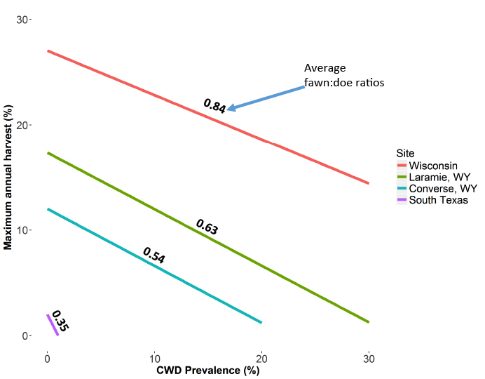

Slide 19
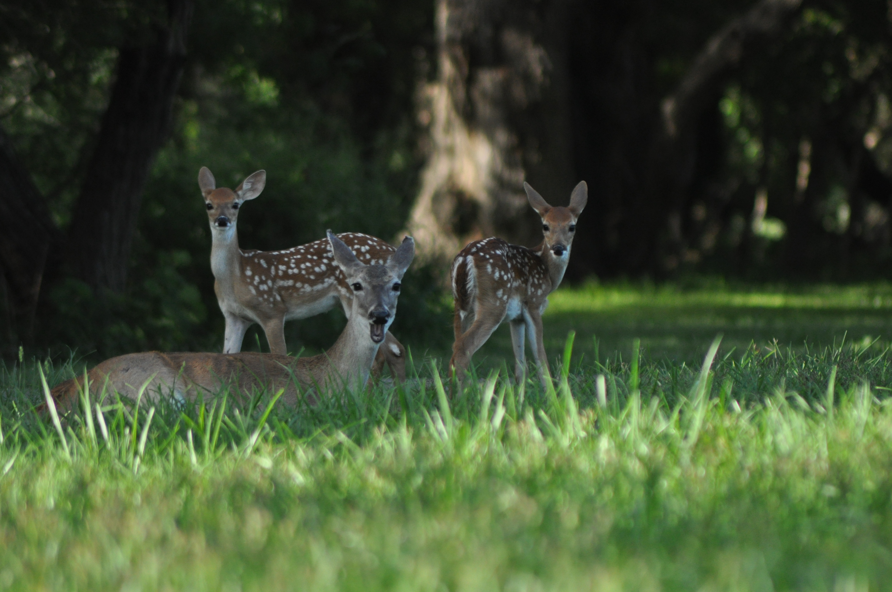
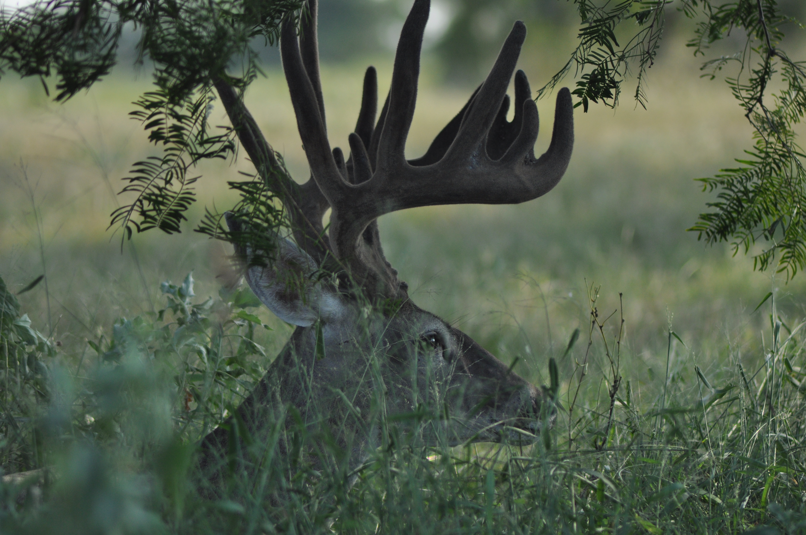
Implications
CWD = less harvest opportunities
Protect females for fawn recruitment
Fewer mature bucks in population

Slide 20
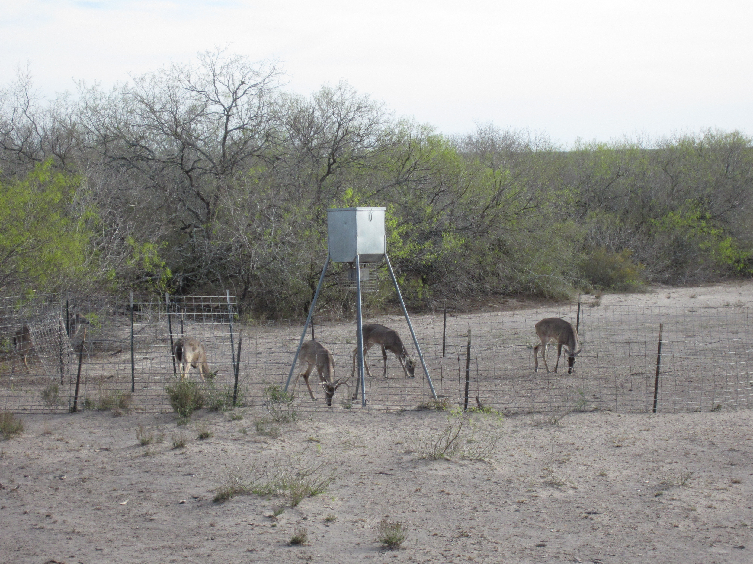
Impact of CWD on hunting in S. Texas
Change in hunting culture and deer management
Ban on bait/feed? WV, VA, MI
Congregation of deer = higher infection rate
Sorensen et al. 2014
Less intensive mgmt. = fewer hunters?

Slide 21
Impact of CWD on hunting in S. Texas
Economic impacts
Reduced money to landowners and rural economies
Private lands switch to alternative sources of income?
Not as beneficial for ecosystem as cattle-wildlife programs

Slide 22
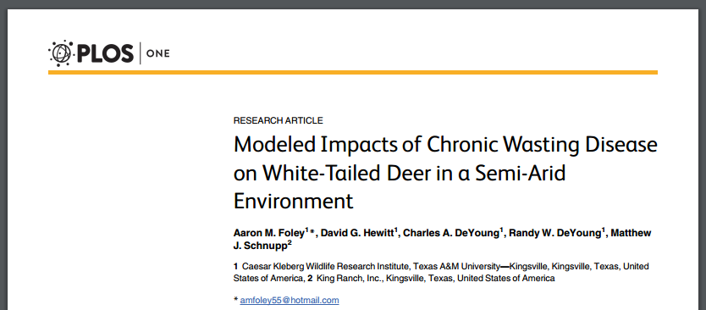
Acknowledgments Available online
doi:10.1371/journal. pone.0163592

