Slide 1
The East-West Yana Project
A Deer Data Gold Mine

Slide 2
The East-West Project Overview
Two 1,100 acre pastures on the Faith Ranch.
Nutrition held constant across both pastures:
100 acres per feeder
Water at every feeder
East Yana (the Control Pasture):
Fed but no culling or other manipulation
West Yana (the Treatment Pasture):
TOTAL cleanout of ALL deer
Repopulated with Faith does and bucks in DMP pens

Slide 3
The East-West Yana Project
Protein
Feeders
West Yana Pasture
1,100 Acres
Water
Troughs
East Yana Pasture
1,100 Acres
Nutrition held constant across both pastures.

Slide 4
The East-West Project Overview
Study began in 2007; oldest bucks are 8 ½ years old.
Methodology:
Annual fawn buck capture to determine age with certainty:
We tag all DMP bucks fawns in West Yana each year.
We capture and tag buck fawns in East Yana each year.
The result is a dataset of KNOWN AGE bucks.
Annual buck capture:
We capture ALL tagged bucks we can find with a helicopter in both pastures and record:
Antler measurements.
Weight.
Body characteristics
We shoot ALL untagged bucks.
But tagged bucks are data: they will never get shot.

Slide 5
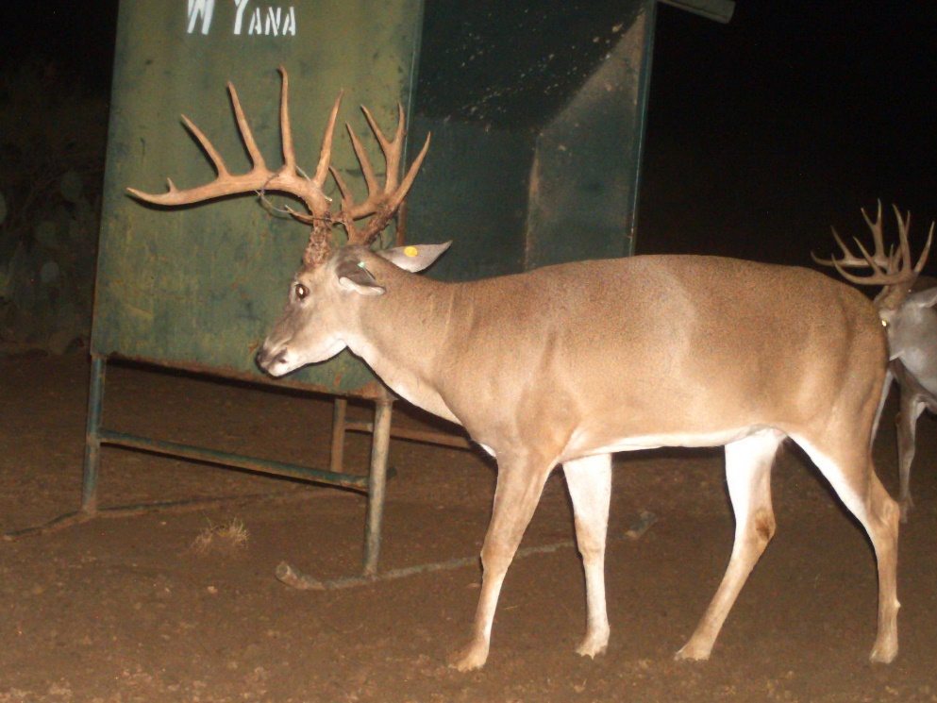
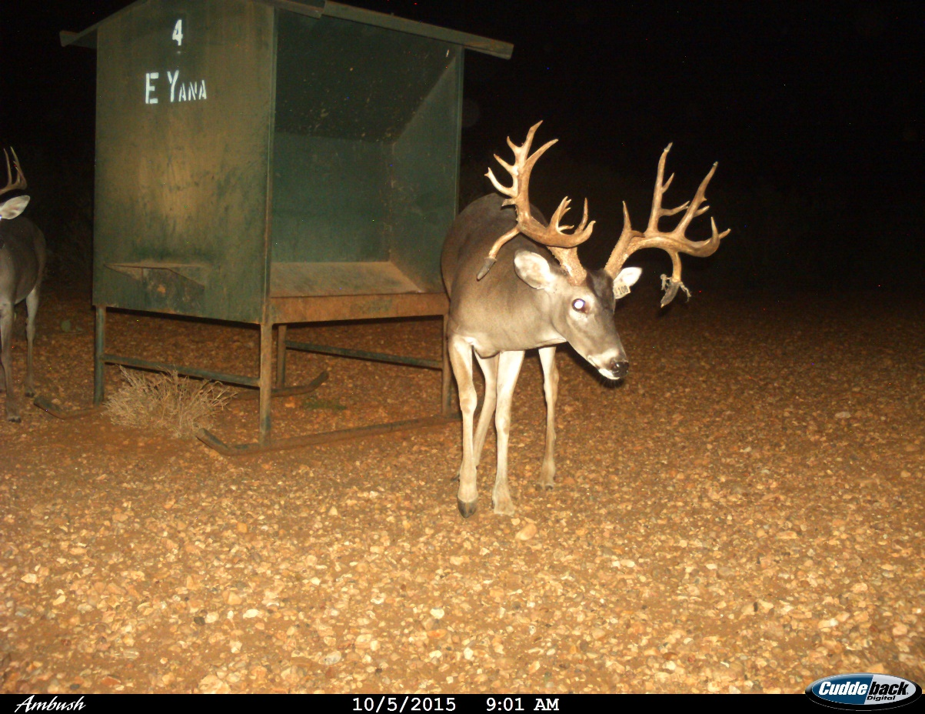
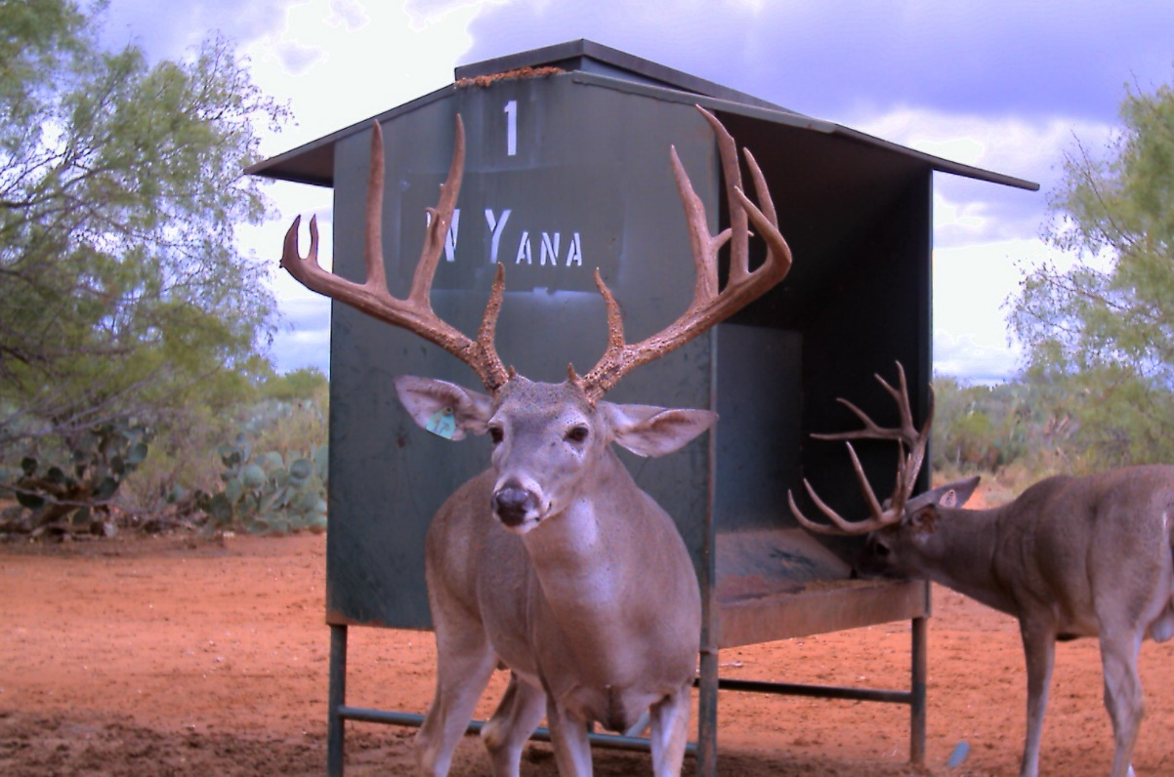
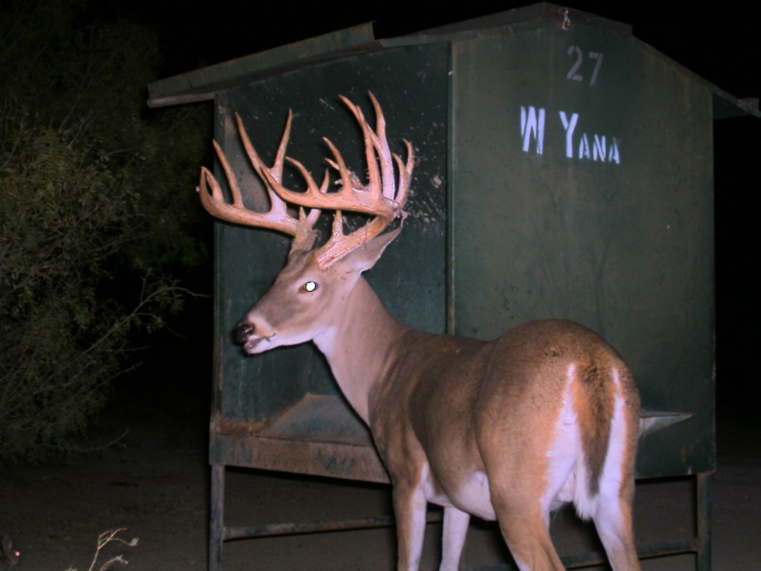
Examples of Bucks with tags—i.e. data that never gets shot

Slide 6
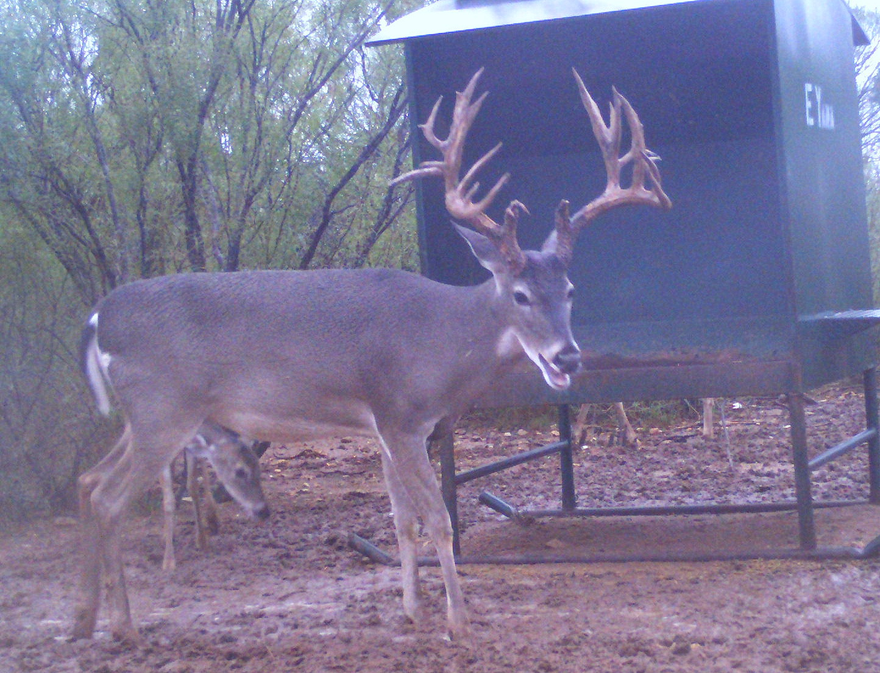
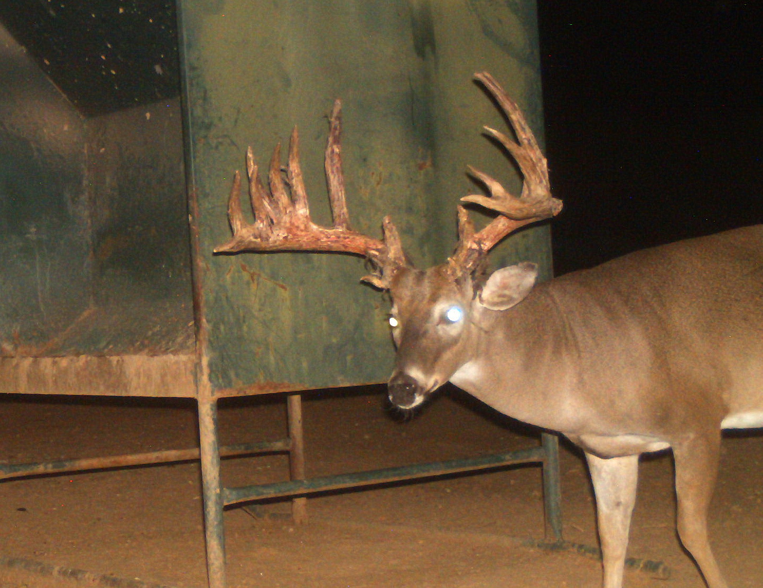
Examples of Untagged Bucks that Escaped Early Harvest: These are not data and they will be shot!!!
“Zeus”
“New Freakin
Monster”

Slide 7
The East-West Project Overview
Why is this growing dataset so special?
All of the bucks are known-age bucks captured (and therefore aged) as fawns.
We take full antler measurements on each buck.
We record and measure variety of physical traits.
Both East and West Yana are high fenced and supplementally fed--data that most deer managers find relevant.
The study will continue for a long time.
How long?
Perhaps until we start seeing most of the older bucks die.

Slide 8
A Rich Dataset of known age bucks: Questions we will be able to answer
Does total cleanout and DMP manipulation produce bigger deer?
What is the bell curve of mature antler scores on fed pastures versus unfed pastures?
What percent of 170+ bucks (e.g.) should you expect in a fed deer herd?
Should you harvest spikes? Or 3-point yearlings?
Should you harvest 2 ½, 3 ½, and 4 ½ year old bucks? Which ones?
At what age do deer antlers peak? 5 ½, 6 ½, 7 ½, 8 ½…?
How does rainfall influence antler size in a fed environment?
Does antler size always jump from 4 ½ to 5 ½ and can you use this jump as precise determinant of age?
Do super old deer explode in antler size because they stop using energy for breeding?

Slide 9
A Rich Dataset of known age bucks: Questions we will be able to answer
What is deer mortality with supplemental feed?
Are there physical features of a deer—a Roman nose or stomach girth, e.g.—that can be used to determine age on the hoof.
Can tracking deer from year to year help a manager determine age? With what precision?
Can feed consumption be used to determine deer numbers?
Paternity and which bucks breed.
Is there evidence of epigenetic change over time:
In antler sizes of the unmanipulated bucks (East Yana).
In the body weight of the West Yana bucks.

Slide 10
A Rich Dataset of known age bucks: Questions we will be able to answer
MY PREDICITON:
Someone will get their Ph.D. from the analysis of this dataset.
Or at least a couple of students will get their masters degrees.
Meantime, we can share with you some results that the dataset has already revealed.

Slide 11
The East-West Yana project: Acknowledgements
Matt Moore, the Faith Ranch biologist, who does all of the work:
He organizes the captures.
He records and enters the data.
And he looks at thousands of photos to determine population and mortality.
He makes sure the feeders are filled.
Wack Ezell, the Faith Ranch manager:
He keeps the ranch running while research is being conducted.
Charlie DeYoung, Ph.D.:
His encouragement and support was critical in making the project a reality.
R.J. Hegedus, Stedman West Interests, Inc. IT Manager:
R.J.’s analysis and sorting of the data in response to my questions made the dataset come alive with meaning.

Slide 12
A work in Progress
Matt and I will present some interesting data today.
But our findings are preliminary because the study will continue.
The sample sizes will increase.
The inferences from the data will be more and more valid.
Surprises will occur.
And it will explore the unknown world of known age very old bucks in native pasture.
What you see today will continue to evolve.

Slide 13
The Topics today
Does total pasture cleanout and DMP pens work: antler sizes in the Treatment (West Yana) v. Control (East Yana).
A comparison of antler sizes in an unmanipulated, fed pasture (East Yana) with an unfed South Texas deer herd.
Mortality (and its corollary, survival) of bucks on feed at various ages.
Should you shoot spikes and can we identify culls at 2 ½, 3 ½, and 4 ½ years old?
Are there physical characteristics of bucks that indicate age on the hoof? Roman noses? Stomach girth? Neck size?
If not, is there a better way to determine age on the hoof?

