Slide 1
The East-West Yana Project: Part 1: Does a Total Cleanout of a Pasture and the Use of DMPs Produce Bigger Antlers? and Part 2: The Enormous Power of Supplemental Feed

Slide 2
The Origin of the East-West Yana Project
In SE Toro Pasture (adjacent to East-West Yana):
Eliminated all bucks and used DMP pens to populate the pasture.
Increased feeder density to 1 feeder per 100 acres.
Water at every feeder.
Result: more big deer than we ever thought possible.
Was it genetic manipulation (cleanout and DMP pens)? OR
Was it nutrition (100 acres/ feeder) and water at each feeder?
I wanted to do it again.
And I wanted to answer the question: genetic manipulation or nutrition?
I also new that culling with a rifle is an exercise in futility, so I wanted to expand the cleanout and DMP method.

Slide 3
The Origin of the East-West Yana Project
So the East-West Yana Project started because:
Evidence in Southeast Toro that a cleanout of bucks and DMPs produced huge bucks.
A realization that the huge bucks might have resulted from high feeder density.
And the knowledge that culling (with a rifle) for genetic change is an exercise in futility.

Slide 4
The East-West Yana Project: The Current Sample Size
Age Class | Number of East Yana Bucks | Number of West Yana Bucks
1.5 | 101 | 138
2.5 | 94 | 115
3.5 | 65 | 80
4.5 | 59 | 54
5.5 | 41 | 33
6.5 | 30 | 23
7.5 | 16 | 13
8.5 | 6 | 6
5.5 to 8.5 | 93 | 75
Total Bucks | 412 | 462
A good sample size of mature bucks (which will get better with time).

Slide 5
THE EAST-WEST YANA PROJECT: DOES A TOTAL CLEANOUT AND THE USE DMP PENS RAISE BIGGER BUCKS THAN JUST A PASTURE ON FEED?

Slide 6
The East-West Yana Project Results
+7
+15
+21
+6
Average B&C Scores are MUCH Higher in Treatment
In All Age Classes Except Yearlings

Slide 7
The East-West Yana Project Results
+1.9
+2.5
+2.9
+2.7
Average Total Points are MUCH Higher in Treatment
In All Age Classes Except Yearlings

Slide 8
The East-West Yana Project Results
+1.7”
+3.0”
+1.0”
Average Total Mass is Noticeably Higher in Treatment
In All Age Classes Except Yearlings

Slide 9
The West-East Yana Project Results
-17
Average Body Weights are LOWER in Treatment
--An epigenetic effect, I believe, based on a intra-ranch TTT of does.

Slide 10
The West-East Yana Project Results
-7.9%
-8.3%
-4.6%
-6.2%
-4.5%
-4.6%
-5.9%
Average Body Weights are LOWER in Treatment
--An epigenetic effect, I believe, based on a intra-ranch TTT of does.

Slide 11
The East-West Yana Project Results
In Sum:
DMP manipulation in West Yana produced higher average B&C scores:
Higher in every age class except yearlings.
An average of 8.5 points higher B&C scores for all mature bucks.
DMP manipulation in West Yana produced more total points and more mass:
1.8 more total points on average for mature bucks.
1.3 more inches of mass on average for mature bucks.
Conclusion: DMP manipulation—at least after a total cleanout of deer—produces bigger antlers.

Slide 12
The East-West Yana Bell Curves

Slide 13
The East-West Yana Bell Curves

Slide 15
Is Cleanout and DMP Manipulation Worth It?
Cleanout and DMP Pens Works to Produce Bigger Antlers.
Costs (compared to fed and unmanipulated):
Annual helicopter expense
Death loss from capture myopathy
Time lost from clean out to maturity: 6 to 7 years
Stigma from some circles: “manipulation”
East v. West Yana Mature Buck (5.5+) Antler Comparison
Pasture | Character | Average B&C | Max B&C Score | Min B&C Score | Avg. Total Points | Avg. Total Mass
East Yana | -Fed -No DMP | 153.6 | 227.5 | 103.0 | 10.7 | 31.2
West Yana | -Fed -DMP | 162.1 | 212.8 | 118.6 | 12.5 | 32.5
West Yana – East Yana |  | 8.5 | -14.7 | 15.6 | 1.8 | 1.3

Slide 17
Is Cleanout and DMP Manipulation Worth It?
When manipulation might be compelling?
Deer antlers on your ranch are historically small.
Feeding will change that, but do you want to wait 6 or 7 years to find out if your base deer herd has great potential.
East v. West Yana Mature Buck (5.5+) Antler Comparison
Pasture | Character | Average B&C | Max B&C Score | Min B&C Score | Avg. Total Points | Avg. Total Mass
East Yana | -Fed -No DMP | 153.6 | 227.5 | 103.0 | 10.7 | 31.2
West Yana | -Fed -DMP | 162.1 | 212.8 | 118.6 | 12.5 | 32.5

Slide 18
Scientific Breeder Bucks
If you decide that a clean out and DMP program is worth it, do you stick with native deer or do you buy/ rent does and bucks from deer breeders?
Considerations:
What kind of deer do you start with?
Do you have identifiable DMP worthy sires on your ranch?
Does the stigma of introducing scientific breeder deer bother you?
The danger of introducing CWD to your ranch.
A personal choice, in my view.
At Faith Ranch, we have decided against it.
But we started with big bucks.
I mention it because A LOT of people are doing it.

Slide 19
Total cleanout and DMP repopulation works to grow bigger antlers.
Is it worth it? You will have to decide.
But the discussion misses an important point:
East Yana unmanipulated and fed bucks are huge!

Slide 20
The Enormous Power of Supplemental Feed
The focus of this talk so far: does manipulation (cleanout and DMP) work?
But what can get lost is the enormous power of supplemental feed.
East v. West Yana Mature Buck (5.5+) Antler Comparison Versus An Unfed Pasture
Pasture | Character | Average B&C | Max B&C Score | Min B&C Score | Avg. Total Points | Avg. Total Mass
East Yana | -Fed -No DMP | 153.6 | 227.5 | 103.0 | 10.7 | 31.2
West Yana | -Fed -DMP | 162.1 | 212.8 | 118.6 | 12.5 | 32.5
South TX Pasture | -Unfed -No DMP | 130.0 | ? | ? | ? | ?

Slide 21
The Bell Curve of Mature Buck Antlers: Based on Random Capture Data of an Unhunted Faith Ranch

Slide 23
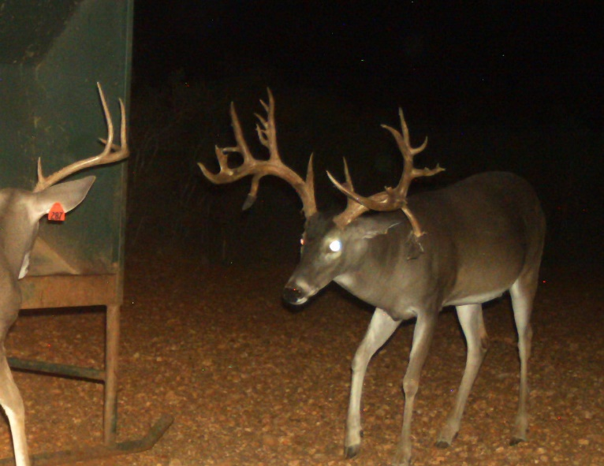
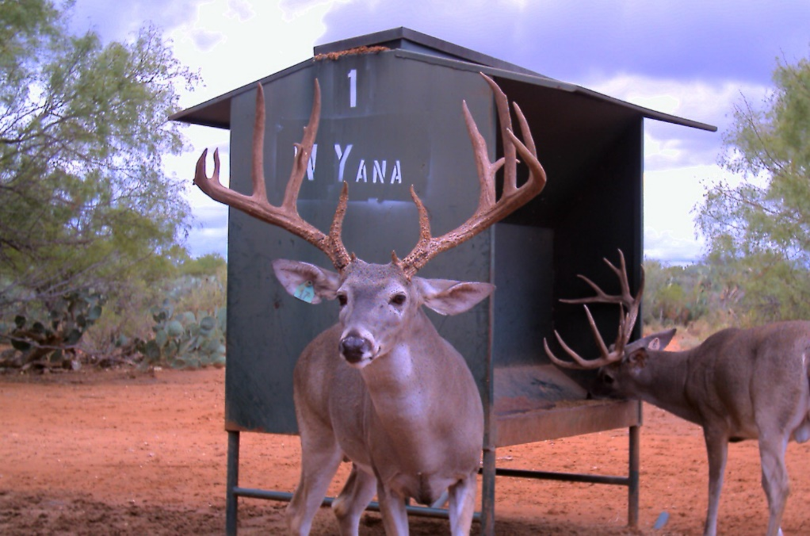
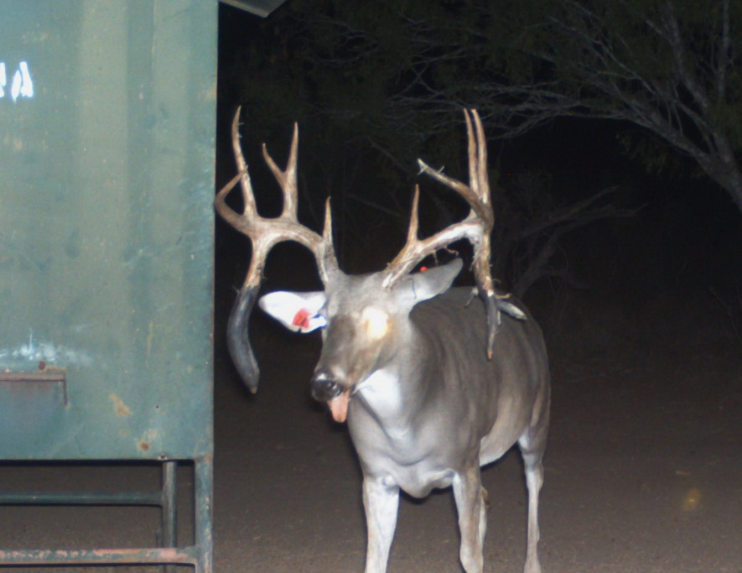
West Yana (DMP)
East Yana (Fed Only)

Slide 24
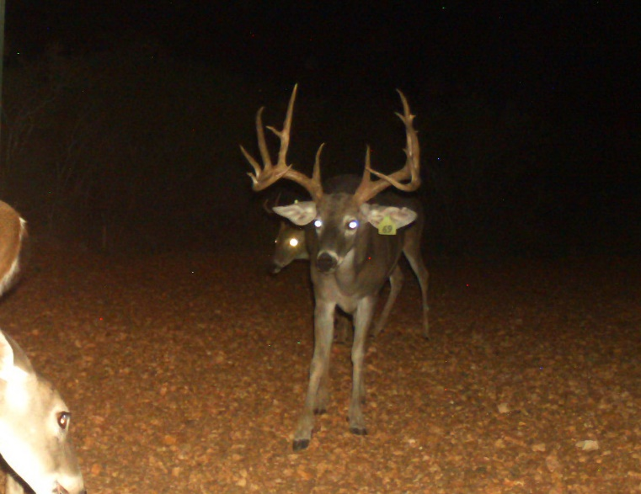
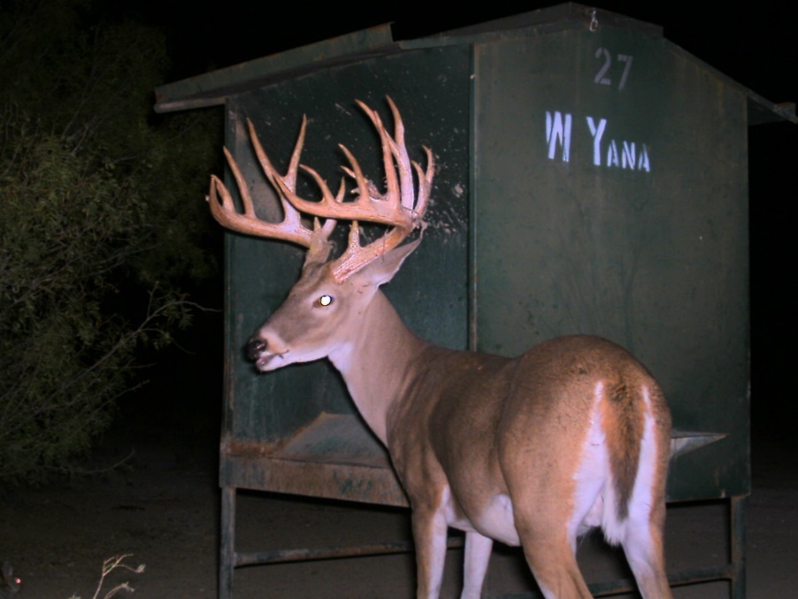
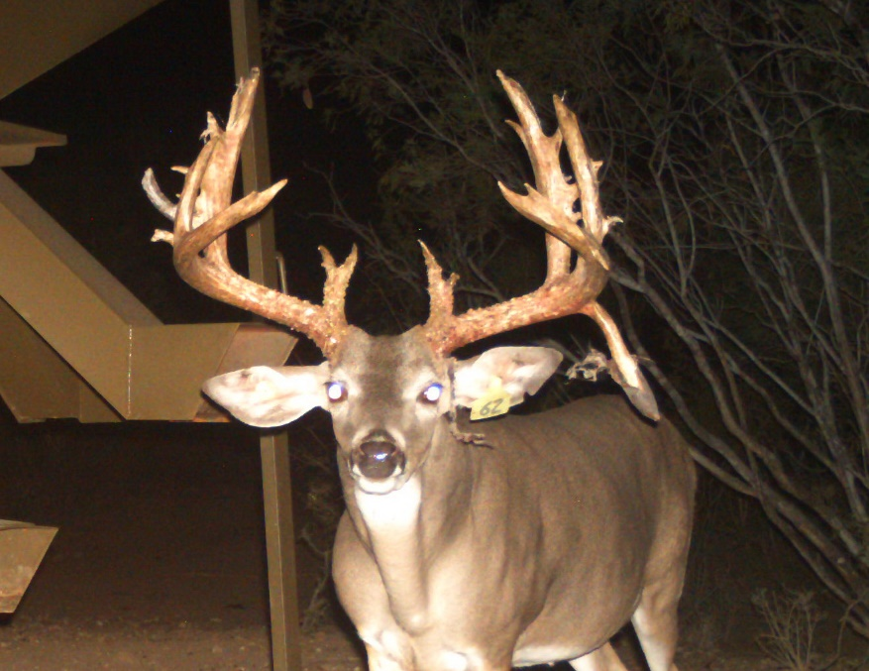
West Yana (DMP)
East Yana (Fed Only)

Slide 25
Is the Cleanout and DMP Worth It?
You will have to decide based on what you are starting with:
East Yana Average B&C = 153.6
West Yana Average B&C = 162.1
But supplemental feeding is the clear game changer:
Unfed average B&C Score = 130
East Yana Average B&C Score = 153.6

Slide 26
End of East-West Yana Project

